Slide 1
Supporting Children with SEND
A brief overview
11th September 2019
60 Pages

Slide 2
Introduction
Part One
The system for supporting pupils with SEND and the outcomes it is achieving
Overview of the current system/processes
Numbers/Data
Needs
Where educated
Outcomes
Part Two
Funding, Spending and financial sustainability
Part Three
Quality of Support
Parent views
Ofsted findings

Slide 3
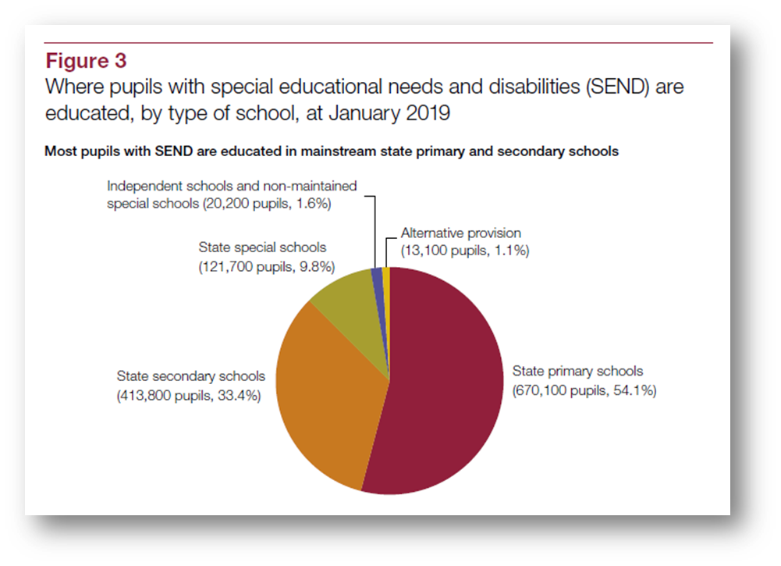
Pupil Outcomes

Slide 4
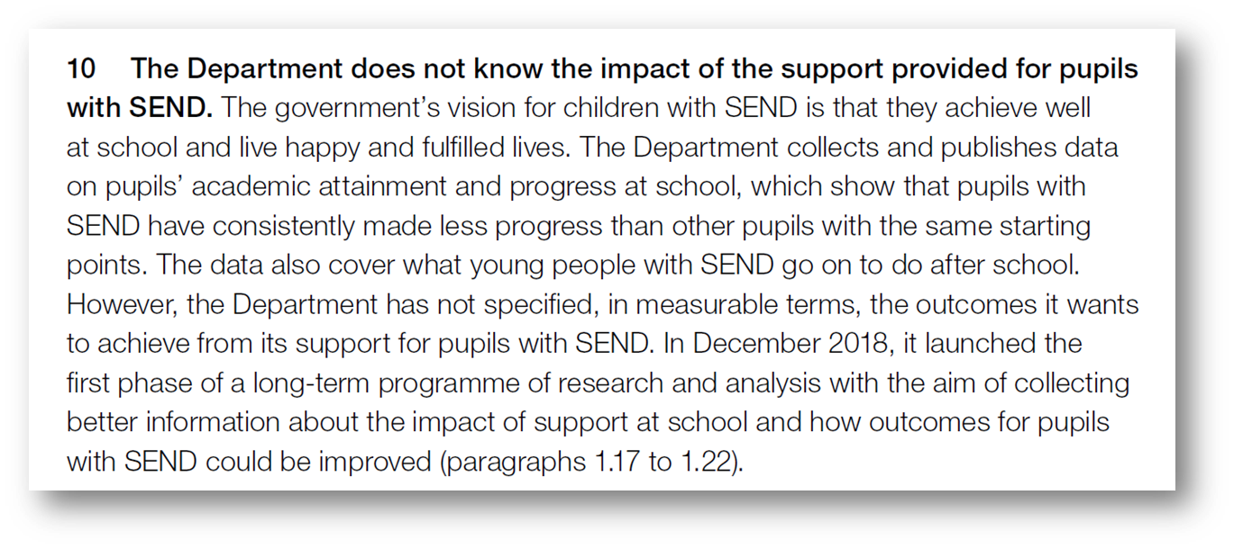

Slide 5
Pupil Outcomes

Slide 6
Funding and Spending

Slide 8
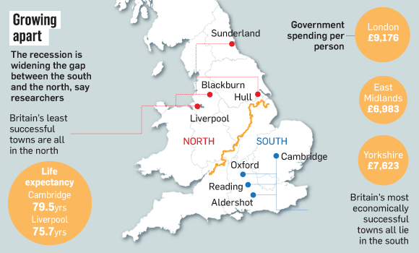
Funding and Spending

Slide 9
Funding and Spending

Slide 10
Quality of Support

Slide 11
Quality of Support

Slide 12
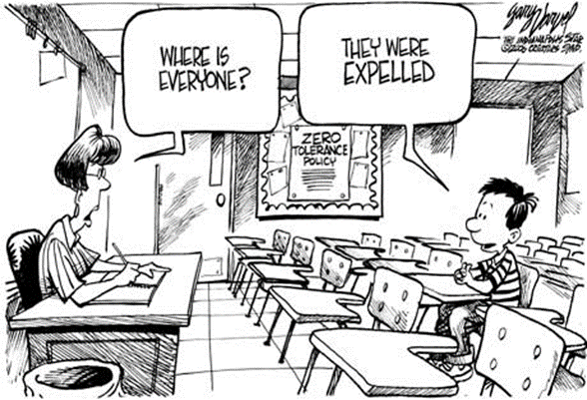
Quality of Support

Slide 13
Quality of Support
Inspection of Local Areas

Slide 14
https://www.nao.org.uk/report/support-for-pupils-with-special-educational-needs-and-disabilities/

