Slide 1
Woodlands Outreach Service

Slide 2
Woodlands Outreach Service Virtual Support and Assessment During School Closure
Solution Focussed Consultation
1 session per pupil
A structured discussion with parents, appropriate school staff and the Specialist Advisory Teacher to explore concerns, needs and generate solutions either by telephone or a virtual meeting as appropriate. Pupil voice can be gained if possible. Please note no individual assessment work is completed with the child.
A concise record of the discussion, summary and next steps is included.
Plan Do Review Consultation
1 session per pupil
Consultation via telephone or virtual meeting with school staff offering advice and guidance on how to support children who are currently in school (vulnerable/child of key workers) who are displaying SEMH/behaviour difficulties which may be due to separation anxieties, displaying adapting to new routines/expectations.
A concise record of the discussion, summary and next steps is included.

Slide 3
Woodlands Outreach Service Virtual Support and Assessment During School Closure
Parent/Carer Support
1 session per pupil
Consultation via telephone call with parent/carers to offer advice and guidance for how to support children at home with their learning, SEMH, Sensory or ASC needs.
A concise record of the discussion, summary and next steps is included.
Screening Assessment
1 session per pupil Screening tools are used with parents, school staff and pupil as appropriate to identify potential needs and areas of difference. Next steps for further assessment and strategies for support identified. These screening assessments can include areas of need such as dyslexia, dyscalculia, ADHD and ASC.
Short report outlining results of the screening and next steps is included.

Slide 4
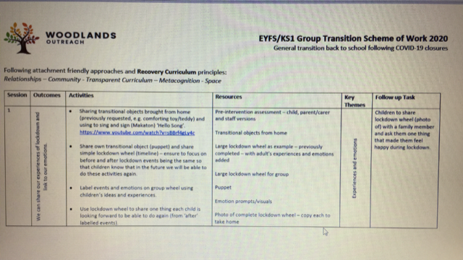
Transition Support Offer

