Slide 1
Supporting Positive Behaviour

Slide 2
Introduction
The number of exclusions are increasing in Shropshire in-line with the national picture

Slide 3
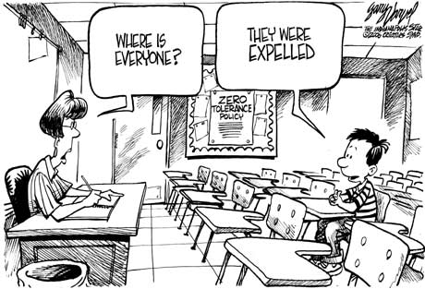
Exclusion Rates in Shropshire
2016/17 Source: ONE |  | No SEN | SEN Support | EHCP | Total
% Pop’n |  | 86.1% | 10.3% | 3.6%
Primary | Permanent | 3 | 4 | 3 | 10
 | Fixed | 68 | 171 | 124 | 363
Secondary | Permanent | 21 | 15 | 2 | 38
 | Fixed | 822 | 473 | 160 | 1455
Total |  | 914 | 663 | 289 | 1866
Percentage |  | 49% | 35.5% | 15.5%
Children with SEN accounted for over 50% of exclusions whilst accounting for less than 14% of the school population.
How effective are we at meeting their additional needs?
Notes:
In school we can equate this to element 1 funding element 2 and element 3
Currently working on developing a matrix that describes what schools should be able to provide form within their resources and what would be considered universal and what is targeted.

Slide 4
Outline of Training
Understanding the behaviour
Developing a ‘toolkit’ of strategies and resources to Positively Manage Behaviour’.
Establishing supportive systems and processes
Introduction to relevant legislation and Guidance
Further Training and Support

Slide 5
Understanding Behaviour
What is challenging Behaviour?
Brainstorm the behaviour you may see in your setting.
Come up with a definition for;
‘Challenging Behaviour’

Slide 6
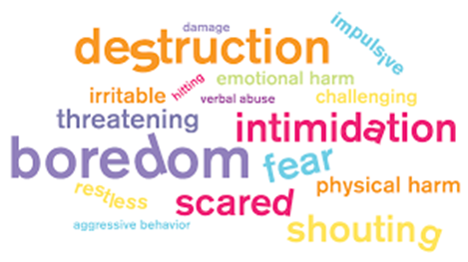
Definition of Behaviour
Understanding Behaviour
Source: Oxford Living Dictionary

Slide 7
Understanding Behaviour

Slide 8
Understanding Behaviour

Slide 9
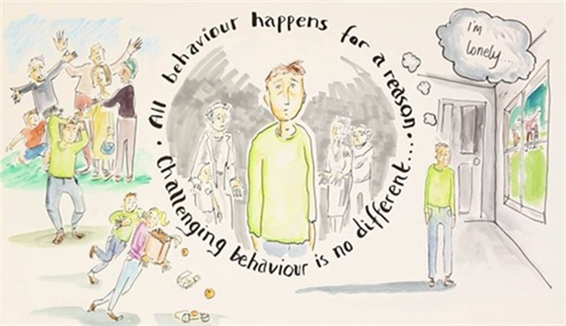
Understanding Behaviour
Understanding where the behaviour comes from may support a more effective response in managing it.
Sometimes we may need to access specialist support.
Early Help, EP, Woodlands, Spectra…

Slide 10
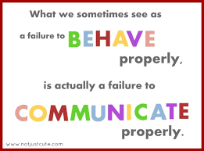
Notes:
In school we can equate this to element 1 funding element 2 and element 3
Currently working on developing a matrix that describes what schools should be able to provide form within their resources and what would be considered universal and what is targeted.

Slide 11
Not a ‘naughty’ child but…
Understanding Behaviour
Anxious
Frustrated
Confused
Nervous
Scared
Uncomfortable

Slide 12
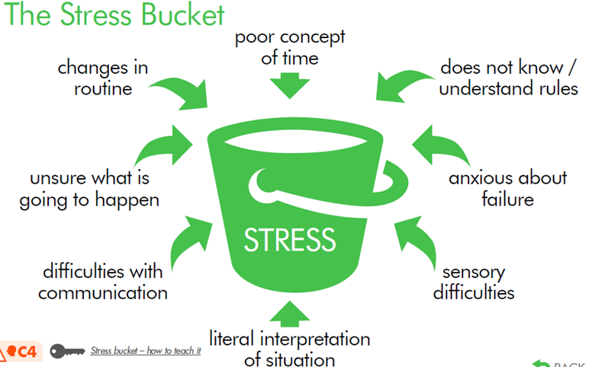
Understanding Behaviour
What happens when the bucket is full?

Slide 13
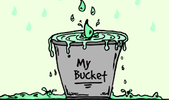
Positively Managing Behaviour
An Integrated Experience
Staff have the ability to escalate or de-escalate a situation
We have choices:
We can add to the ‘bucket’
We can take away from the ‘bucket’
We could cause the ‘bucket’ to overflow.
We must look for signs that the ‘bucket’ is becoming close to overflowing.
What do these ‘signs’ look like?
Adult’s behaviour
Child’s behaviour

Slide 14
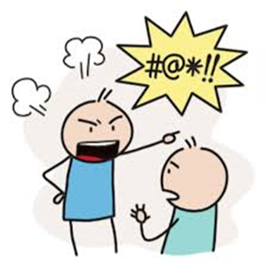
Positively Managing Behaviour
Staff Response
Staff need to remain Calm – take a step back from the situation, both physically and emotionally
Consider;
Your body language, personal space, don’t make prolonged eye contact
Use of language
Use their name to ‘connect’
Use simple language, keep it to a minimum
One person to communicate
Allow take up/processing time
Be positive, say what you DO want, not what you DON’T want
Consider the tone and volume that you use
Talk privately if possible / remove any audience
Allow time and space
Avoid blame, labelling or powerplay
Pick your battles – can you ignore the behaviour

Slide 15
Positively Managing Behaviour
Charlie Taylor’s Behaviour Checklist
Key findings;
The most important thing to improve and manage behaviour is CONSISTENCY
Where there is inconsistency in schools, children are more likely to push the boundaries. If a pupil thinks there is a chance that the school will forget about a detention they are unlikely to turn up. If they get away with it, the threat of detention will be no deterrent in the future.
(Expectations – quiet)
Create a ‘checklist’ to ensure consistency of approach across the school
Praise/acknowledge good behaviour, catch children being good

Slide 16
Positively Managing Behaviour
Scripted Intervention Framework-
Interrupt – “Garry, I’ve noticed…”
Redirect – remind of previous/positive experience
“ You did a great piece of work yesterday…”
“ You were the first to finish…”
“ You got 3 rewards…”
“ Let’s take deep breaths (3,4,5)…”
Reinforce – Expectations
“ Complete question 1 and I’ll come back…”
“ Sit on your chair and listen….”
Thanks for listening
Praise/motivate others

Slide 17
Positively Managing Behaviour
Scripted Intervention Framework-
Fogging
“ I hear what your saying…”
“I can see you’re upset…”
“ I understand that’s how your feeling…”
Walk away, don’t get involved in a powerplay
Return to reinforce

Slide 18
Positively Managing Behaviour
Know your Children
To support staff to be CONSISTENT create a Behaviour Support Plan
To develop a plan it will be necessary to gather information about the child.
This should involve:
Key adults
Teachers
TA (s)
SENCo
Parent
Others
The Child

Slide 19
Positively Managing Behaviour
Know your Children
Information gathering tools:
ABC Charts
Behaviour Logs
Observations
PCA tools
Be creative

Slide 20
Positively Managing Behaviour
Once the plan has been created it should be shared with all staff involved with the child and the parent/carers and, if appropriate, the child.
The plan is a ‘living document’ and will need to be reviewed and updated as things change

Slide 21
Positively Managing Behaviour
Other things to consider
Changing the person supporting the child
Ensure all adults are working together and are empowered to respond
TA/Teacher – who?
Remove the audience
Do nothing
Have a ‘Safe Space/break out room to go to
Differentiate sanctions – consider SEN/Equality Act
3 D’s – Diffusion, Distraction, De-escalation
If SEN, are the outcomes on their PCP related to their social and emotional regulation?
Is external agency involvement necessary?
Are their further training needs, eg. MAPA?

Slide 22
Positively Managing Behaviour
Following an incident
Document the incident
Allow plenty of time to ‘calm’
Consider restorative conversation
What can we learn from the incident and what needs to change to move forward?
Could use social stories or cartoon strips to gather information

Slide 23
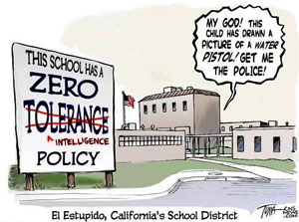
Legislation and Guidance

Slide 24
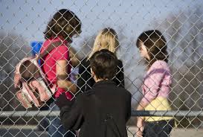
Legislation and Guidance

Slide 25
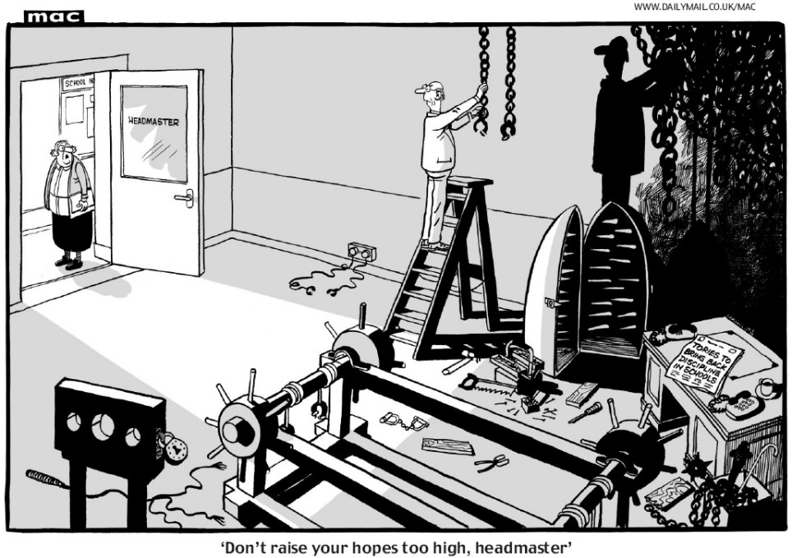
Legislation and Guidance

