Slide 1
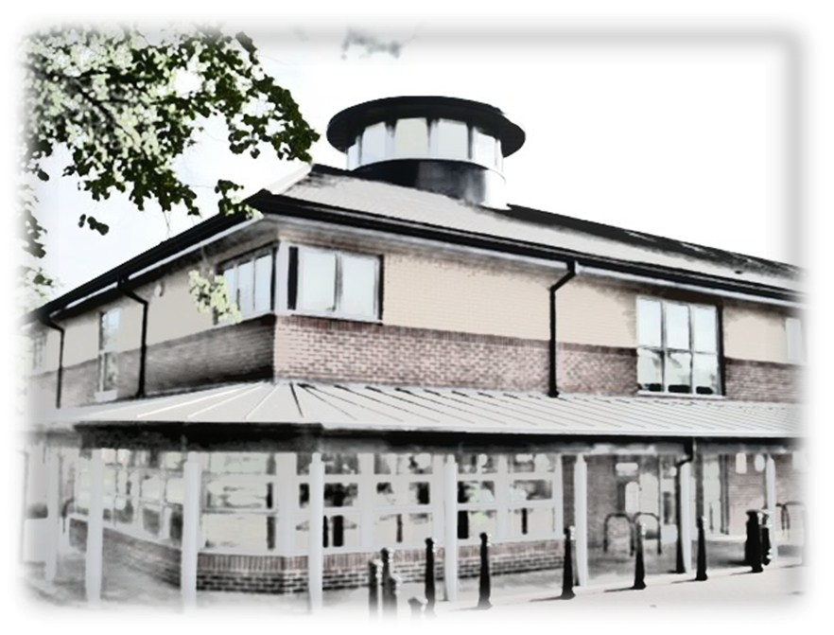
Terms & Conditions
The Lantern
For your Safety:
No smoking is allowed in any part of the building
Please do not block gangways or the exit doors
The event organiser is responsible for the prevention of any activity that may endanger public safety, for example preventing disorderly behaviour, over-crowding, and ensuring that health and safety requirements are observed
There are fire extinguishers throughout the building
If there is a fire, leave the building by the nearest exit door and telephone 999. Please go to the assembly point in the car park
Please ask if you want to use your own electrical equipment as a PAT Certificate is required
Loss and Damage:
Please let us know of any damage to the room or equipment. You may be asked to pay for any repair or replacement costs due to damage or loss caused while the room was hired to you
Noise:
Please do not make excessive noise as this may disturb others in the building or neighbours
When you leave
Please ensure you have all of your belongings
For more information about room hire and building use please ask to see the Lantern User Guide
Meadow Farm Drive
Shrewsbury SY1 4NG
Tel: 01743 250800
Email: thelantern.scf@shropshire.gov.uk
What’s available
Community Library
Equal Access Library
Café
1st Floor meeting rooms
Community Hall

Slide 2
Lantern Room Information
Room Hire Rates – effective 1st April 2021
Community Hall
The community hall is located on the ground floor and has a sprung hard wood floor suitable for dancing. The room can accommodate up to 130 people. It can also be divided into sections (community hall 1 & 2). Community hall 1 can accommodate up to 80 people and community hall 2 can hold 50 people. The room is an empty space but has chairs and tables available on request. There is a small kitchen also available to hire which can be used in conjunction with the full hall or with hire of community hall 2 only
Interview/Meeting Room
A small room is available on the ground for use for one-to-one meetings/ interviews or drop in advice sessions
Ground Floor Meeting Room
The meeting room is located on the ground floor and can hold a maximum of 40 people depending on the room layout required.
Large & Small Meeting Rooms
The meeting rooms are located on the 1st floor and can hold 20 or 12 people respectively. The rooms are set up in boardroom style and also have a hearing loop system
Room | Monday to Friday 8.30am – 6pm | Monday to Friday 6pm – 11pm | Saturday & Sunday 9am – 11pm
Community Hall 1 | Commercial £18.75 per hour | Commercial £35.40 per hour | Commercial £52.00 per hour
Community Hall 1 | Charity/Community £8.90 per hour | Charity/Community £13.30 per hour | Charity/Community £18.75 per hour
Community Hall 2 | Commercial £18.75 per hour | Commercial £35.40 per hour | Commercial £52.00 per hour
Community Hall 2 | Charity/Community £8.90 per hour | Charity/Community £13.30 per hour | Charity/Community £18.75 per hour
Community Hall 1 & 2 | Commercial £31.20 per hour | Commercial £62.50 per hour | Commercial £93.70 per hour
Community Hall 1 & 2 | Charity/Community £15.60 per hour | Charity/Community £23.40 per hour | Charity/Community £31.20 per hour
IT Suite | Commercial £17.70 per hour | Commercial £34.40 per hour | Commercial £51.00 per hour
IT Suite | Charity/Community £8.90 per hour | Charity/Community £12.25 per hour | Charity/Community £17.70 per hour

Slide 3
Room Hire Rates – effective 1st April 2021
Room Hire Rates – effective 1st April 2021
Room | Monday to Friday 8.30am – 6pm | Monday to Friday 6pm – 11pm | Saturday & Sunday 9am – 11pm
Interview/ Meeting Rm | Commercial £15.60 per hour | Commercial £32.00 per hour | Commercial £48.70 per hour
Interview/ Meeting Rm | Charity/Community £8.90 per hour | Charity/Community £9.90 per hour | Charity/Community £15.60 per hour
Ground Floor Meeting Rm | Commercial £16.70 per hour | Commercial £33.30 per hour | Commercial £50.00 per hour
Ground Floor Meeting Rm | Charity/Community £8.90 per hour | Charity/Community £10.90 per hour | Charity/Community £16.70 per hour
Large Meeting Rm | Commercial £16.70 per hour | Commercial £33.30 per hour | Commercial £50.00 per hour
Large Meeting Rm | Charity/Community £8.90 per hour | Charity/Community £10.90 per hour | Charity/Community £16.70 per hour
Small Meeting Rm | Commercial £16.70 per hour | Commercial £33.30 per hour | Commercial £50.00 per hour
Small Meeting Rm | Charity/Community £8.90 per hour | Charity/Community £10.90 per hour | Charity/Community £16.70 per hour
Room |  | Monday to Friday 8.30am – 6pm | Monday to Friday 6pm – 11pm |  | Saturday & Sunday 9am – 11pm
Community Kitchen |  | Commercial £10.40 | Commercial £13.50 |  | Commercial £15.00
Community Kitchen |  | Charity/ Community £5.50 | Charity/Community £6.00 |  | Charity/ Community £6.50
Please note: Community Kitchen charged as a flat rate not per hour {Please note that washing up liquid & tea towels are not provided within kitchen hire}
Equipment Hire Rates
 | Commercial £12.00 + VAT |  |  | Commercial £31.50 + VAT
 | Charity/Community £5.00 + VAT |  |  | Charity/Community £11.50 + VAT
Please note: minimum charge of £8.90 per hour for Charity/Community

