Slide 1
ICS Induction Pack
September 2022

Slide 2
Contents
Item | Page
Welcome | 3 – 4
Introduction to Shropshire, Telford and Wrekin | 5 – 7
ICS Purpose and System Pledges | 8 – 14
Our People Promise | 15 – 16
The Role You Play | 17

Slide 3
Welcome

Slide 4
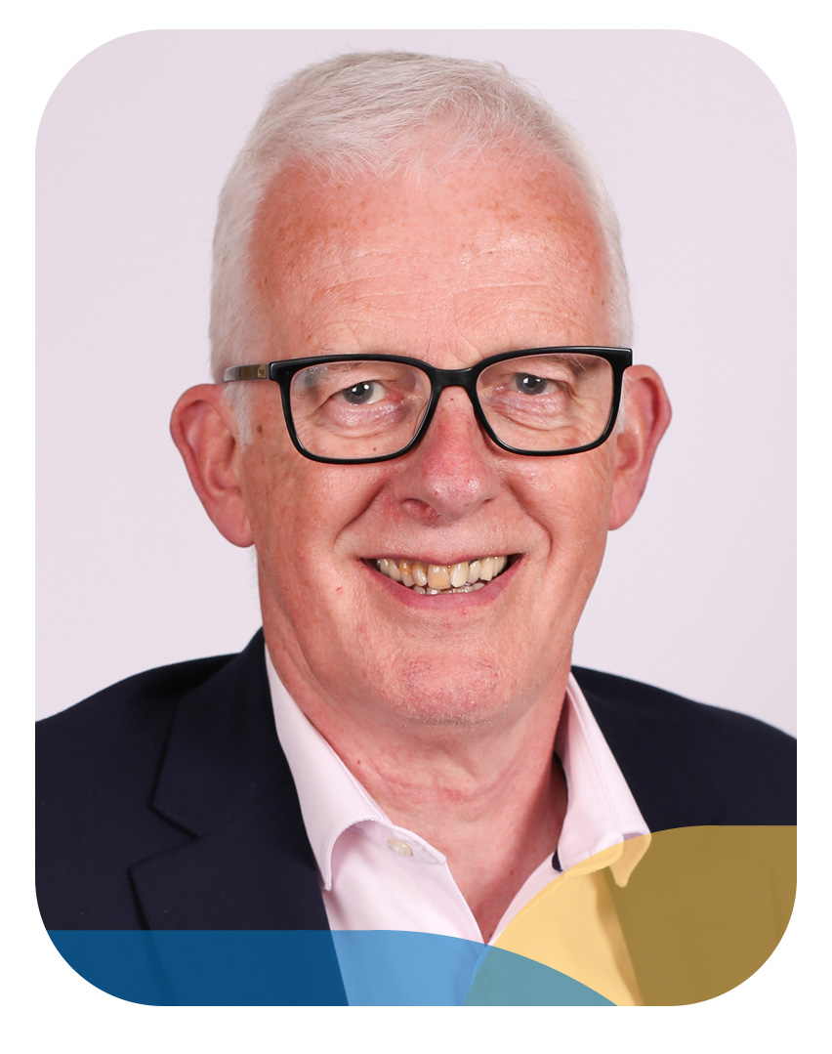
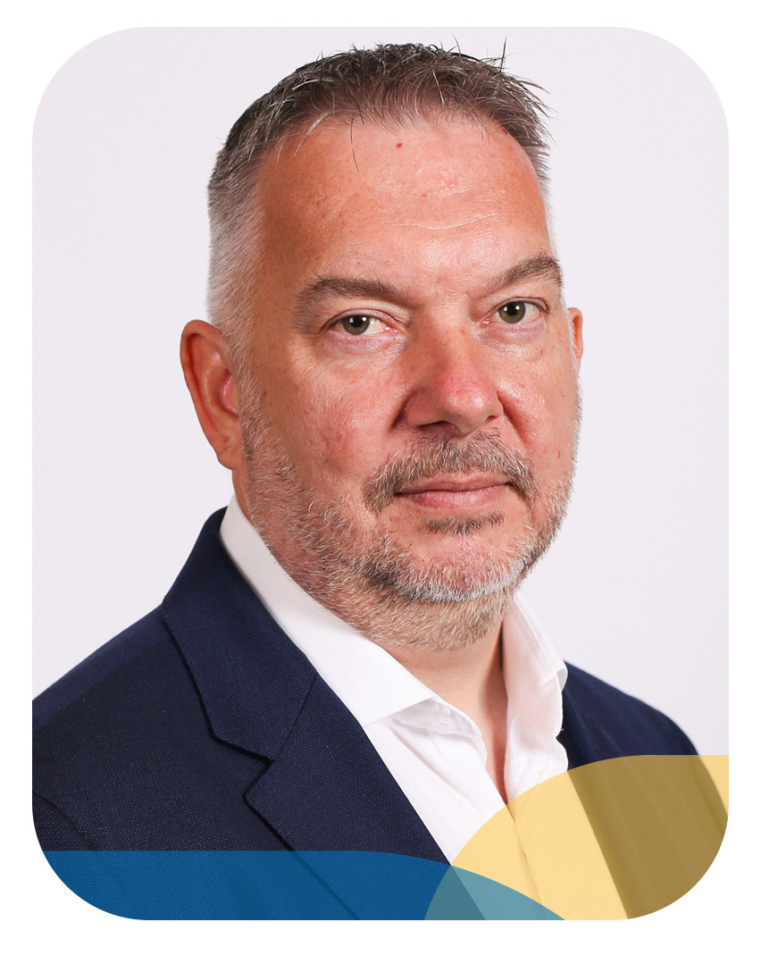
Welcome to Shropshire, Telford and Wrekin ICS
On behalf of the entire ICS, we would like to give you a warm welcome to Shropshire, Telford and Wrekin.
This is the start of a new era for health and care – one in which organisations are coming together in partnership and putting artificial boundaries aside in the interests of everyone who lives in our communities.
As part of our new organisation, you are at the forefront of this change – we hope that you will embrace it. These are exciting times, and we are confident that together we can make a tangible difference for the local people that we serve.
Only 20% of health and wellbeing is driven by clinical care. The rest depends on health behaviours, the environment in which people live and other wider determinants of health. As an ICS we need to tackle the whole agenda as partners. The partners include NHS providers, local government, VCSE, education, and the broader public and private sector. Our focus will be on tackling some of our immediate challenges, but also on the longer term, population health outcomes, health inequalities, and prevention agenda. We will need to build and develop different partnerships and different relationships.
Our vision is for us to work together, with our population, to develop safe and high-quality sustainable health and care services that meet their needs.
We aim to attract and retain the best staff so we can implement and deliver world-class care. We want to support people to live healthy and independent lives, helping them to stay well for as long as possible. Together, as a system, we will create services that work better for our community and for those who provide their care. We are at the forefront of that work – so we should be excited by this challenge.
We want to assure you that the Board, and all of our senior leadership team, are fully committed to involving you in the development of NHS and social care services in Shropshire, Telford and Wrekin; and to supporting every one of you to reach your full potential.
As a group of ICS leaders we are commitment to your health and wellbeing, and in showing our gratitude and appreciation for your hard work and dedication to providing the best quality of care for our local communities.
So, thank you for everything that you will do as we move forward to ensure that everyone across Shropshire, Telford and Wrekin has access to the high-quality health and care services they need and deserve. There is a lot to be done, but we are optimistic and confident about the future that we will build together.
Best wishes
Sir Neil McKay Chair
Simon Whitehouse Chief Executive
4

Slide 5
About NHS Shropshire, Telford and Wrekin
Integrated Care Systems
Integrated Care Systems embody a new way of working which brings together all health and care organisations in our area. Shropshire, Telford and Wrekin is one of the smallest of 42 Integrated Care Systems across England and will be formally established on Friday 1 July 2022. Our Integrated Care System is responsible for looking after and delivering all the health and care services in the area.
Shropshire, Telford and Wrekin Integrated Care System (ICS) footprint covers 1,347 square miles and is home to 500,000 people – a reflection of the region’s semi-rural setting. There is a rich diversity of healthcare provision in our area – presenting a host of opportunities for career progression and many ways to help shape the future of health and social care.
Our providers include two acute hospitals, sited less than 20 miles apart, with services delivered by one acute trust, Shrewsbury and Telford NHS Trust (SaTH). In the north west of the county, patients can access a specialist orthopaedic hospital, Robert Jones and Agnes Hunt Orthopaedic Hospital NHS Foundation Trust (RJAH), which provides elective orthopaedic surgery. Other provision available here includes Shropshire Community Health Trust (ShropCom), which aims to be the best local provider of high quality, innovative health services near people’s homes. A mental health service is also provided by the Midlands Partnership Foundation Trust (MPFT), and our region is served by the West Midlands Ambulance Service University NHS Foundation Trust (WMAS).
Health and care organisations across the area will be better supported by each other working collaboratively to improve efficiency and reduce duplication - thereby supporting higher quality, more sustainable services. Decisions will be taken closer to the communities they affect, supporting better outcomes, and there will be better use of community assets and greater focus on prevention and wellbeing.

Slide 6
About NHS Shropshire, Telford and Wrekin
Shropshire, Telford and Wrekin Integrated Care Partnership (ICP)
Our health is affected by many things – housing, unemployment, financial stress, domestic abuse, poverty, and lifestyle choices. This can only truly be addressed via a partnership between the NHS, local government, and the voluntary sector.
Shropshire, Telford and Wrekin Health and Care Partnership will operate as a statutory committee consisting of health and care partners from across the region, including voluntary, community, faith and social enterprise (VCSE) organisations and independent healthcare providers. It provides a forum for NHS leaders and local authorities to come together, as equal partners, alongside key stakeholders from Shropshire, Telford and Wrekin.
A key role of the partnership is to assess health, public health and social care needs and to produce a strategy to address them – thereby helping to improve people’s health, care outcomes and experiences.

Slide 7
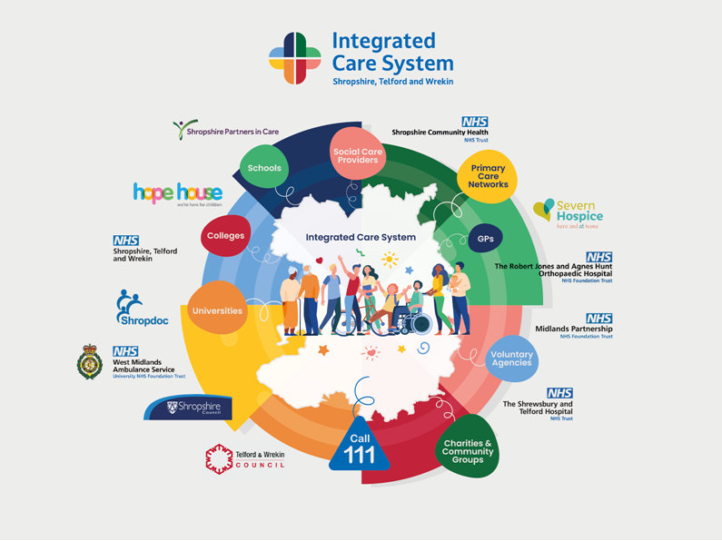
Working Together in Partnership
More than 22,000 members of staff are employed across health and social care
50,000 unpaid carers supporting our local population
3,800 voluntary and community organisations
Over 280 social care providers
51 GP Practices
Three hospitals
Two Local Authorities
One Community Health Trust
One Mental Health Trust

Slide 8
Purpose &
System Pledges

Slide 9
As we start on our journey together…
Our Purpose and Aim
Principles of an ICS
Integrated Care Systems (ICSs) are partnerships of health and care organisations that come together to plan and deliver joined-up services and to improve the health of people who live and work in our area.
ICS’s exist to achieve four aims:
1
Improve outcomes in population health and healthcare
2
Tackle inequalities in outcomes, experience and access
3
Enhance productivity and value for money
4
Help the NHS support broader social and economic development
5

Slide 10
System Pledges
To guide our work and to enable us to be held to account by our staff, the public and politicians, we have committed to delivering 10 key pledges which have been co-produced by system partners.
1
Improving safety and quality
We will make sure our services are clinically safe throughout the system, delivering the System Improvement Plan and tackling the backlog of elective procedures as a system.
Integrating services at place and neighbourhood level
We will develop local health and care hubs to improve not just the physical but mental health of people, build on the principles of one public estate and the assets of communities, better manage the volume of hospital admissions and establish new models of care to best serve all our communities.
2
3
Tackling the problems of ill health, health inequalities and access to health care
We will agree measurable outcomes for accelerated Smoking Cessation, improving respiratory health, and reducing the incidence of type 2 diabetes and obesity. We will have a strategy for the implementation of segmented population health management (PHM) approach by April 2021 and undertake a post COVID-19 review of access to all services by September 2021.
4
Delivering improvements in mental health and learning disability / autism provision
We will, through our transformation programmes and working through whole system approaches, deliver improvements in quality of life for people with learning disabilities by March 2022, and meet the national milestones for mental health transformation by 2023/24.
Economic regeneration
We will harness the potential of the health and care system together with wider public services to contribute to innovation, productivity and good quality work opportunities. In turn this will create economic prospects that will help improve the health and wellbeing of our population.
5

Slide 11
System Pledges
To guide our work and to enable us to be held to account by our staff, the public and politicians, we have committed to delivering 10 key pledges which have been co-produced by system partners.
6
Climate change
We will create economic prospects that will help improve the health and wellbeing of our population.
7
Leadership & governance
We will review and revise our ICS Governance arrangements with an emphasis on place, neighbourhood and provider collaborative arrangement.
8
Enhanced engagement and accountability
We will increase our engagement, involvement and communication with stakeholders, politicians and the public
9
Creating system sustainability
We will produce a sustainable ICS Financial Recovery plan alongside a System People Plan committing to recruiting and retaining the best people in a supportive working environment.
10
Workforce
We will make our system a great place to work by creating environments where people choose to work and thrive and by building system leadership and a flexible co-operative workforce.

Slide 12
Our Long Term Plan
Our local long term Plan is Shropshire, Telford & Wrekin ICS’s localised approach to the publication of the national NHS Long Term Plan launched in 2019. It is clinically led, locally owned and financially sustainable.
Our Shropshire, Telford & Wrekin Long Term Plan brings together the aspirations of all eight partner organisations which include two local authorities, NHS commissioners and providers into one joined up approach to health and care for the next five years. It aims to allow us to deliver the vision for innovative, safe and high quality services, to support people in their own communities, drive forward efficiency and deliver environmentally friendly services that make the best use of our resources.
The plan sets out what local health and care organisations plan to deliver over the next five years. It includes a description of local need and a summary of our local population; what service changes will be taken forward and how; the development of our local workforce, digital innovations and aspirations and the plan for how we will restructure across the county. Importantly it sets out how we will achieve this against a backdrop of a tough financial climate and how we have and will continue to work alongside local people, including seldom heard groups, staff, the two Healthwatch organisations, the voluntary and community sector and local politicians in defining how our services need to be reshaped over the coming years.
The Shropshire, Telford & Wrekin Long Term Plan will be submitted to NHS England at the end of 2019 in line with all other Sustainability and Transformation Partnerships.

Slide 13
System Pledges
Equality, Diversity and Inclusion
We talk about equality, diversity and inclusion sitting at our core – but what does that mean in practice?
For the Shropshire, Telford and Wrekin Integrated Care System (ICS) it means an ongoing commitment to look inwards and recognise that each of us has a role in addressing inequalities and structural racism. It also means working to help eradicate inequality and discrimination in the communities that we serve.
We want to shape workplaces and deliver services that support people of all backgrounds and cultures to feel included, welcomed and valued. We believe strongly that all forms of racism and discrimination are unacceptable and will not tolerate them.
Our stance is proactive. It is no longer enough for us to simply stand up and condemn racism - we must be actively anti-racist.
The power of our ICS comes from our ability to influence beyond health and social care. We can also influence the socio-economic factors that are so important in tackling inequalities, such as access to employment, education and housing.

Slide 14
System Pledges
Equality, Diversity and Inclusivity pledges
These pledges include:
Ensuring diverse representation on key groups, boards and in decision-making processes
Encouraging staff to positively challenge when they see a lack of diversity and call out inappropriate behaviour or discrimination
Actively engaging with ethnic minority communities in our work, ensuring we include people from marginalised and seldom-heard groups.
This journey towards exemplar equality, diversity and inclusion will be underpinned by learning. Our pledges incorporate a mission to share best and unsuccessful practices relating to equality, diversity and inclusion initiatives. We will support all organisations to evolve and enhance their diversity strategies and encourage them to share their successes and challenges with others.
As a team, we have the opportunity to work collectively to meet the needs of ethnic minority staff and communities, nurturing a supportive culture that everybody can embrace and be a part of.

Slide 15
Our People Promise & The Part You Play

Slide 16
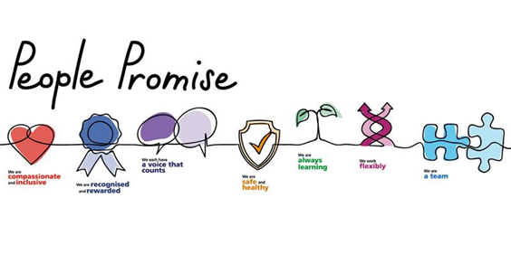
Our People Promise
These pledges include:
We are compassionate and inclusive
We are recognised and rewarded
We each have a voice that counts
We are safe and healthy
We are always learning
We work flexibly
We are a team
Focusing on how we must all continue to look after each other and foster a culture of inclusion and belonging, as well as action to grow our workforce, train our people, and work together differently to deliver patient care.

Slide 17
The Part You Play
We are all leaders, and our words, actions and behaviours have a huge impact on how we and those around us feel at work. We can be our best as leaders through:
The Heart, Head and Hands of leadership:
the things we must consciously think about
the things we and others feel
the things we should do
We should lead with compassion, curiosity and collaboration
We are Compassionate; we are inclusive, promote equality and diversity and challenge discrimination. We are kind and treat people with compassion, courtesy and respect.
We are Collaborative; we collaborate, forming effective partnerships to achieve our common goals. We celebrate success and support our people to be the best they can be.
We are Curious; we aim for the highest standards and seek to continuously improve harnessing our ingenuity. We can be trusted to do what we promise.

Slide 18
Thank you

