Slide 1

Joint Strategic Needs
Assessment (JSNA):
Place-based approach
Stakeholder Event – Shrewsbury South and Shrewsbury West & Central
Notes:
Intro my role

Slide 2


Overview
What is a JSNA
Why and what is a needs assessment?
Initial work to date
Next Steps
Notes:
There are 18 place-based areas through Shropshire, the assets and needs are different in each area and the JSNA process is a way to dig deeper into these needs.
Looking at health data as well as what is on the ground – what agencies say about an area and what people say about area are very different.
We have been working with the Highley area and are formulating an action plan to work with key areas that have arisen i.e. access to services - the Highley GP gave notice on the contract for the current surgery and that has opened an opportunity to work with the PCN to relocate the surgery.

Slide 3
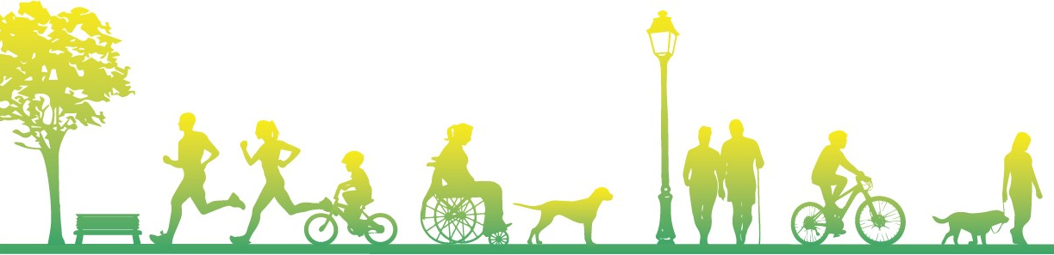
What is a Joint Strategic Needs Assessment?
Local Authorities and CCGs (now ICS) have a legal Statutory Duty to undertake a Joint Strategic Needs Assessment (JSNA), through the health and wellbeing board.
​​
The JSNA seeks to identify current and future health and wellbeing needs in the local population and identify strategic priorities to inform commissioning of services based on those needs. ​
These priorities in turn inform the Health and Wellbeing Strategy and Integrated Care Strategy, key documents as a basis for commissioning health and social care services in the local area. We also believe they should support local partners/communities' priorities.​​
In Shropshire, our JSNA takes three types:​
Web based profiling Tool​
Thematic Needs Assessments - e.g., pharmacy, drug and alcohol and children​
Place Based Needs Assessments

Slide 4
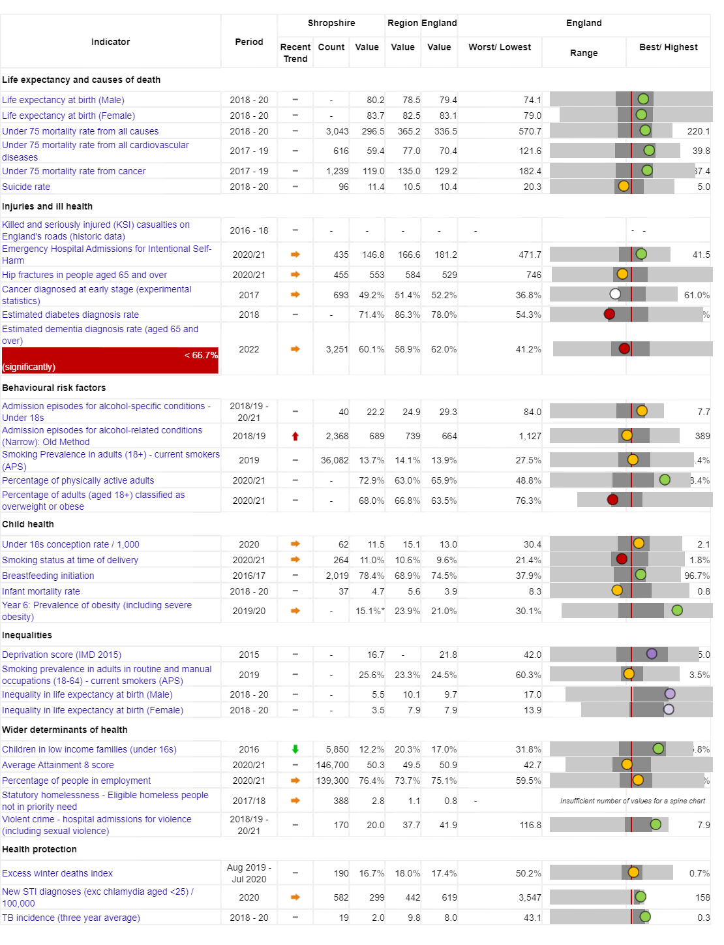

Vision:
For Shropshire people to be the healthiest and most fulfilled in England
Reducing inequalities
Improving Population Health
Working with and building strong and vibrant communities
Joined up working

Slide 5
People in Shropshire are living longer, but not necessarily healthier lives…
Measure | England | Shropshire | Range (Ward) | Range (Ward)
IMD Score | 21.7 | 17.2 | 3.7 (Copthorne) | 37.6 (Harlescott)
Life expectancy at birth, (Male) | 79.7 | 80.5 | 75.3 (Sundorne) | 85.8 (Copthorne)
Life expectancy at birth, (Female) | 83.2 | 83.6 | 79.5 (Sundorne) | 89.6 (Clun)
Deaths all causes, all ages, SMR | 100 | 96.7 | 65.4 (Copthorne) | 145 (Worfield)
Deaths all causes, under 75, SMR | 100 | 89.7 | 55.2 (Clun) | 149 (Sundorne)
Preventable deaths, under 75, SMR | 100 | 85.7 | 48.2 (Corvedale) | 160.6 (Sundorne)
Indicator | Shropshire | England
Healthy Life Expectancy (HLE) Males | 62.8 | 63.1
Inequality in HLE Males | 5.5 | 9.7
HLE Females | 67.1 | 63.9
Inequality in HLE Females | 3.5 | 7.9
Ward | Sundorne | Copthorne
Male Life Expectancy | 75.3 years | 85.8 years
Female Life Expectancy | 79.6 years | 87.7 years

Slide 6
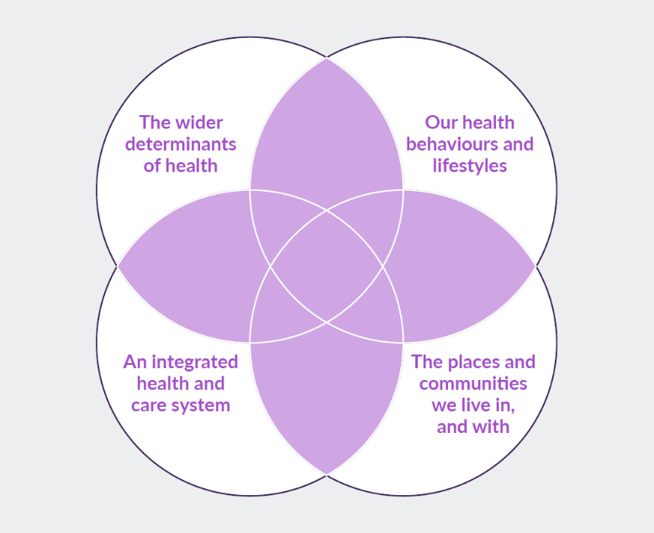
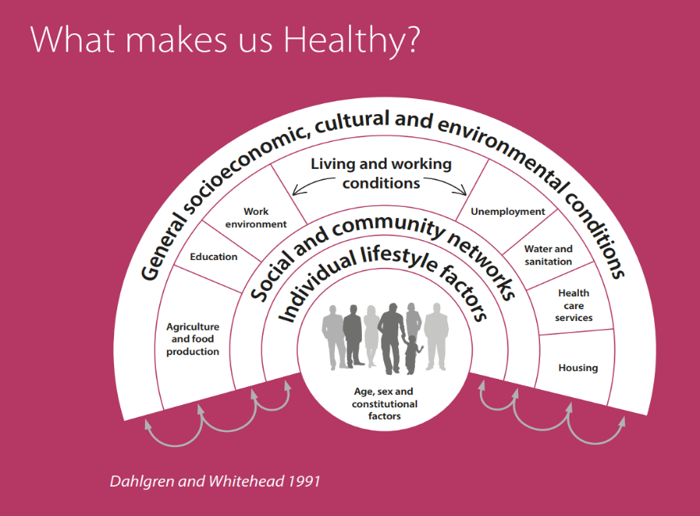
What makes us healthy?
Understanding and Addressing Inequalities
– taking a preventative approach
Health Protection
Understanding our Population Health/Population Health Management (Insight/JSNA)

Slide 7
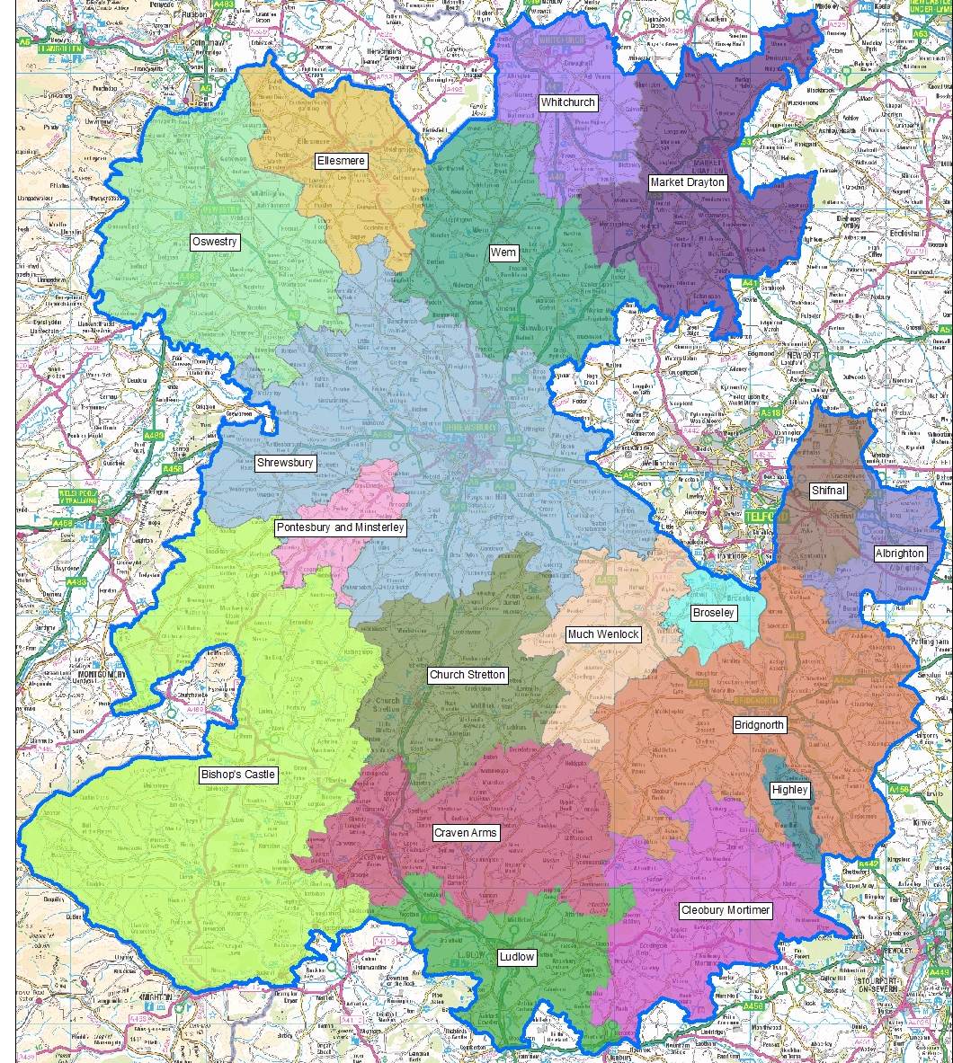
JSNA Place Based Geographies
JSNA’s for Shropshire and Place Plan Areas (PPA)
18 PPA focused mainly on a market town and its surrounding rural communities.
PPA’s are based along geographical/communities' boundaries not political ones.
Capture the uniqueness of the areas in Shropshire.
Identify meaningful local differences and areas of need.

Slide 8
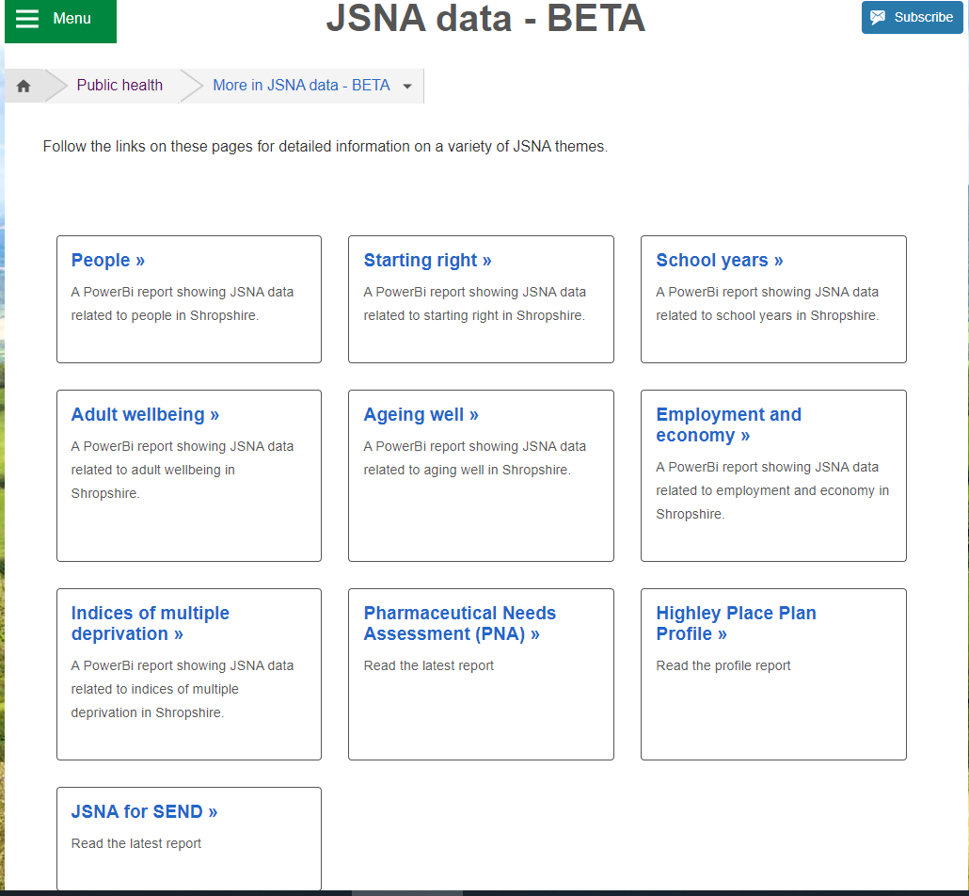
JSNA Web Based Profiler Tool
https://www.shropshire.gov.uk/public-health/jsna-data-beta/
The web-based JSNA is an interactive tool that allows users to explore data relating to health need in Shropshire.

Slide 9
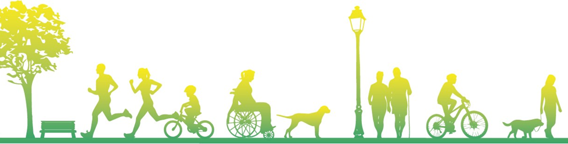
Community Engagement
Stakeholder and Resident engagement via:
  Questionnaires to residents
  Interviews
  Focus Groups
  Attending key meetings/groups

Slide 10

Shrewsbury Place Plan
Examples of Key Health and Wellbeing Data
Notes:
Intro my role

Slide 11
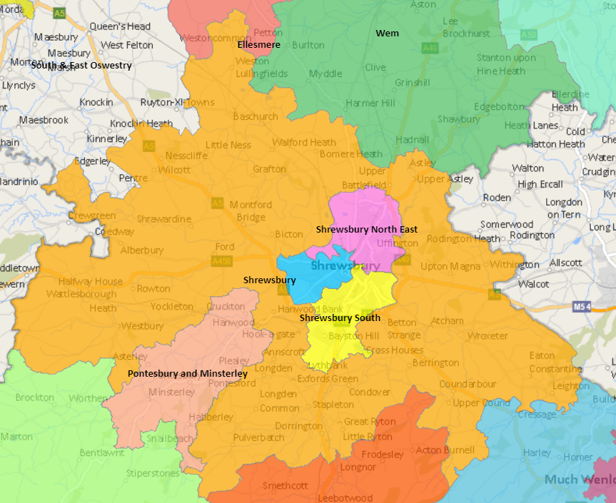

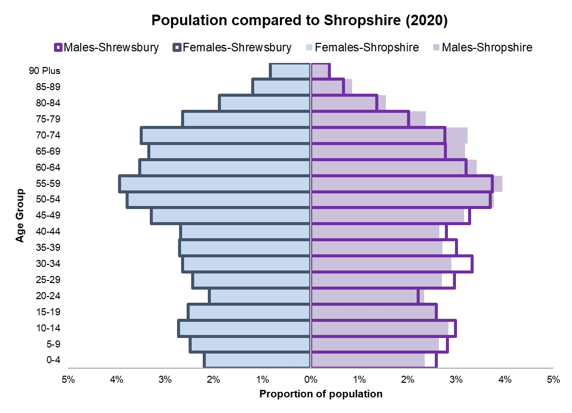
Shrewsbury Place Plan Area
Interactive map here: https://shropshire.maps.arcgis.com/apps/webappviewer/index.html?id=fa75f921e771451382533a854cce6a1e
103,524
Population estimate
(all ages)
49% 51%
Male Female
Notes:
Intro my role

Slide 12
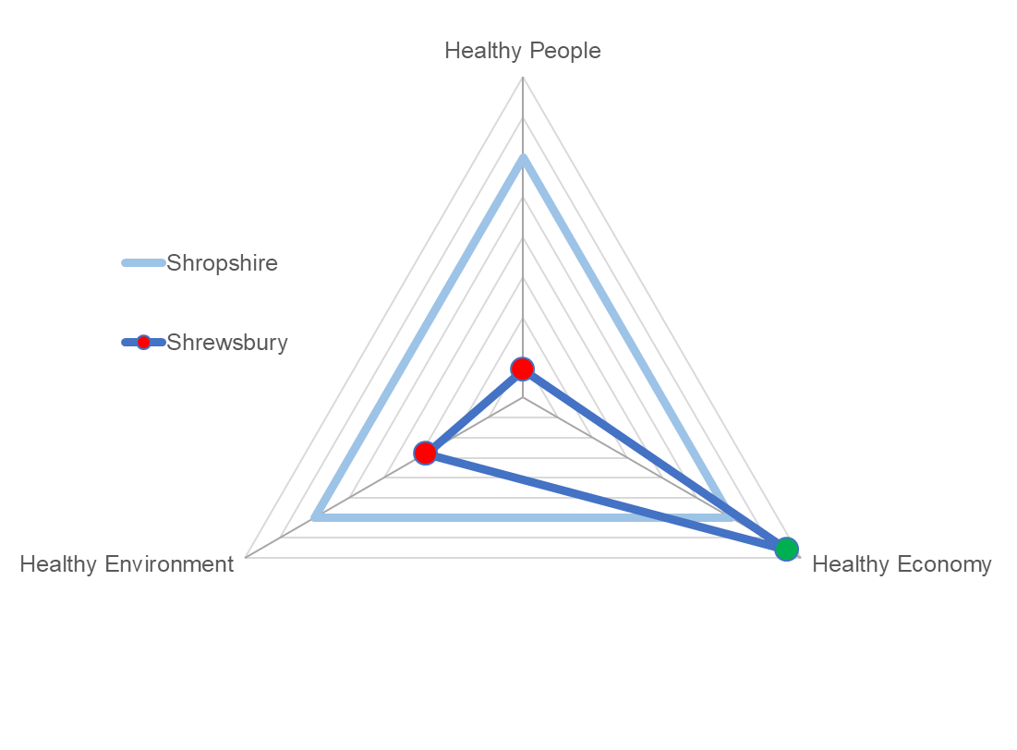

Shrewsbury Health & Wellbeing Index: Overview
Healthy People
Compared to Shropshire average:
Better:
Healthy economy
Worse:
Healthy People
Healthy Environment
Healthy Environment
Healthy Economy

Slide 13
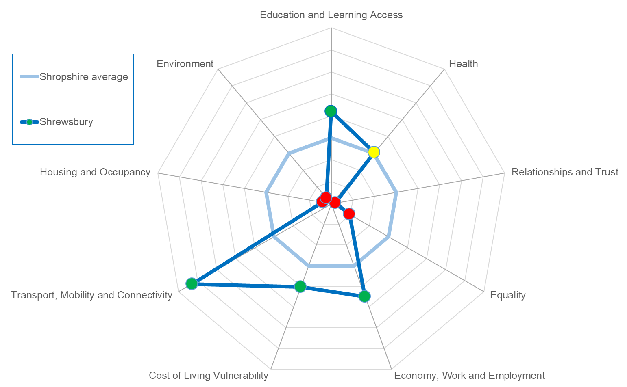
Shrewsbury Health & Wellbeing Index: Sub-themes
Identifies where Shrewsbury is stronger or weaker for the specific themes.
Stronger:
Education and learning access
Economy, Work and Employment
Cost of living vulnerability
Transport, Mobility and Connectivity
Weaker:
Housing and occupancy
Environment
Relationships and trust
Equality

Slide 14
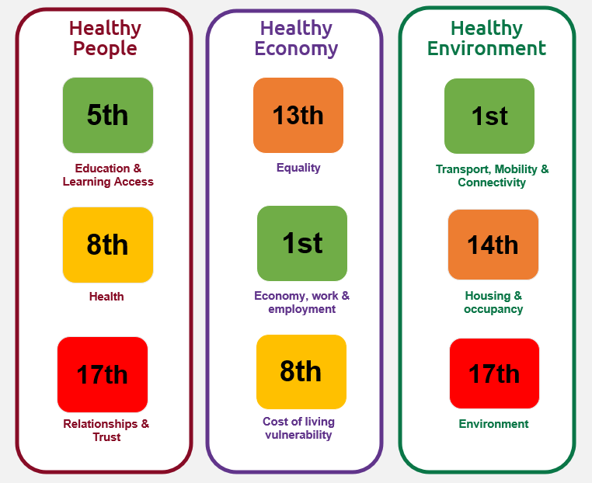
How does Shrewsbury overall compare to other areas?
Healthy People
Healthy Economy
Healthy Environment
Strengths
Education and Learning Access e.g. Average journey time to Further Education
Economy, Work and Employment e.g. Median Income
Transport, Mobility and Connectivity e.g. Local Geographical barriers
Challenges
Relationships and Trust e.g. Crime Rate
Housing and Occupancy e.g. Affordability
Environment e.g. Index of Multiple Deprivation, Outdoors Subdomain

Slide 15
Disease Prevalence
There are differences in disease prevalence within the Shrewsbury area:
Disease or condition | Shrewsbury North East | Shrewsbury Rural | Shrewsbury South | Shrewsbury West and Central | Shrewsbury Place Plan Area | NHS Shropshire, Telford and Wrekin CCG
Atrial Fibrillation Prevalence | 2.2% | 2.9% | 2.7% | 2.6% | 2.6% | 2.5%
Asthma Prevalence (6+) | 7.7% | 7.6% | 7.9% | 7.5% | 7.7% | 7.1%
CHD Prevalence | 3.1% | 3.6% | 3.5% | 3.4% | 3.4% | 3.5%
COPD Prevalence | 1.8% | 1.6% | 1.6% | 1.6% | 1.7% | 2.0%
Dementia Prevalence | 0.9% | 0.9% | 1.1% | 1.0% | 1.0% | 0.9%
Depression Prevalence (18+) | 15.3% | 13.8% | 14.1% | 13.0% | 14.2% | 14.5%
Heart Failure Prevalence | 0.7% | 0.9% | 0.9% | 0.8% | 0.8% | 0.9%
Hypertension Prevalence | 14.2% | 16.8% | 15.0% | 14.6% | 15.0% | 15.6%
Learning disabilities Prevalence | 0.5% | 0.6% | 0.7% | 0.5% | 0.6% | 0.5%
Mental health Prevalence | 1.0% | 0.7% | 1.0% | 1.0% | 0.9% | 0.8%
Obesity Prevalence (18+) | 6.8% | 6.6% | 7.4% | 6.6% | 6.9% | 7.3%
Peripheral arterial disease Prevalence | 0.9% | 0.7% | 0.8% | 0.8% | 0.8% | 0.8%
Stroke and transient ischaemic attack Prevalence | 2.2% | 2.5% | 2.5% | 2.4% | 2.4% | 2.4%
Quality & Outcomes Framework (QOF) Indicators 2020/21

Slide 16



Smoking at time of delivery
Source: SATH Maternity Dataset for 2017/18, 2018/19, 2019/20, 2020/21 and 2021/22
Shrewsbury had 4,213 deliveries between 2017/18 and 2021/22, which is the highest of all place plan areas.
1 in 10 mothers were smoking at delivery for Shrewsbury, statistically similar to Shropshire’s (10.7%)
Shrewsbury West and Central had a statistically lower rate than Shropshire overall at 6.1%% overall.
Smoking at Delivery data for Shropshire and Shrewsbury Place Plan Area, 2017/18 to 2021/22
Area name | Number of deliveries | Percentage of mothers who were known to be smoking at time of delivery | Statistical comparison against Shropshire
Shrewsbury Place Plan Overall | 4,213 | 10.0% | Similar
Shrewsbury North East | 1,739 | 14.3% | Higher
Shrewsbury Rural | 713 | 8.0% | Similar
Shrewsbury South | 923 | 7.0% | Lower
Shrewsbury West and Central | 838 | 6.1% | Lower
Shropshire | 9,626 | 10.7% | -

Slide 17
Wider determinants of health
There are differences between wards within the Shrewsbury area across a number of wider determinants, Ranking : 1 = worst, 63 = best)
Ward | In Place Plan Area | Unemployment | Child Poverty 2019 | Income deprivation 2019 | IMD Score, 2019 | Long term unemployment | General fertility rate: live births per 1,000 women aged 15-44 years | Low birth weight of live babies | A&E attendances in under 5 years old | Emergency admissions in under 5s | Emergency hospital admissions for injuries in under 15 years old
Harlescott | Shrewsbury | 1 | 1 | 1 | 1 | 8 | 2 | 17 | 9 | 13 | 1
Castlefields and Ditherington | Shrewsbury | 1 | 2 | 4 | 4 | 4 | 4 | 24 | 20 | 27 | 5
Monkmoor | Shrewsbury | 12 | 4 | 2 | 2 | 3 | 21 | 2 | 10 | 3 | 39
Sundorne | Shrewsbury | 3 | 6 | 6 | 5 | 7 | 5 | 31 | 16 | 11 | 11
Underdale | Shrewsbury | 11 | 5 | 5 | 20 | 11 | 11 | 35 | 17 | 18 | 43
Bowbrook | Shrewsbury | 20 | 28 | 25 | 31 | 33 | 13 | 33 | 13 | 1 | 30
Meole | Shrewsbury | 20 | 15 | 17 | 48 | 25 | 14 | 18 | 28 | 17 | 53
Battlefield | Shrewsbury | 34 | 26 | 33 | 50 | 33 | 3 | 42 | 8 | 2 | 25
Quarry and Coton Hill | Shrewsbury | 8 | 18 | 24 | 22 | 18 | 59 | 7 | 52 | 54 | 21
Bayston Hill, Column and Sutton | Shrewsbury | 41 | 45 | 37 | 56 | 32 | 22 | 47 | 23 | 4 | 3
Belle Vue | Shrewsbury | 39 | 31 | 30 | 52 | 52 | 54 | 20 | 47 | 42 | 7
Bagley | Shrewsbury | 34 | 55 | 60 | 59 | 37 | 26 | 63 | 15 | 21 | 13
Abbey | Shrewsbury | 37 | 58 | 54 | 54 | 10 | 48 | 46 | 40 | 29 | 16
Tern | Shrewsbury | 51 | 44 | 52 | 41 | 55 | 55 | 43 | 41 | 5 | 10
Radbrook | Shrewsbury | 47 | 59 | 56 | 62 | 33 | 30 | 47 | 33 | 35 | 24
Copthorne | Shrewsbury | 62 | 62 | 63 | 63 | 55 | 18 | 39 | 30 | 14 | 55
Porthill | Shrewsbury | 47 | 63 | 58 | 58 | 54 | 62 | 35 | 18 | 34 | 45

Slide 18
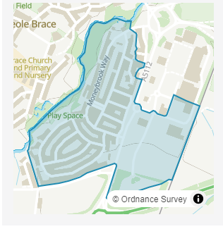
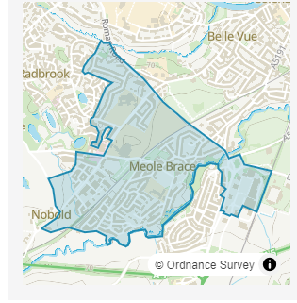
Wider determinants of health
There are variations even between Wards – best illustrated by the Meole Brace Ward
Indicator | Meole Estate | Meole Village & West
Population | 1,600 | 2,800
1 person household | 31.5% | 24.5%
2 person household | 25.7% | 40.6%
Household is not deprived in any dimension | 29.8% | 62.5%
Household is deprived in one dimension | 39.1% | 29.7%
Household is deprived in two dimensions | 22.3% | 6.8%
Disability under the equality act | 23.7% | 14.4%
Works mainly from home | 11.3% | 33.7%
Economically inactive | 35.2% | 41.8%
Meole Estate
Meole Village & West

Slide 19
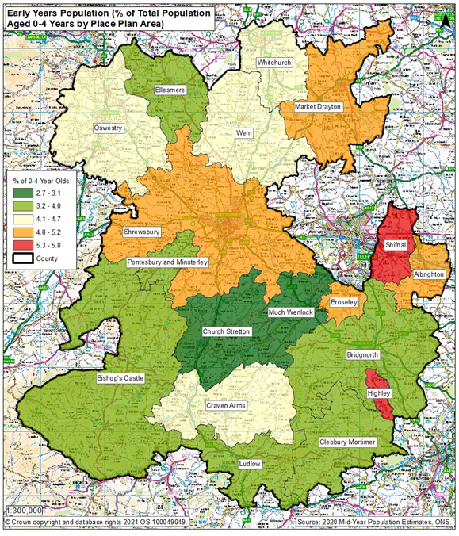
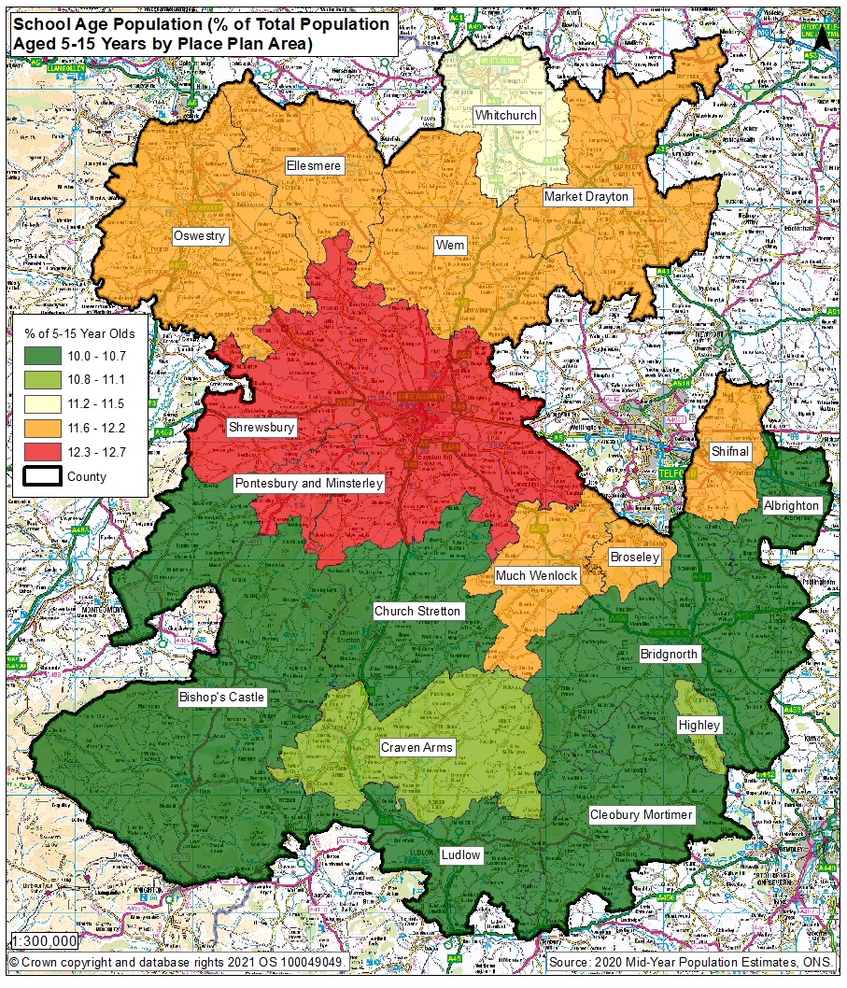
Early Years and School Age Population

Slide 20
Community Engagement Survey Results
580 surveys completed during the consultation period
The results of this survey DO NOT feed into the data metrics shown before, rather they are an ADDITIONAL source of information
The postcode provided allows us to breakdown the respondent’s home into the smaller Shrewsbury areas:
Wider Place Plan Area | Number of Surveys
Shrewsbury North East | 168
Shrewsbury Rural Area | 62
Shrewsbury South | 150
Shrewsbury West and Central | 135
Postcode blank / unrecognised / out of Shrewsbury place plan area | 65

Slide 21
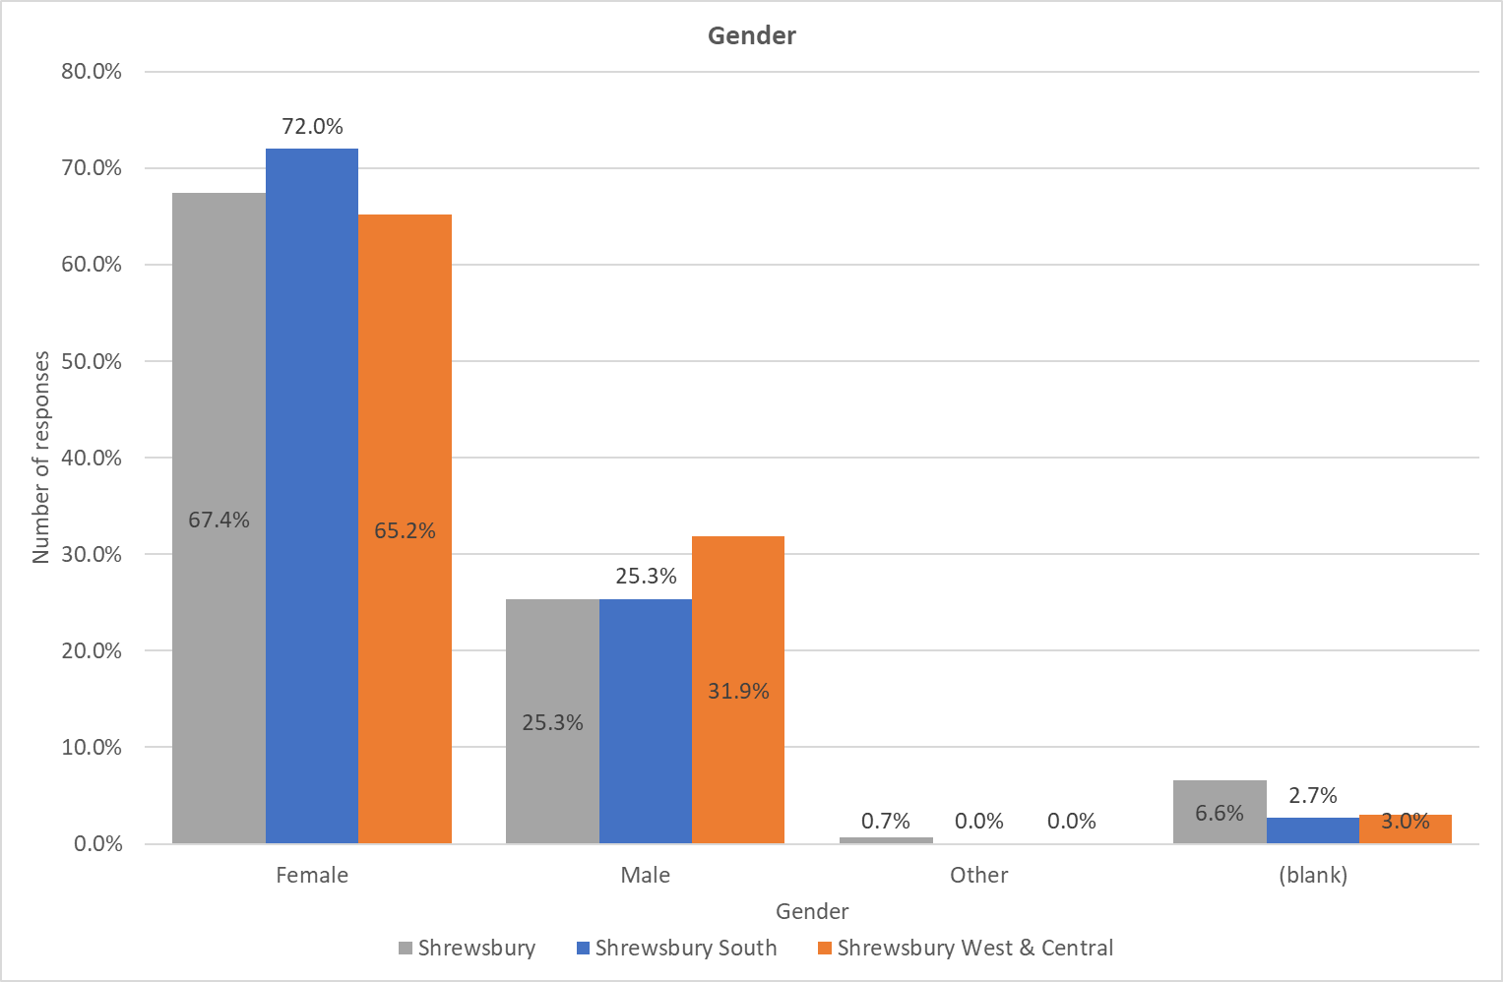
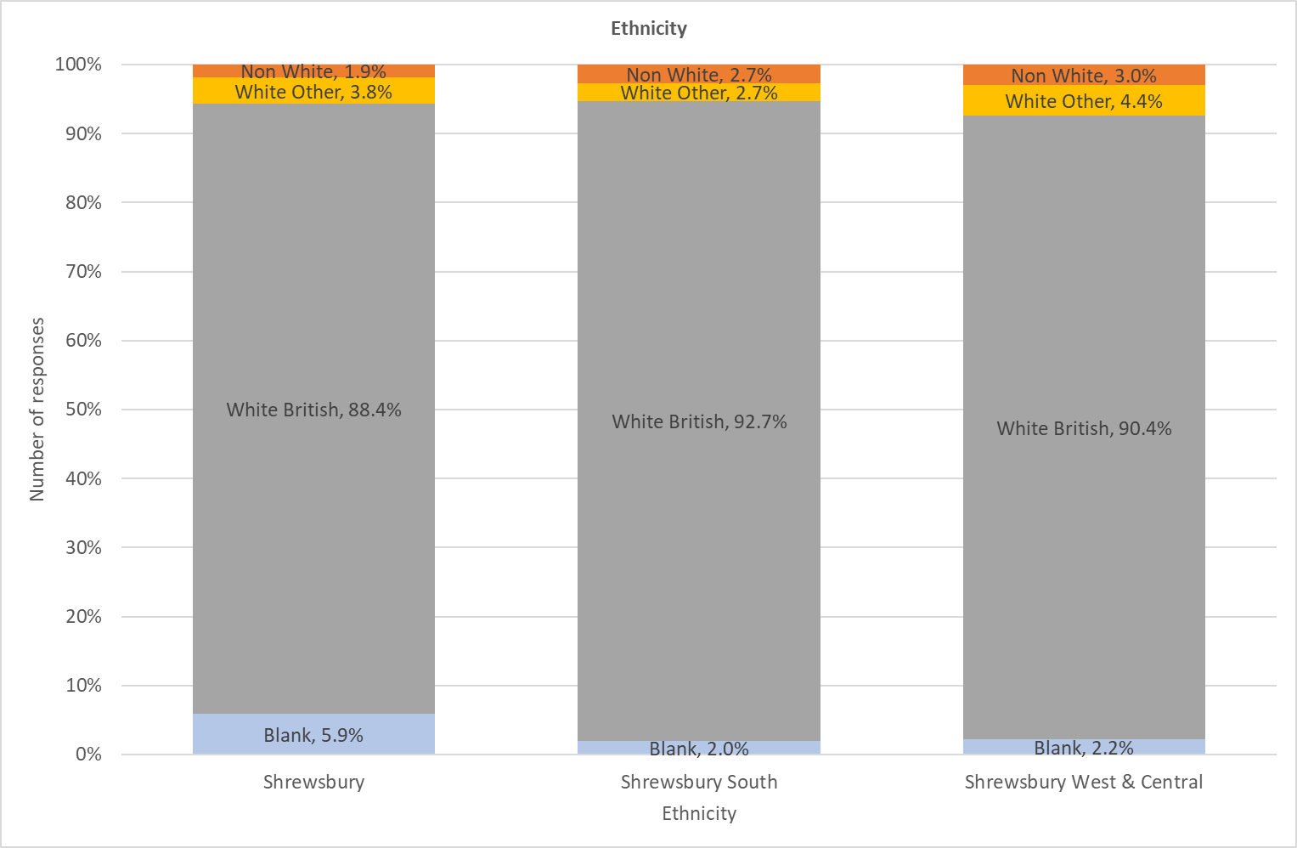
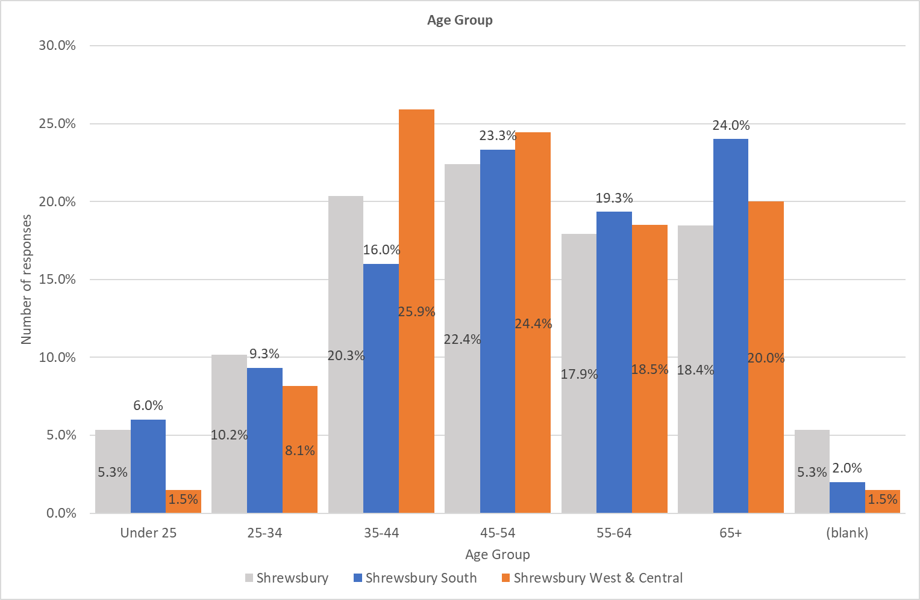
Survey Respondents: Demographics

Slide 22
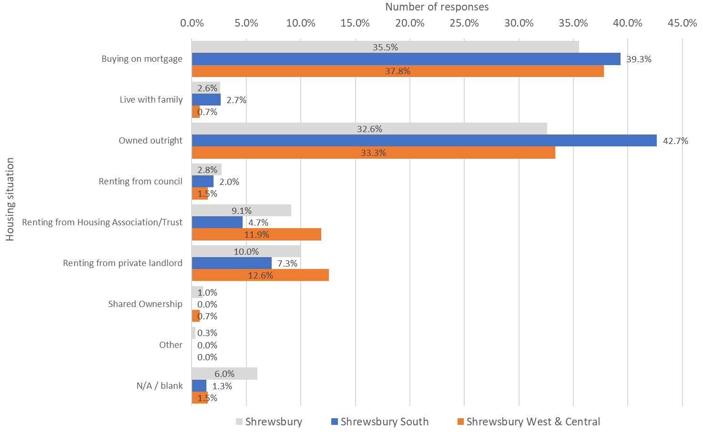
Housing by Type: Shrewsbury Place Plan Areas

Slide 23
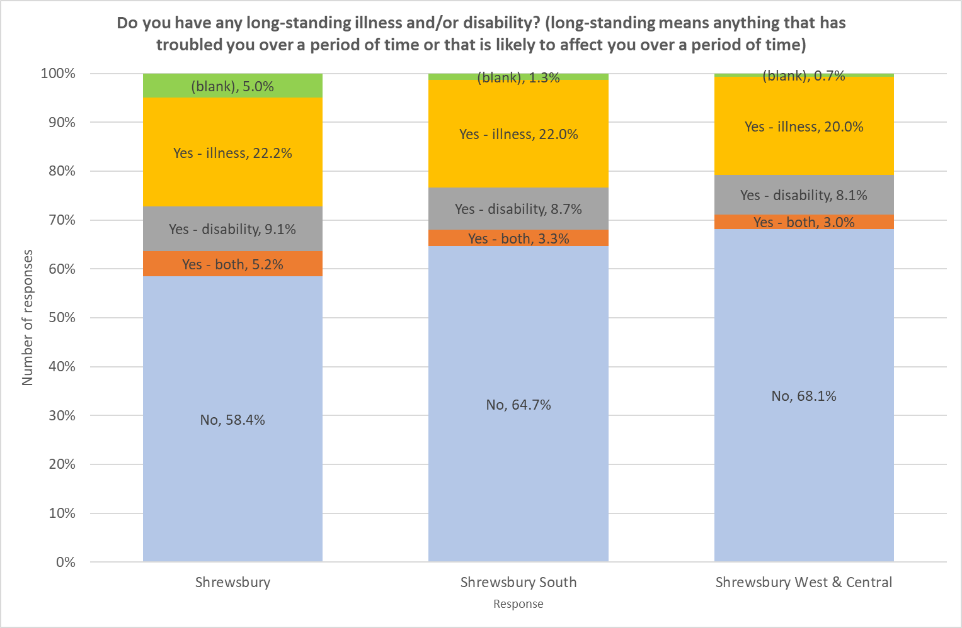
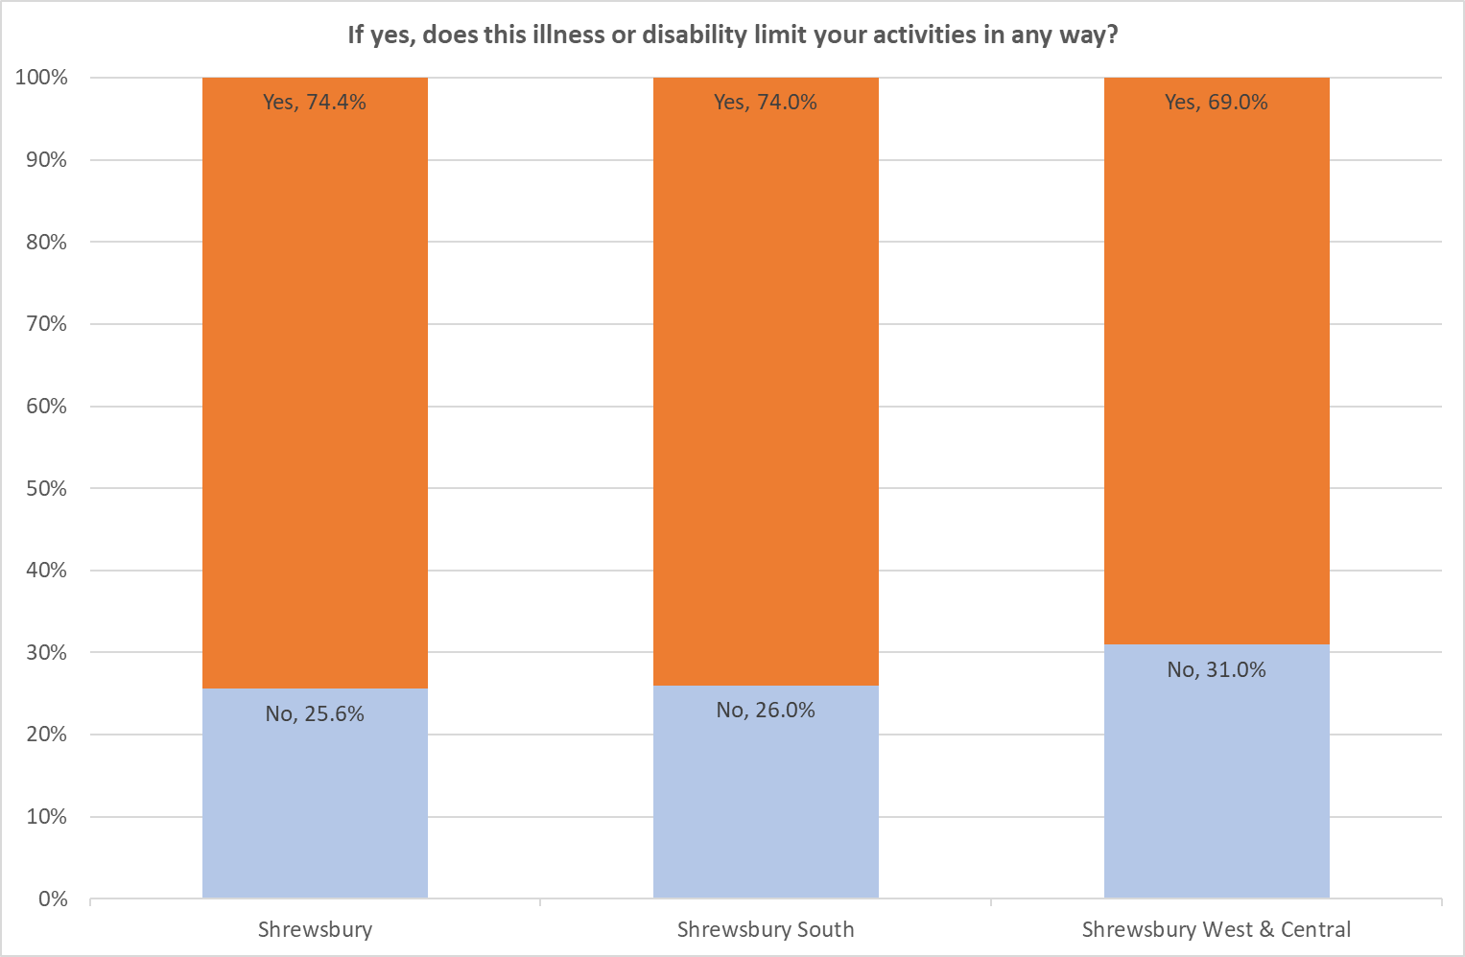

Slide 24
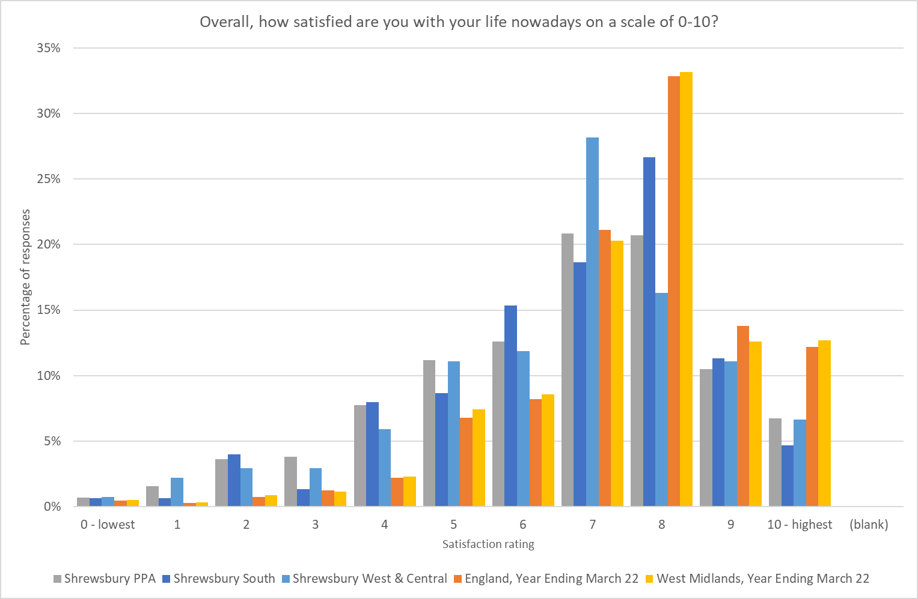
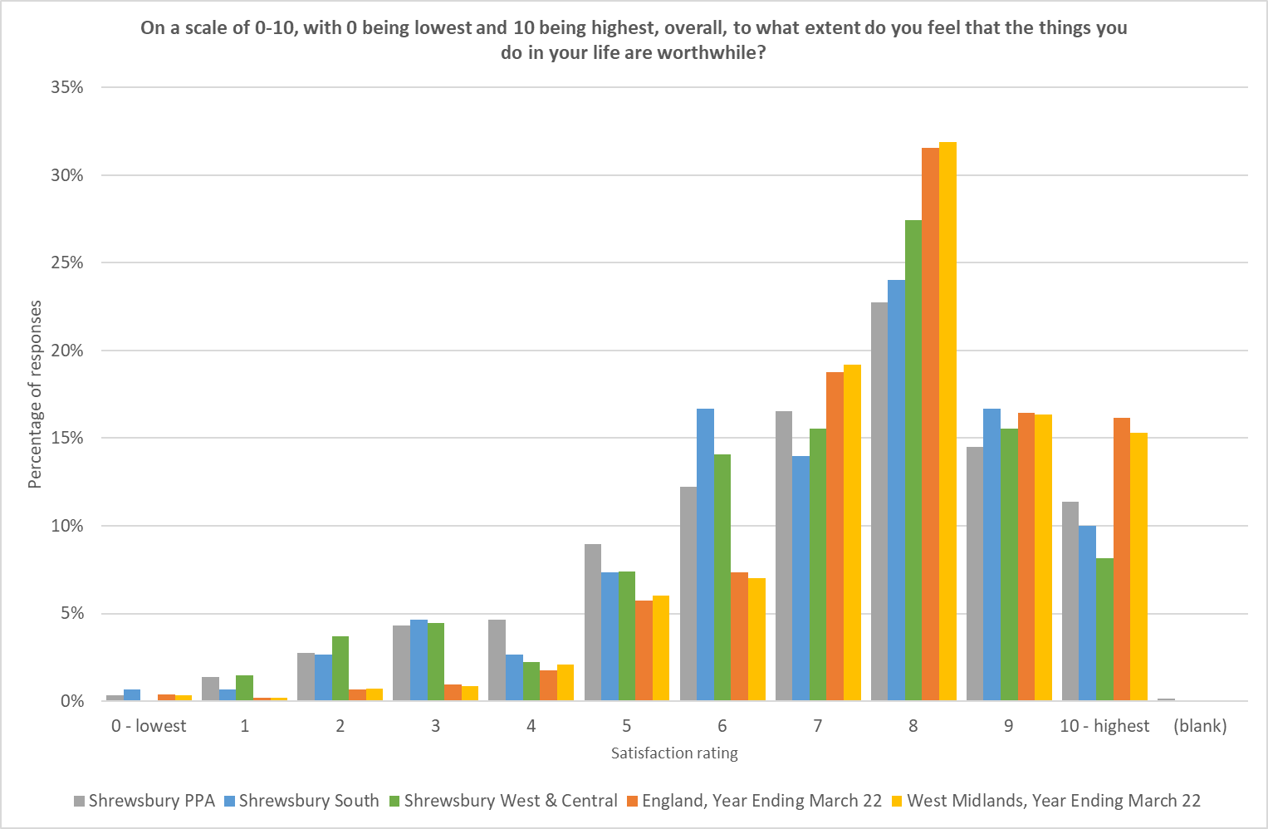
How satisfied are you with your life nowadays?
England and West Midlands figures from Annual Population Survey, ONS, for year ending March 2022
Shrewsbury figures from local survey
To what extent do you feel that the things you do in your life are worthwhile?

Slide 25
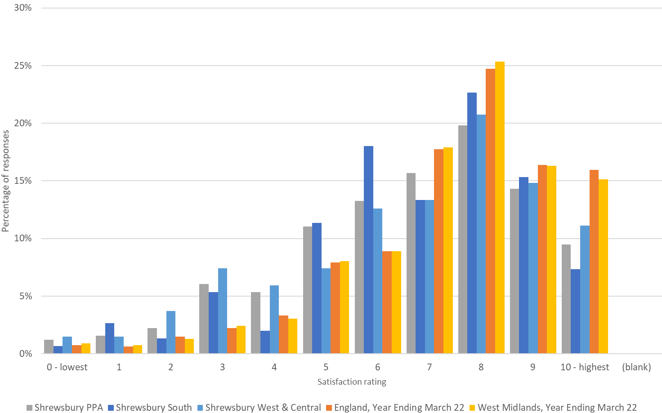
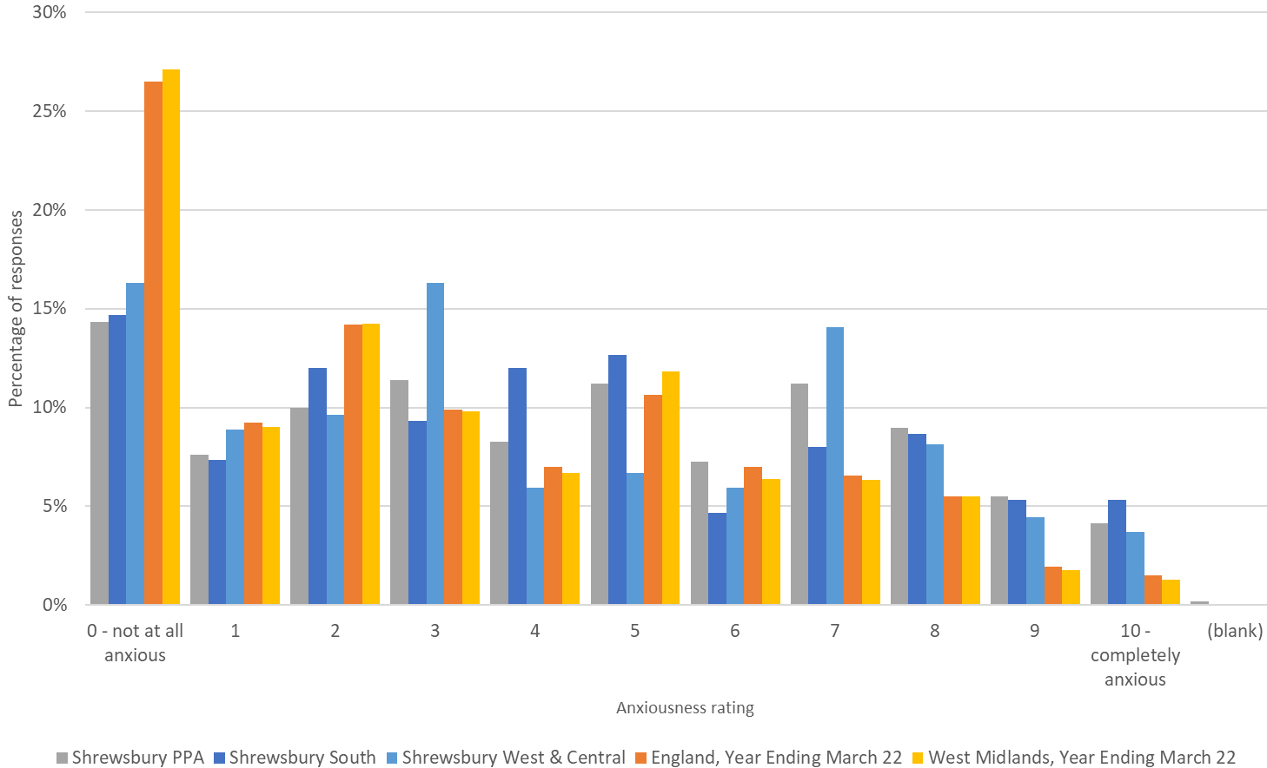
How happy did you feel yesterday?
England and West Midlands figures from Annual Population Survey, ONS, for year ending March 2022
Shrewsbury figures from local survey
How anxious did you feel yesterday?

Slide 26
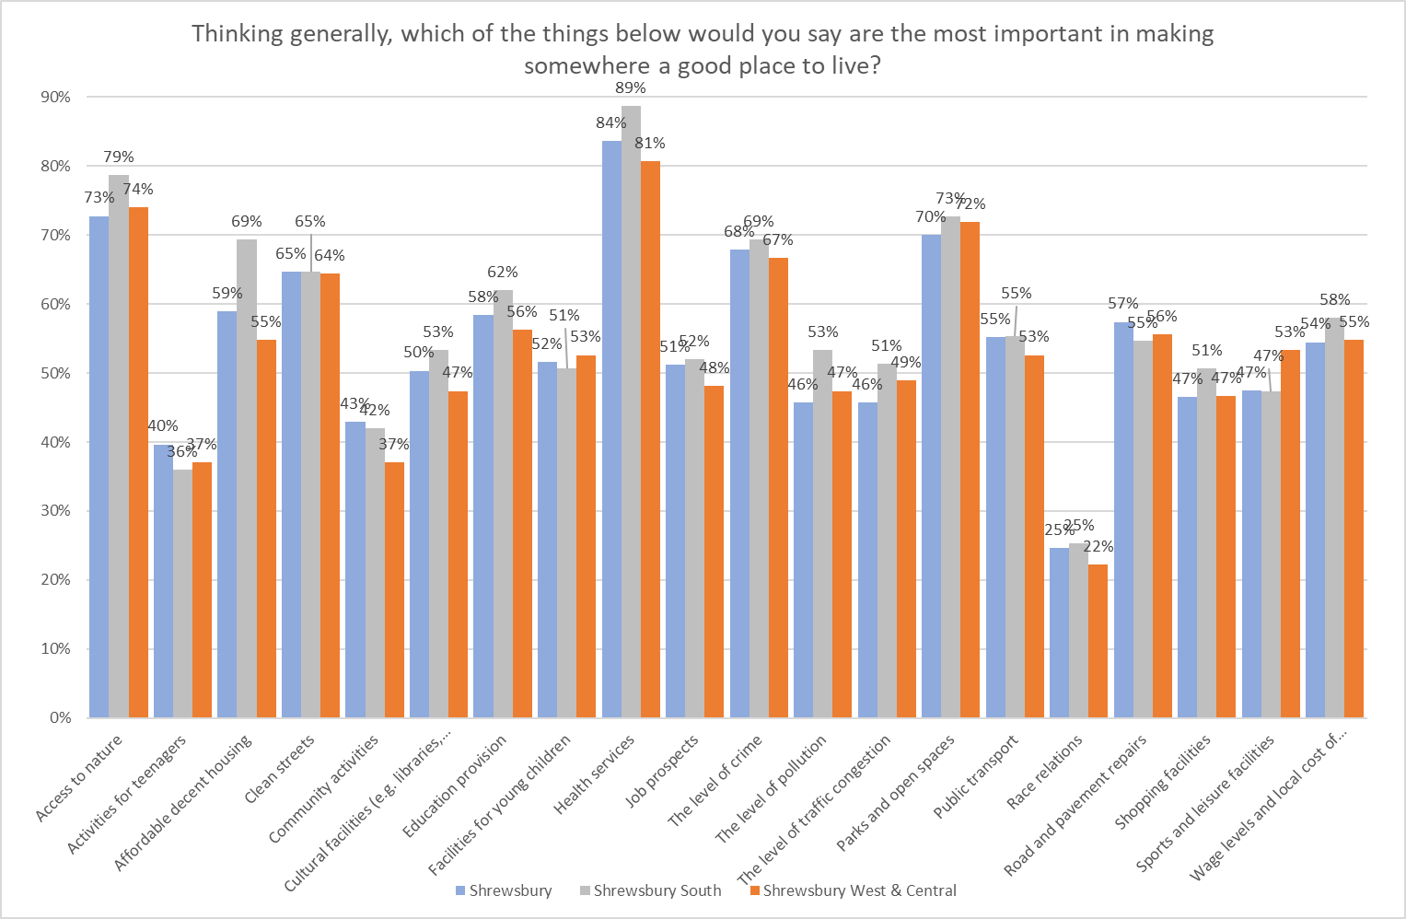
Thinking generally, which of the things below would you say are the most important in making somewhere a good place to live?
SOME QUOTES
Well funded mental health support
Wages need to be upped
Tight controls on development, new houses architect designed eco houses
Noise pollution of racing cars at night & out of season fireworks
Mental health services and homeless Outreach services
Good communication between local government and the people
Cycling network in Shrewsbury for all ages and abilities
Businesses like Nerdy Coffee Co that provide a safe, welcoming and affordable space for all people, especially vulnerable ones

Slide 27
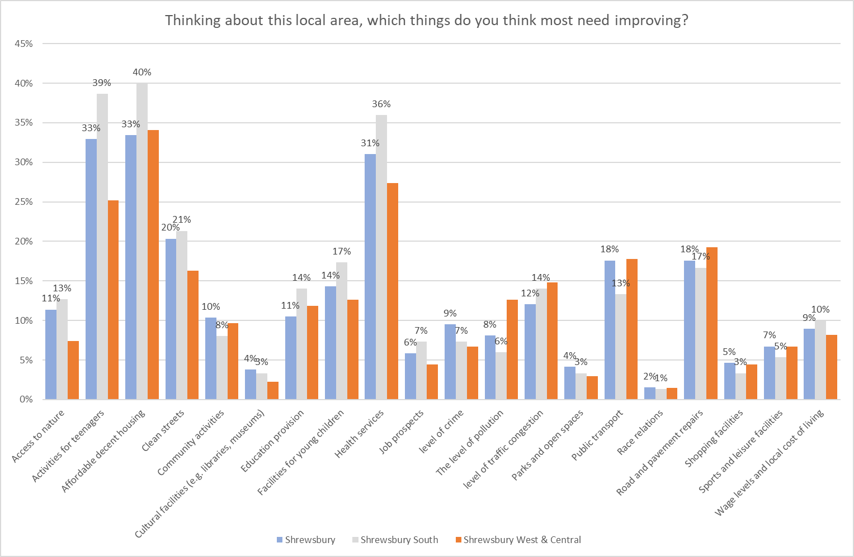
Thinking about this local area, which things do you think most need improving?
SOME QUOTES
No defibrillators in Meole Brace or Meole Village Traffic congestion at rush hour exiting onto Roman Road from both ends of Meole Village
Houses being built without adequate school places/ GP provision to support the increase in population.

Slide 28
What are the most important factors in making somewhere a good place to live v What needs improving the most in Shrewsbury

Slide 29
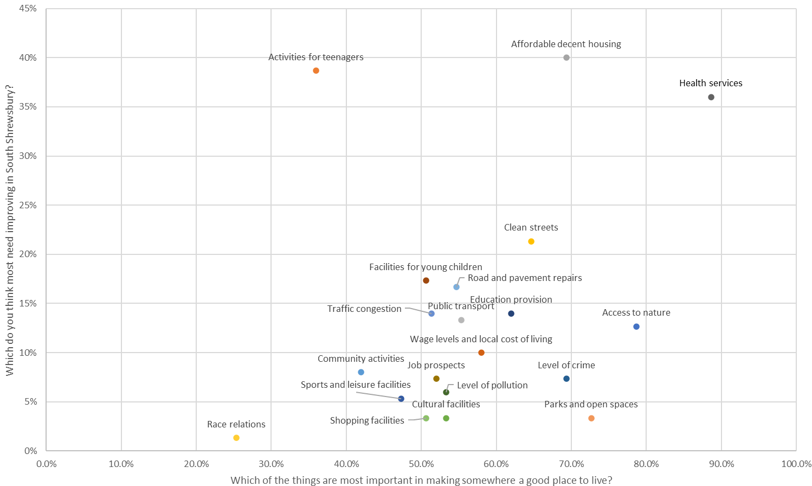
What are the most important factors in making somewhere a good place to live v What needs improving the most in South Shrewsbury

Slide 30
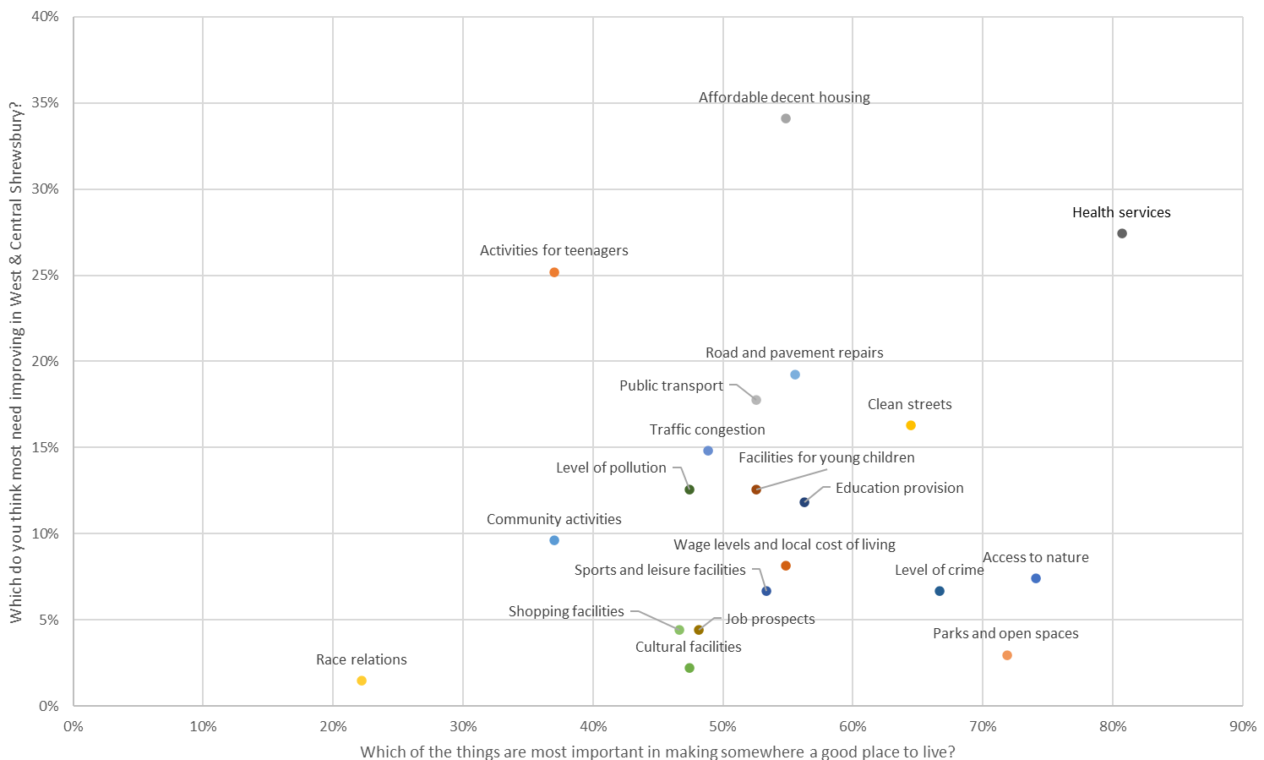
What are the most important factors in making somewhere a good place to live v What needs improving the most in West & Central Shrewsbury

Slide 31
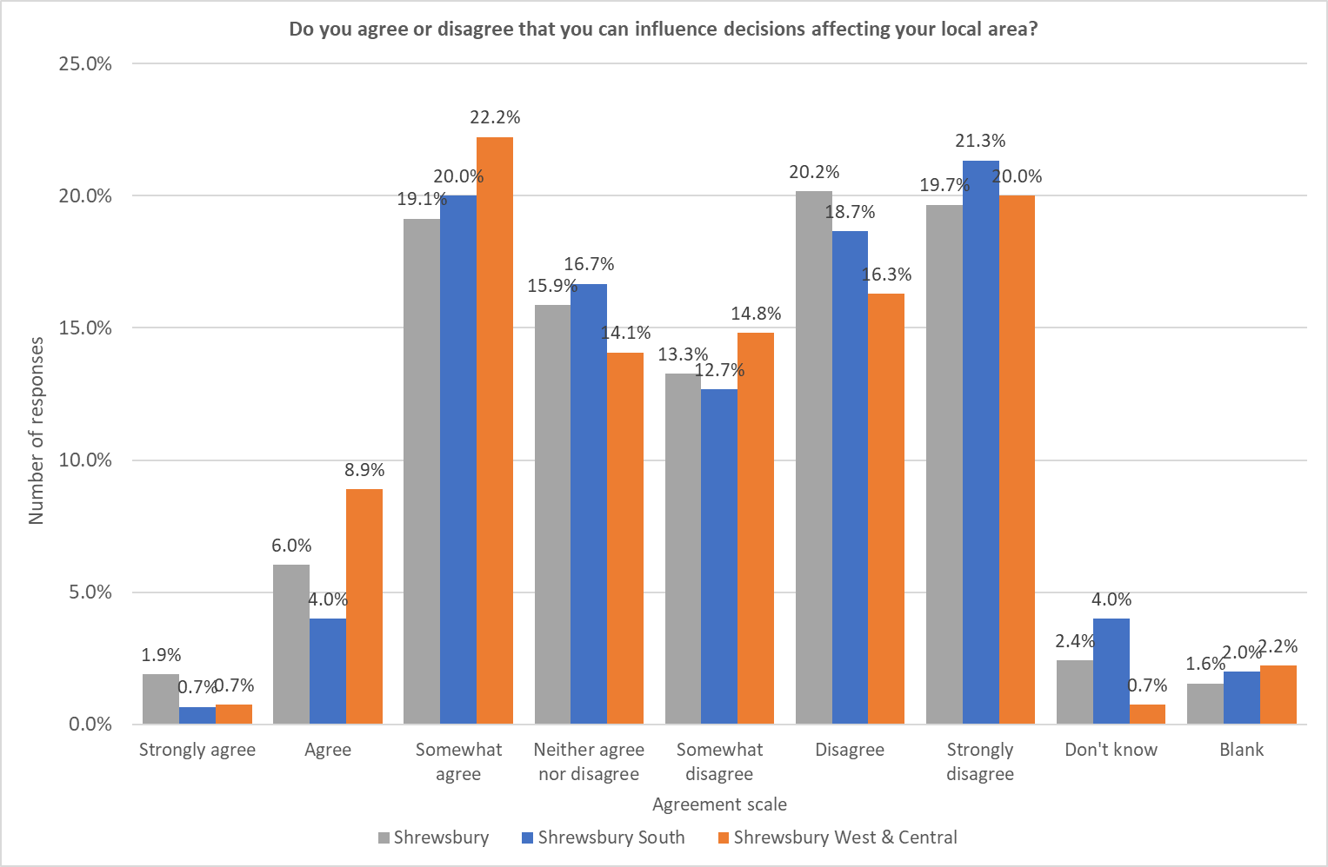
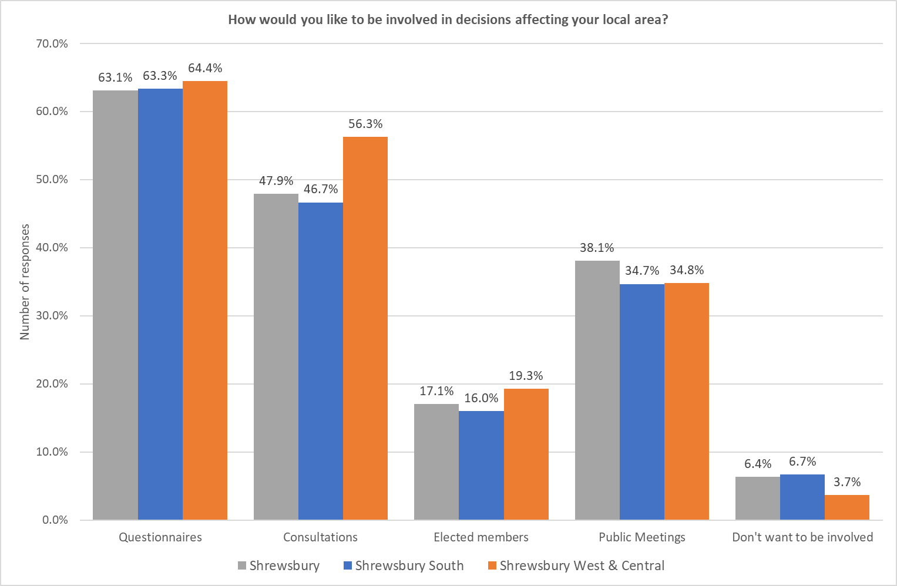
Do you feel you can influence decisions affecting your local area?
How would you like to be involved in decisions?

Slide 32
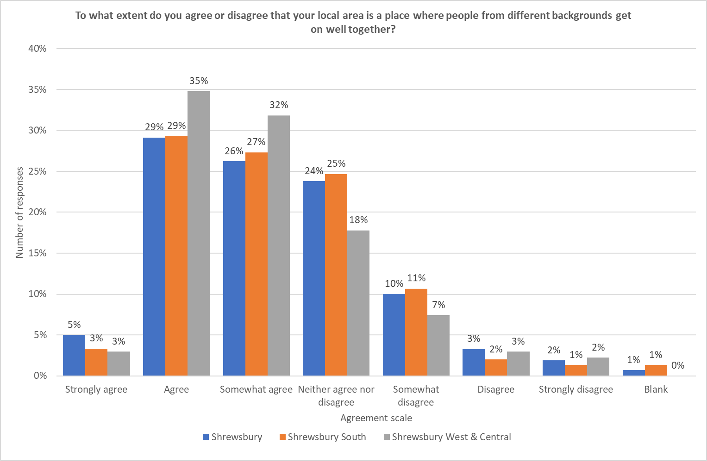
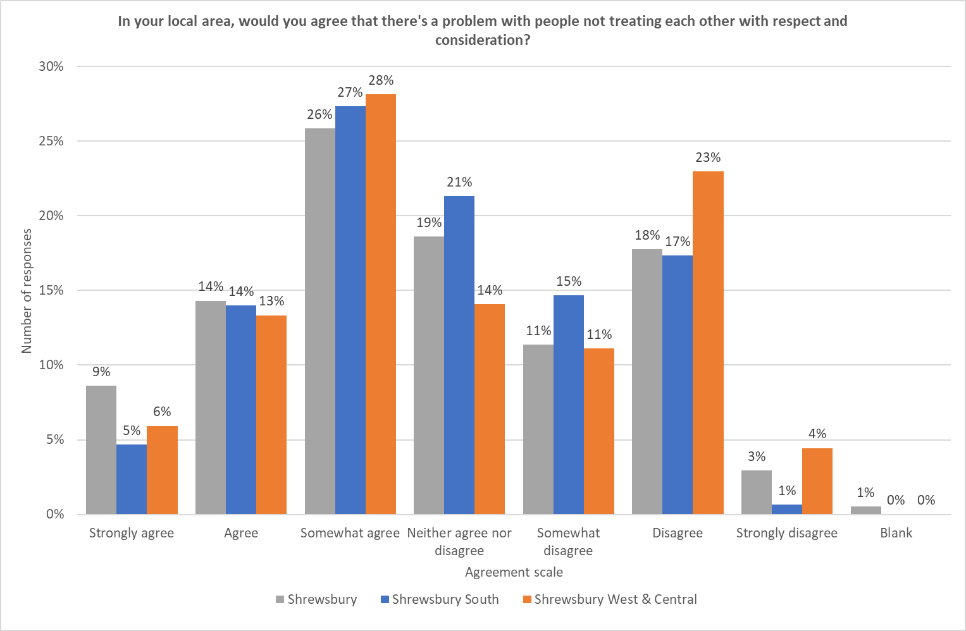
To what extent do you think that your local area is a place where people from different backgrounds get on well together?
Do you agree that there's a problem with people not treating each other with respect and consideration?

Slide 33
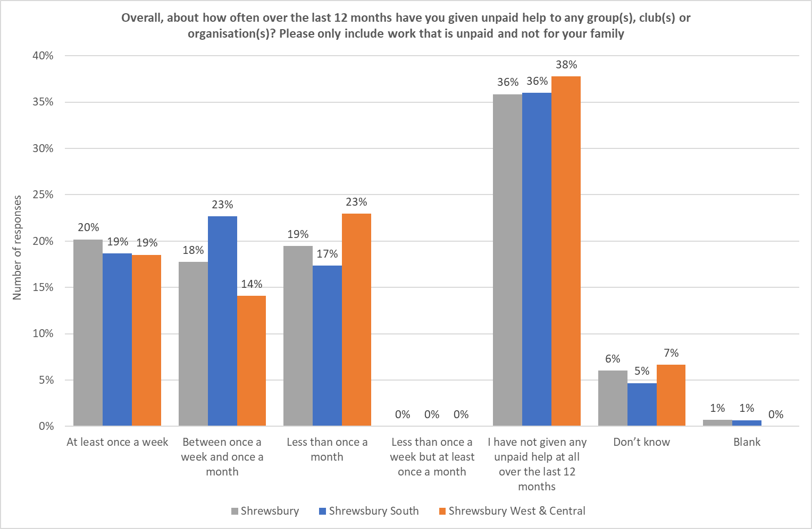
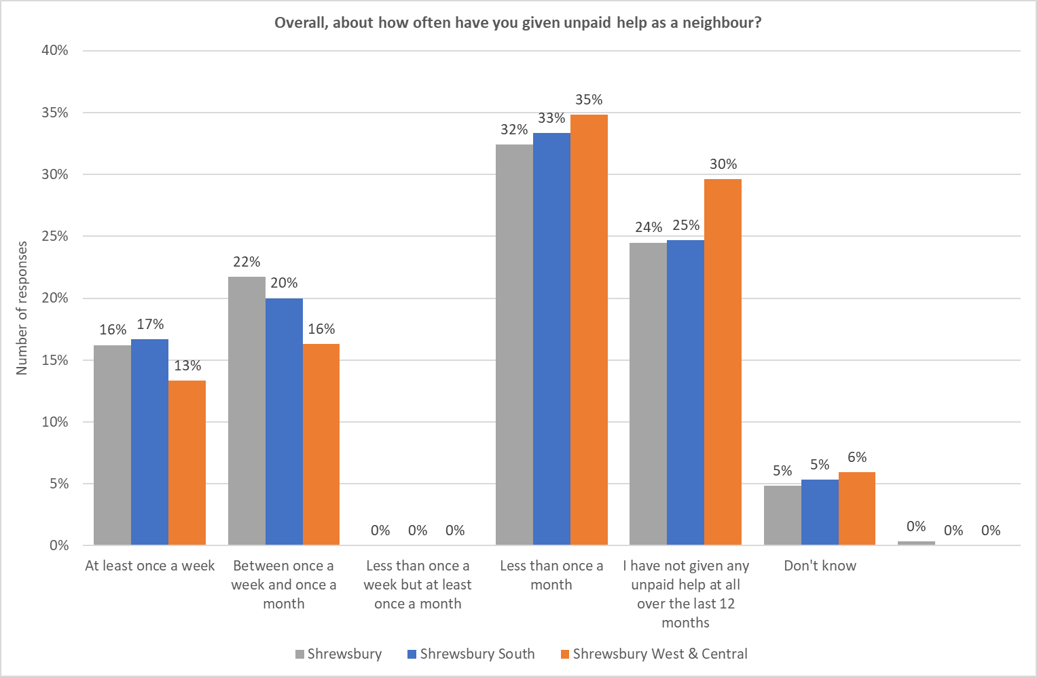
How often over the last 12 months have you given unpaid help to any group(s), club(s) or organisation(s)? Only include work that is unpaid and not for your family
Overall, about how often have you given unpaid help as a neighbour?

Slide 34
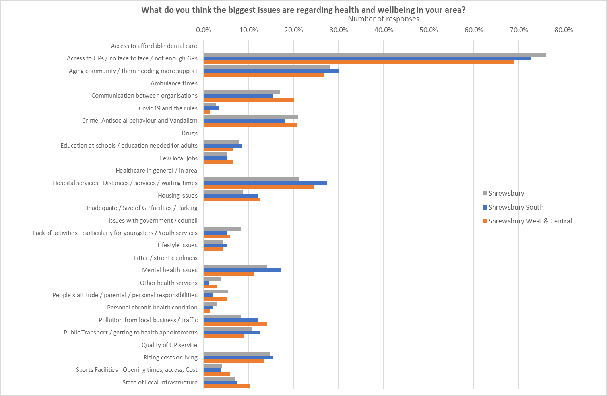
What do you think the biggest issues are regarding health and wellbeing in your area?
SOME QUOTES
Young people’s access to Mental health services
Very poor quality of GP services
If people could include activity in their day eg cycling or walking they would be less sedentary.
Car dependency and lack of sustainable transport options
Car parking at RSH is abysmal, I had to miss an appointment due to nowhere to park. When I returned for the substituted appointment the situation was the same.
Better footpaths, better bike paths

Slide 35
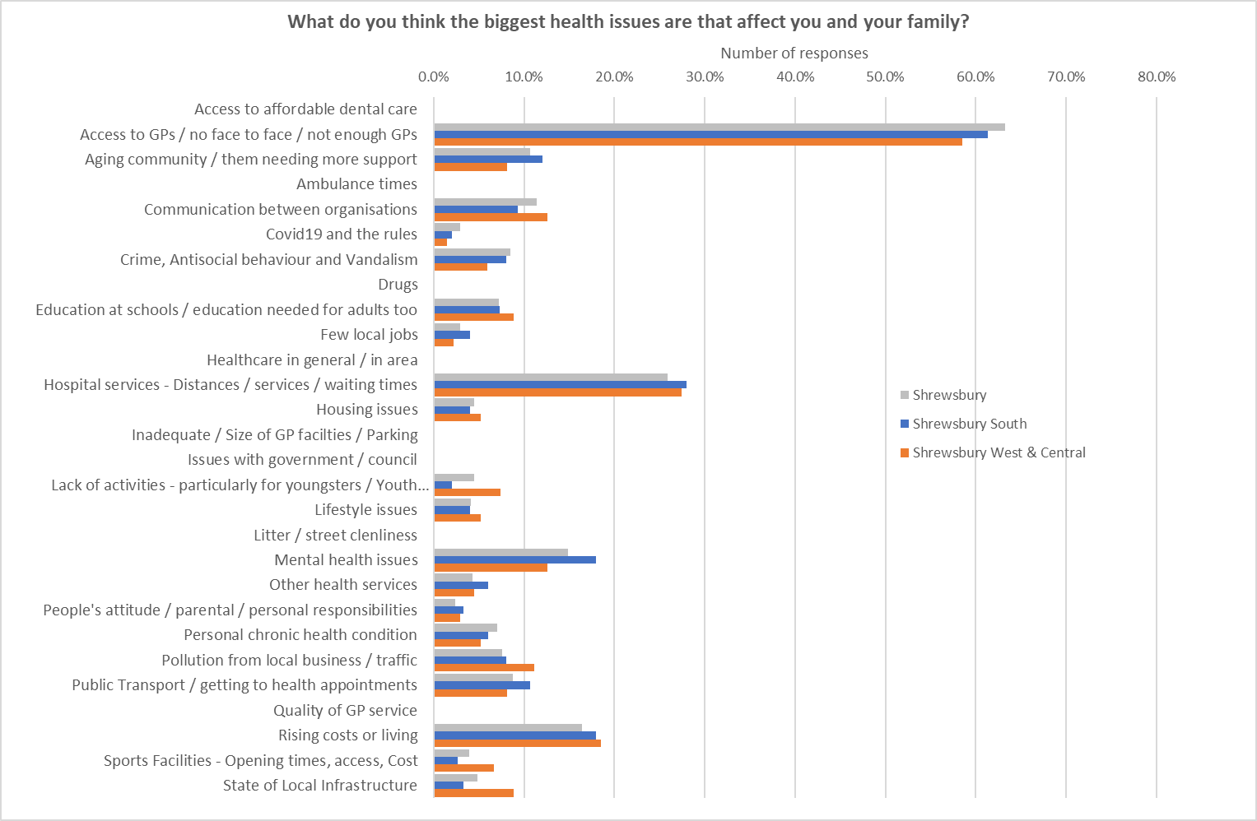
What do you think the biggest health issues are that affect you and your family?
SOME QUOTES
Work stress
Why has the large pool at the Quarry leisure centre still not reopened?
Vaping as above
Supermarket shopping, unhealthy and expensive food
Lack of support for elderly e.g district nurse
Lack of a proper cycle network
Key workers worn down during/since covid.
Finding it hard to walk around the local area to stay active
Access to CAHMS

Slide 36
What do you think the biggest health issues are regarding health and wellbeing in your area v What do you think are the biggest health issues affect you and your family in Shrewsbury

Slide 37
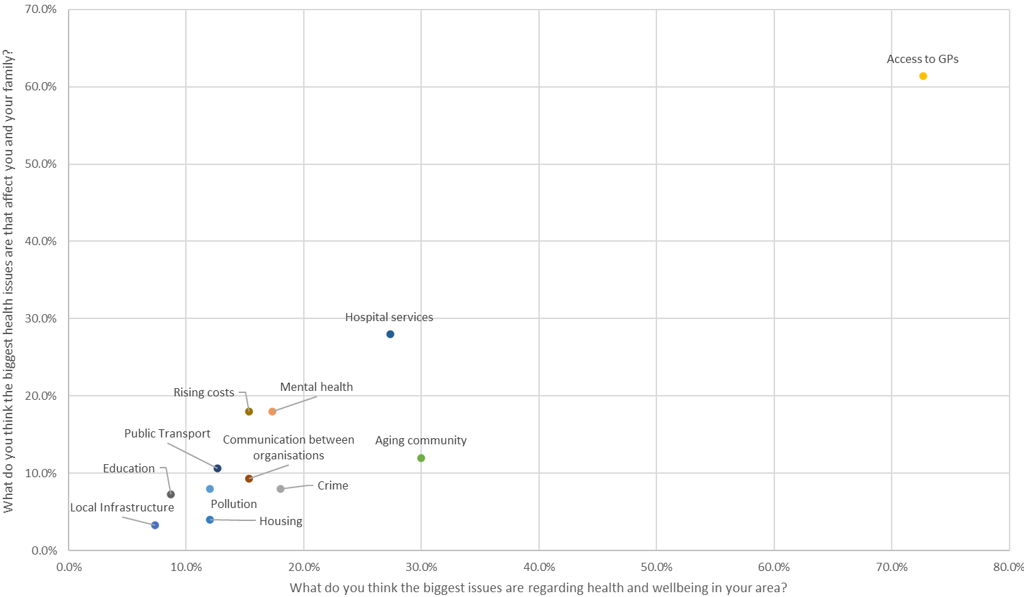
What do you think the biggest health issues are regarding health and wellbeing in your area v What do you think are the biggest health issues affect you and your family in South Shrewsbury

Slide 38
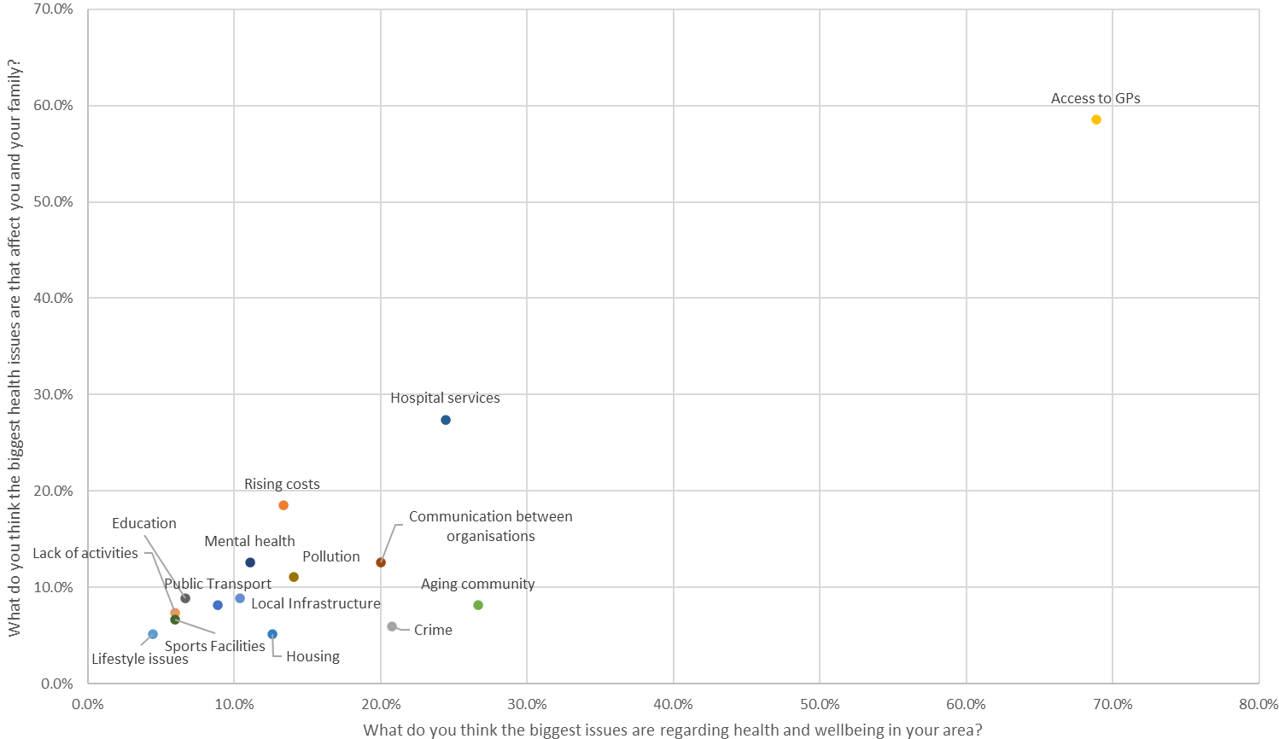
What do you think the biggest health issues are regarding health and wellbeing in your area v What do you think are the biggest health issues affect you and your family in West & Central Shrewsbury

Slide 39
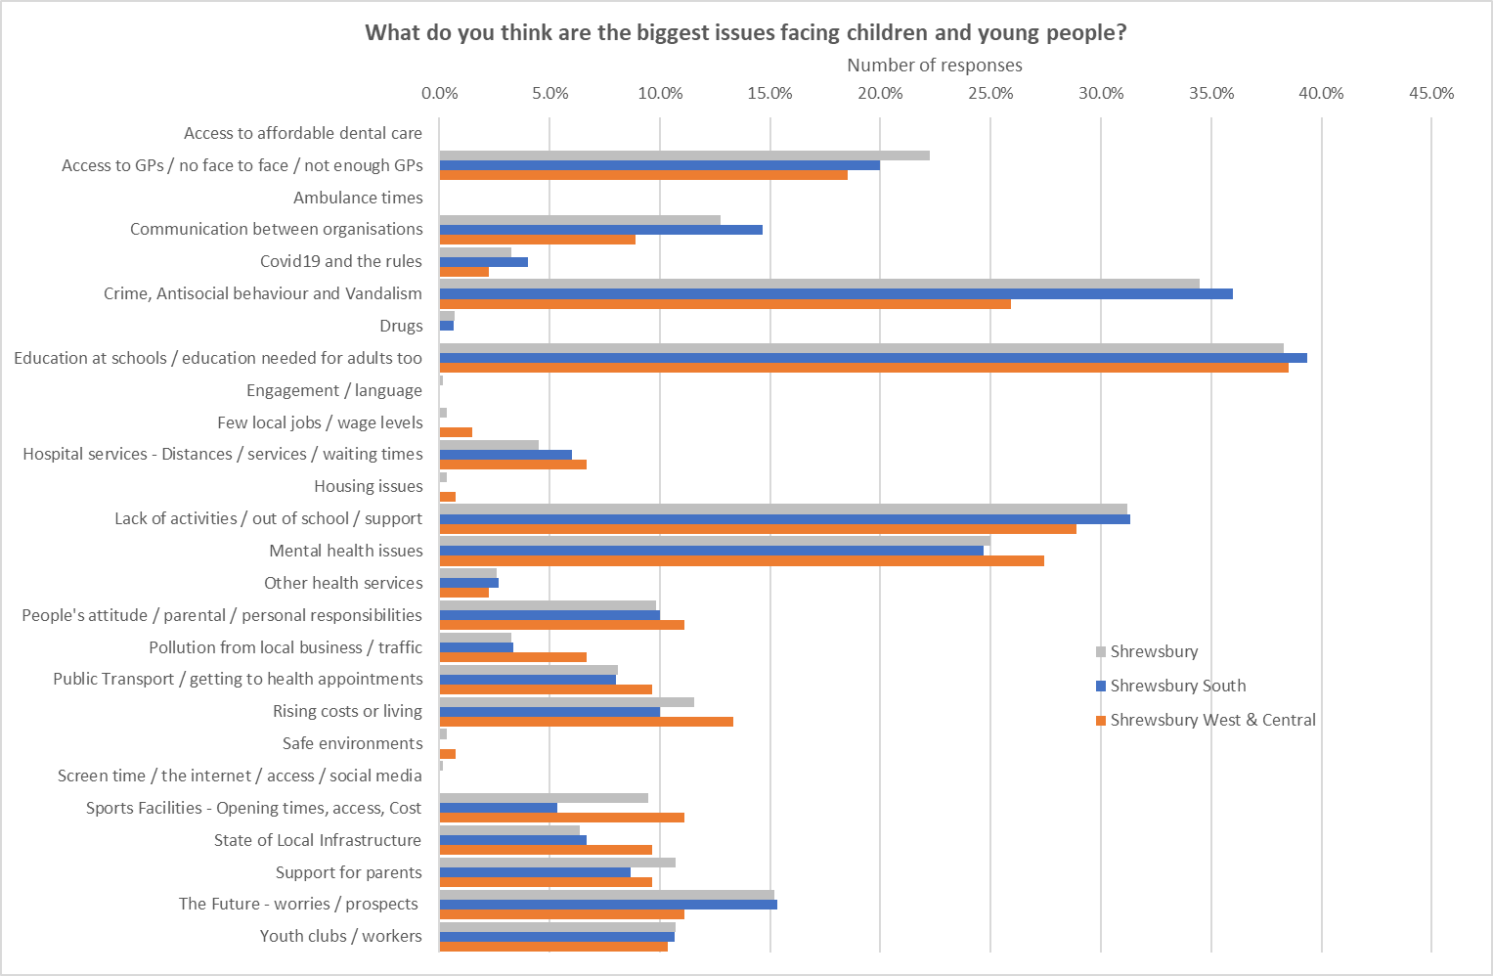
What do you think are the biggest issues facing children and young people?
Quotes
Children can't cycle to school safely as we used to when we were young - they get driven instead
Crime and feeling unsafe to enjoy the outside
Drugs being all around the town
Lack of respect for society and it’s conventions
Lack of safe cycling routes
Lack of youth provision
Local community hubs needing to close, despite having big huge communities that rely on them
Provide safe cycle routes to give them independence.
Young people not being understood and listened to. They are not involved in development of services which meets their needs. Lack of spaces to access can lead onto issues such as drugs alcohol. exploitation, ASBOs

Slide 40
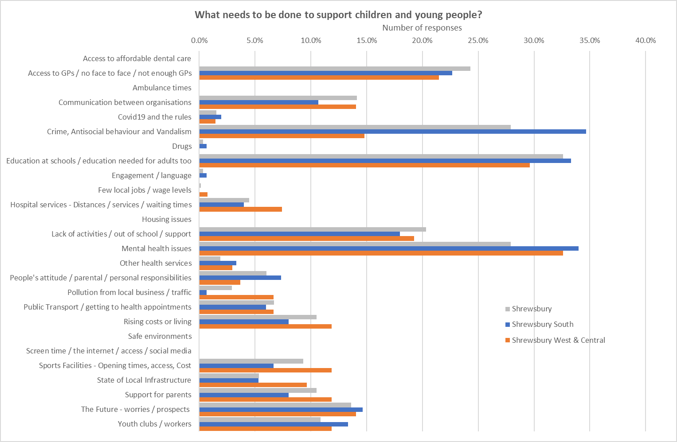
What needs to be done to support children and young people?
Quotes
Build bike paths so they can get about independently
Improvement in CAHMs & Learning Disability resources
Lack of a proper cycle network
Outside address biodiversity with raised beds fruit trees and seating areas for old people
Schools getting their teachers trained appropriately
Teaching them to be independent
Tell them they are responsible for there own wellbeing not victims of the system or other generations
The fact we are not educating youngsters how to deal with life’s ordeals. We just teach them to say they have mental health issues.
Young people's participation is critical to finding out what they need from their communities

Slide 41
What do you think are the biggest issues facing children and young people v What needs to be done to support children and young people in Shrewsbury

Slide 42
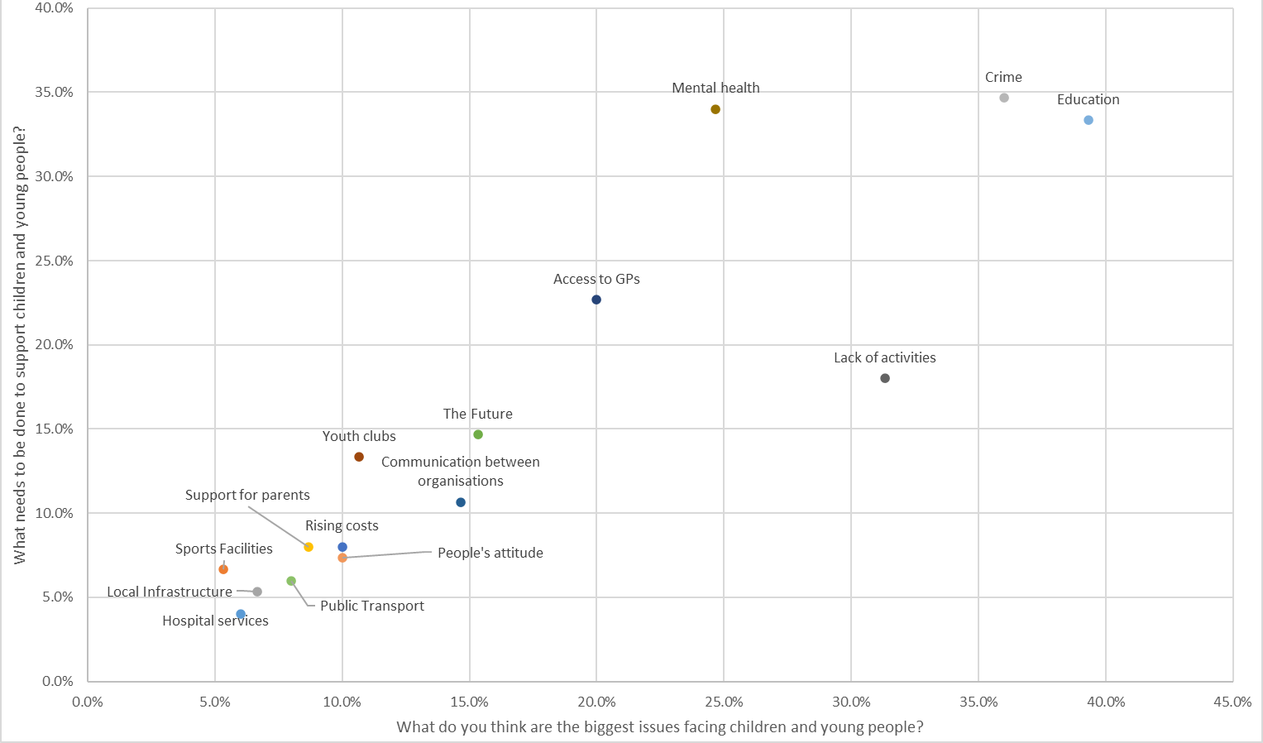
What do you think are the biggest issues facing children and young people v What needs to be done to support children and young people in South Shrewsbury

Slide 43
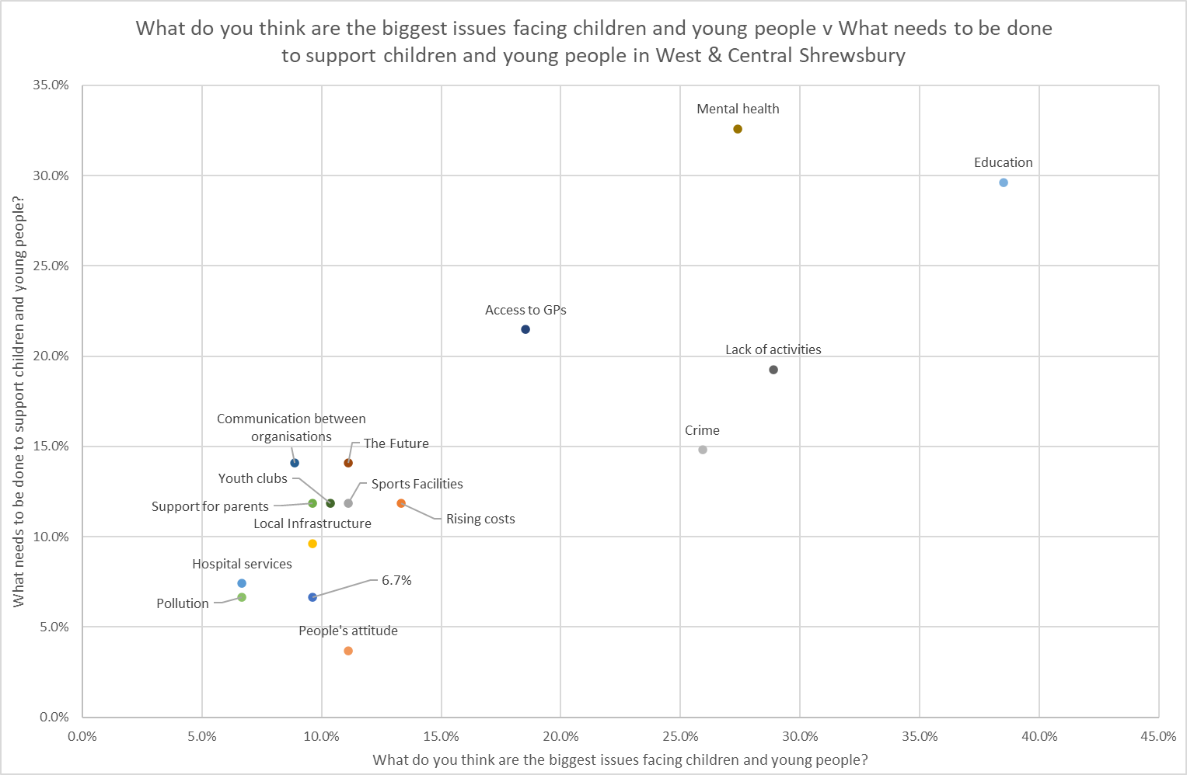
What do you think are the biggest issues facing children and young people v What needs to be done to support children and young people in West & Central Shrewsbury

Slide 44
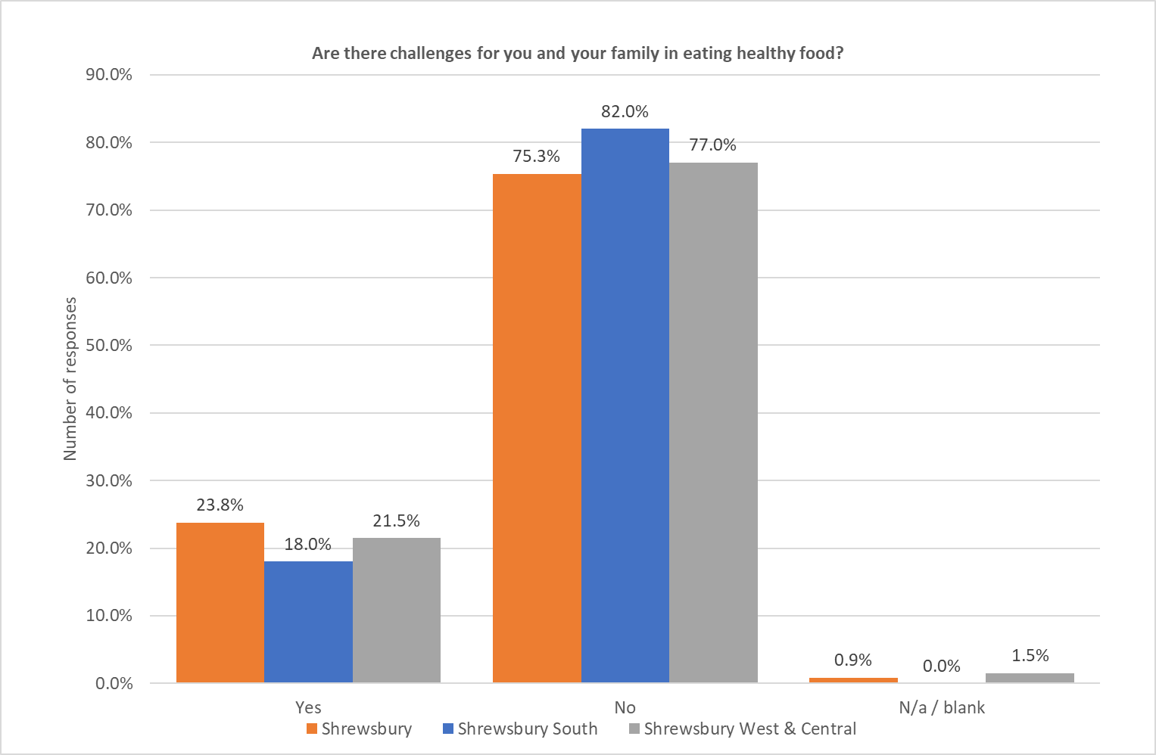
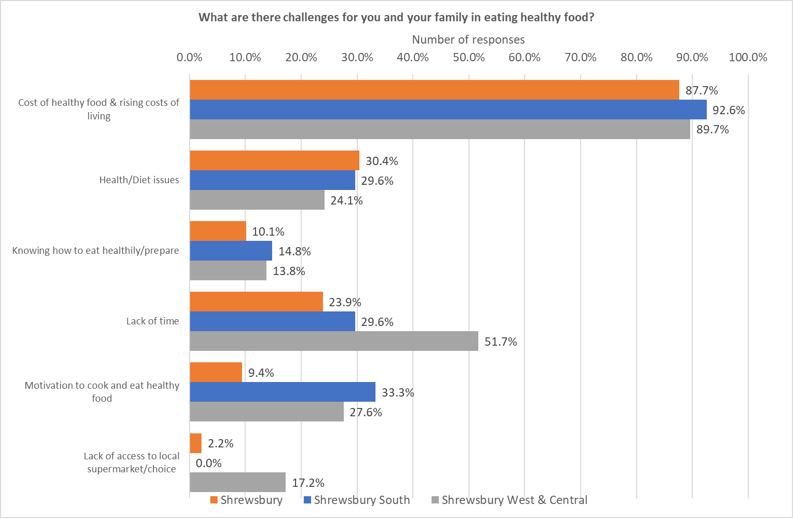
Are there challenges for you and your family in eating health food?
What are there challenges?

Slide 45
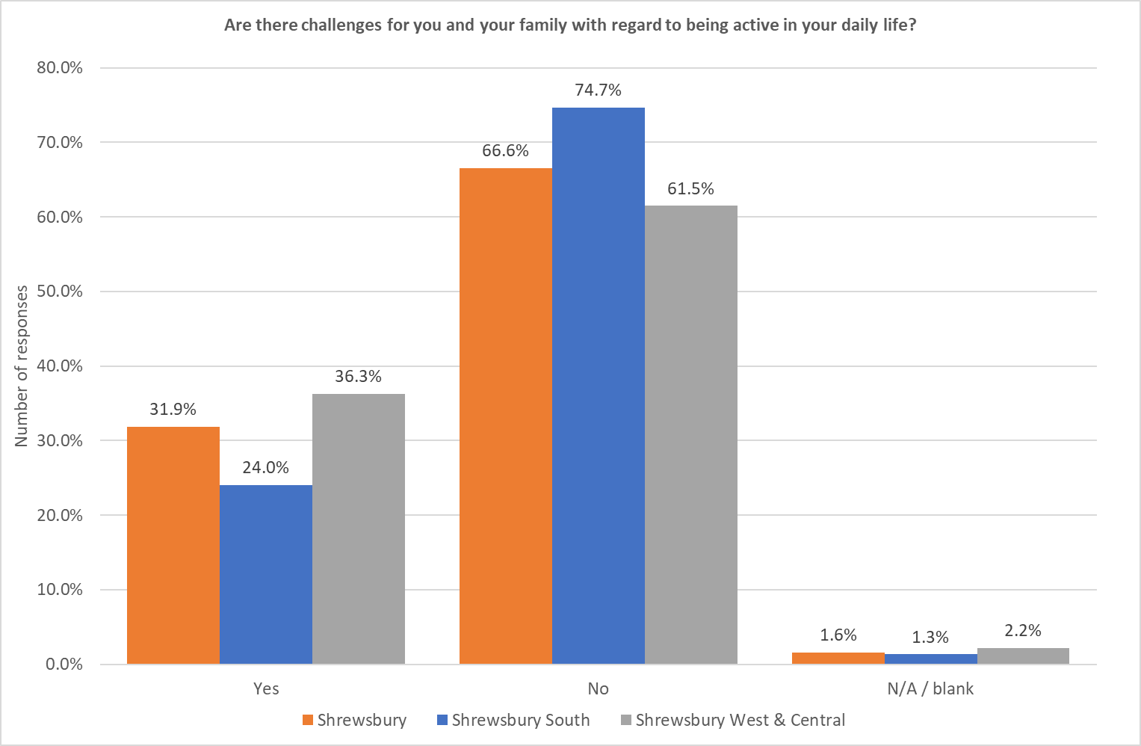
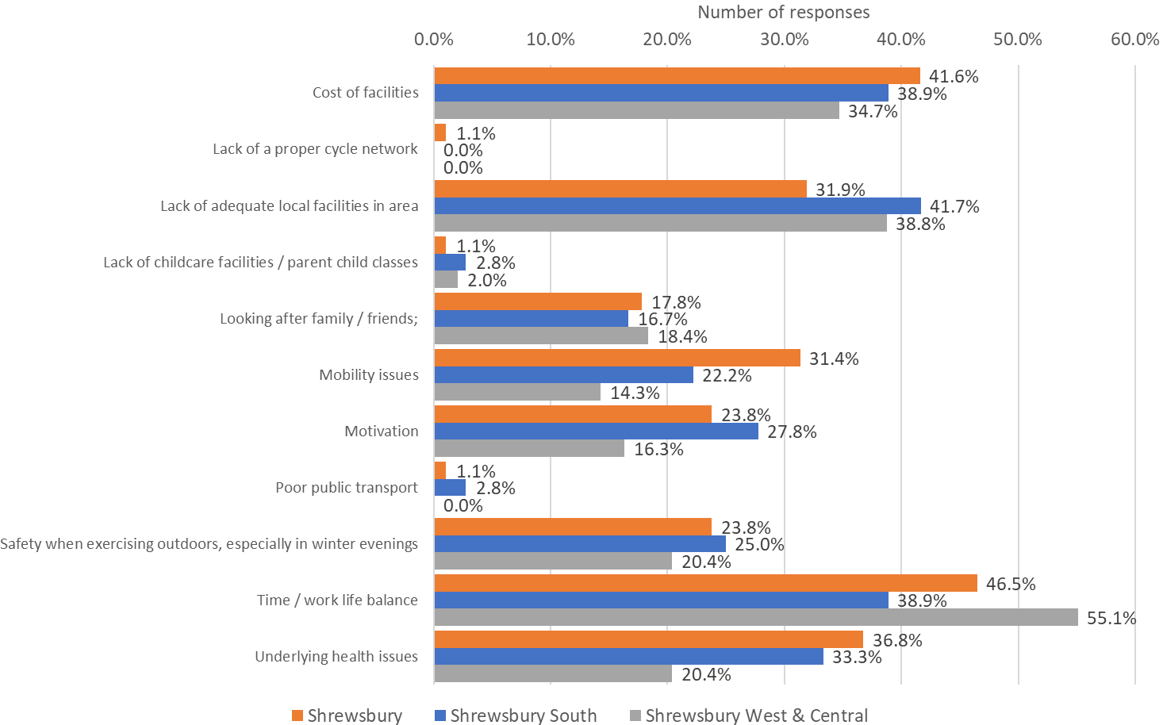
Are there challenges for you and your family with regard to being active in your daily life?
What are there challenges?
OTHER QUOTES
Being able to walk around our local area and feeling safe
Lack of a proper cycle network No childcare facilities
Lack of a proper cycle network No childcare facilities
No local facilities where you can take your child with you while you exercise. Lots of nowhere town's have parent child classes (only for small babies here)
Safety on the roads when cycling
The Quarry Leisure Centre is in a dire state
The same Traffic regulation orders I've previously mentioned
Working from home

Slide 46
Group Discussion
What are the key themes for the Shrewsbury Plan Areas?
What is already happening around the key themes?
What actions do we need to take to improve the key themes?

