Slide 1

Joint Strategic Needs
Assessment (JSNA):
Place-based approach
Stakeholder Event – Shrewsbury North East
Notes:
Intro my role

Slide 2


Overview
What is a JSNA
Why and what is a needs assessment?
Initial work to date
Next Steps
Notes:
There are 18 place-based areas through Shropshire, the assets and needs are different in each area and the JSNA process is a way to dig deeper into these needs.
Looking at health data as well as what is on the ground – what agencies say about an area and what people say about area are very different.
We have been working with the Highley area and are formulating an action plan to work with key areas that have arisen i.e. access to services - the Highley GP gave notice on the contract for the current surgery and that has opened an opportunity to work with the PCN to relocate the surgery.

Slide 3
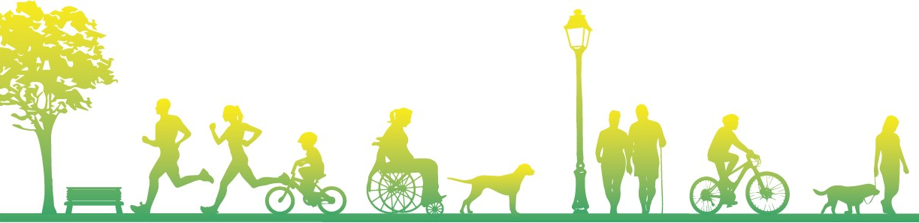
What is a Joint Strategic Needs Assessment?
Local Authorities and CCGs (now ICS) have a legal Statutory Duty to undertake a Joint Strategic Needs Assessment (JSNA), through the health and wellbeing board.
​​
The JSNA seeks to identify current and future health and wellbeing needs in the local population and identify strategic priorities to inform commissioning of services based on those needs. ​
These priorities in turn inform the Health and Wellbeing Strategy and Integrated Care Strategy, key documents as a basis for commissioning health and social care services in the local area. We also believe they should support local partners/communities' priorities.​​
In Shropshire, our JSNA takes three types:​
Web based profiling Tool​
Thematic Needs Assessments - e.g., pharmacy, drug and alcohol and children​
Place Based Needs Assessments

Slide 4
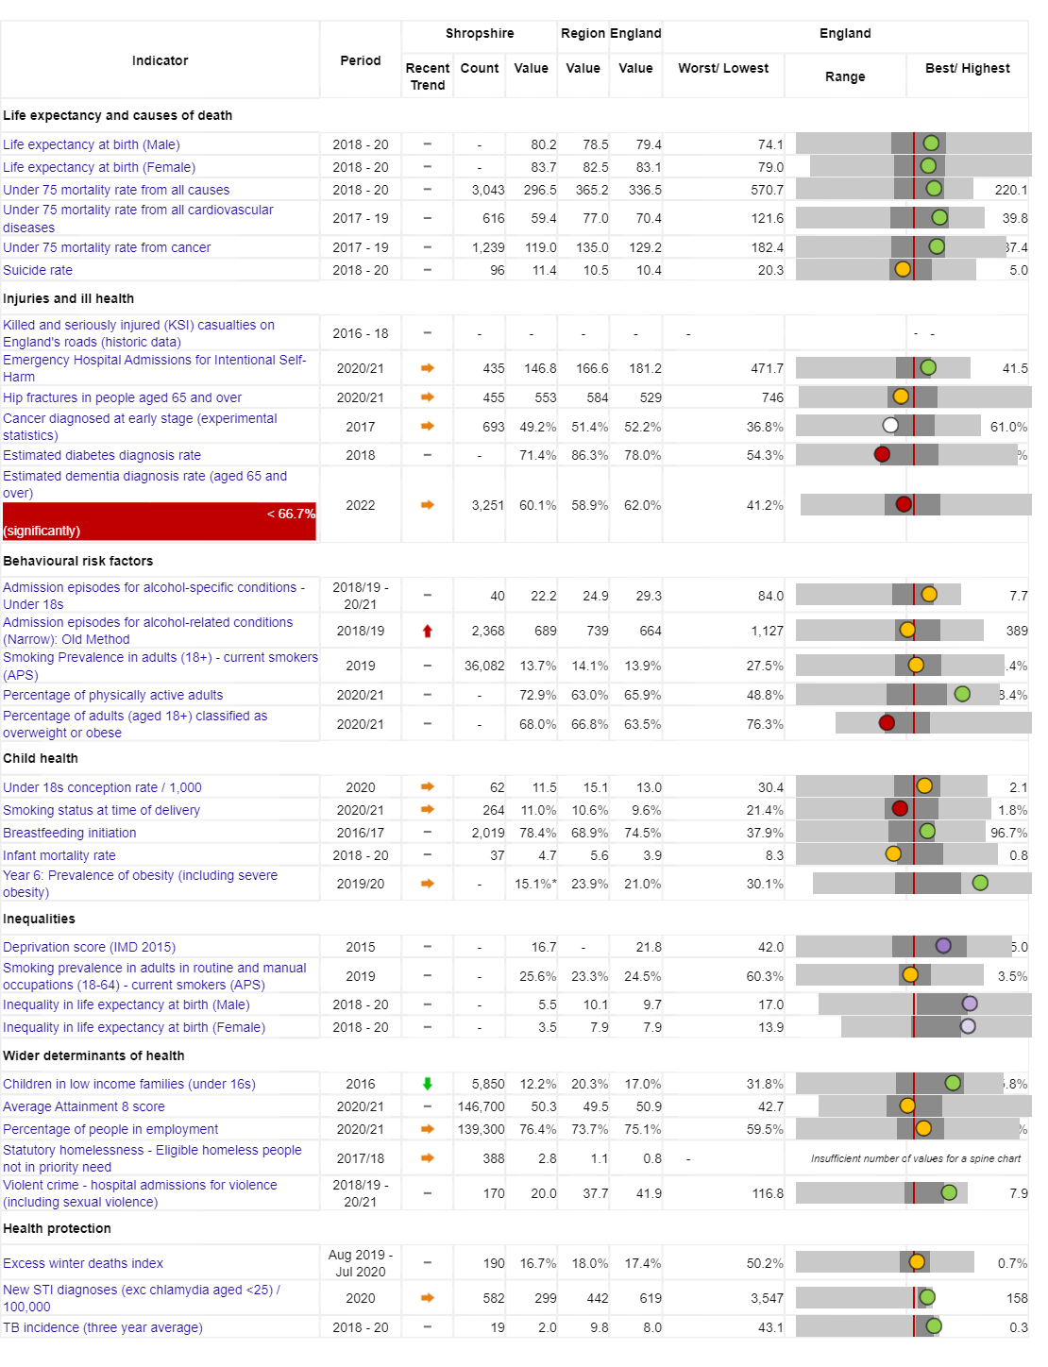

Vision:
For Shropshire people to be the healthiest and most fulfilled in England
Reducing inequalities
Improving Population Health
Working with and building strong and vibrant communities
Joined up working

Slide 5
People in Shropshire are living longer, but not necessarily healthier lives…
Measure | England | Shropshire | Range (Ward) | Range (Ward)
IMD Score | 21.7 | 17.2 | 3.7 (Copthorne) | 37.6 (Harlescott)
Life expectancy at birth, (Male) | 79.7 | 80.5 | 75.3 (Sundorne) | 85.8 (Copthorne)
Life expectancy at birth, (Female) | 83.2 | 83.6 | 79.5 (Sundorne) | 89.6 (Clun)
Deaths all causes, all ages, SMR | 100 | 96.7 | 65.4 (Copthorne) | 145 (Worfield)
Deaths all causes, under 75, SMR | 100 | 89.7 | 55.2 (Clun) | 149 (Sundorne)
Preventable deaths, under 75, SMR | 100 | 85.7 | 48.2 (Corvedale) | 160.6 (Sundorne)
Indicator | Shropshire | England
Healthy Life Expectancy (HLE) Males | 62.8 | 63.1
Inequality in HLE Males | 5.5 | 9.7
HLE Females | 67.1 | 63.9
Inequality in HLE Females | 3.5 | 7.9
Ward | Sundorne | Copthorne
Male Life Expectancy | 75.3 years | 85.8 years
Female Life Expectancy | 79.6 years | 87.7 years

Slide 6
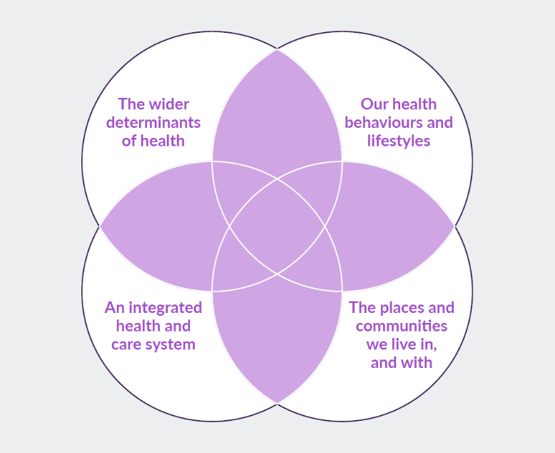
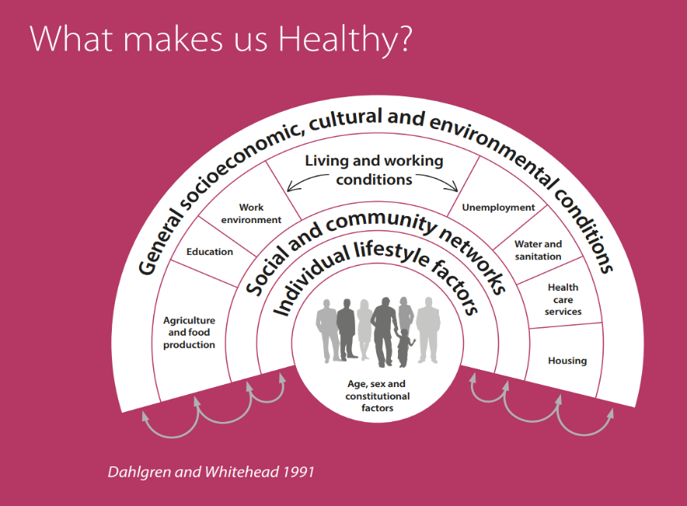
What makes us healthy?
Understanding and Addressing Inequalities
– taking a preventative approach
Health Protection
Understanding our Population Health/Population Health Management (Insight/JSNA)

Slide 7
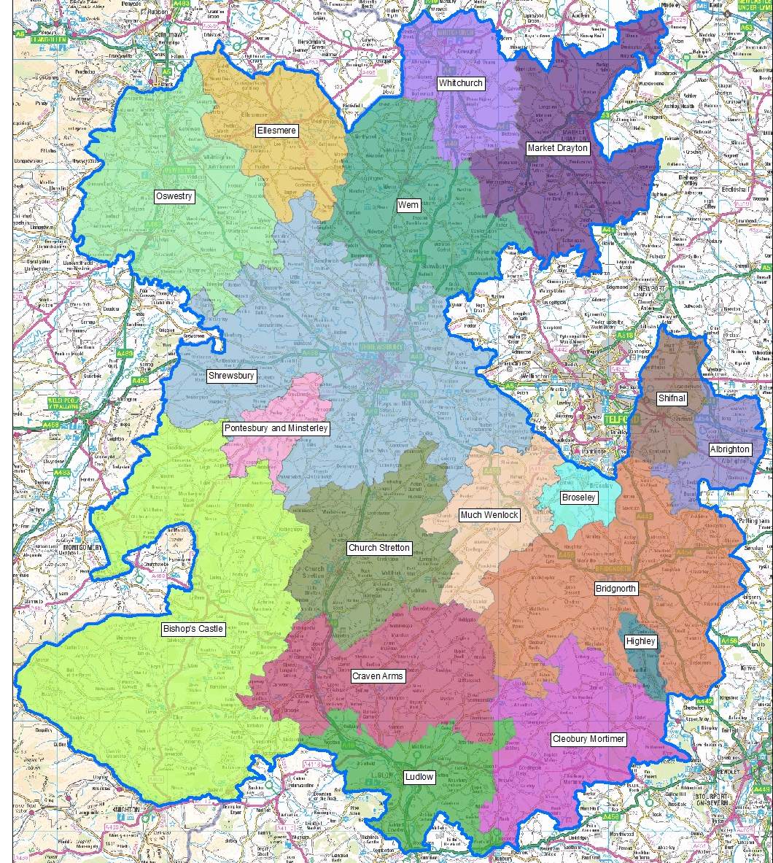
JSNA Place Based Geographies
JSNA’s for Shropshire and Place Plan Areas (PPA)
18 PPA focused mainly on a market town and its surrounding rural communities.
PPA’s are based along geographical/communities' boundaries not political ones.
Capture the uniqueness of the areas in Shropshire.
Identify meaningful local differences and areas of need.

Slide 8
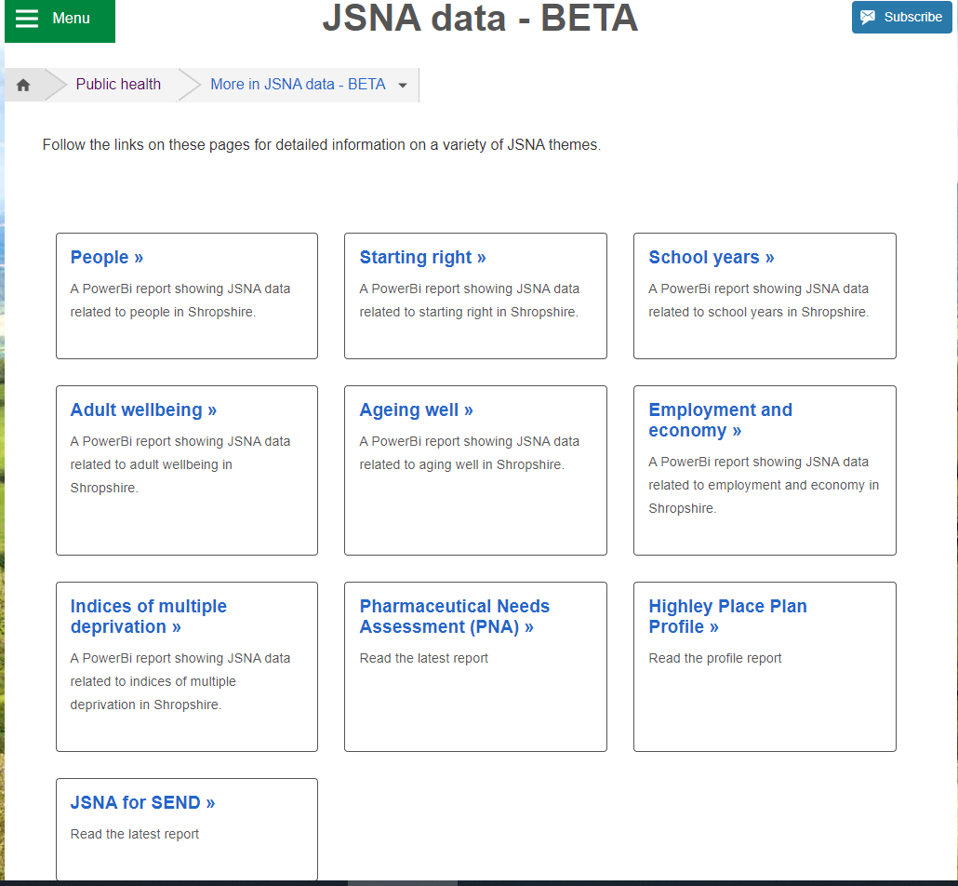
JSNA Web Based Profiler Tool
https://www.shropshire.gov.uk/public-health/jsna-data-beta/
The web-based JSNA is an interactive tool that allows users to explore data relating to health need in Shropshire.

Slide 9
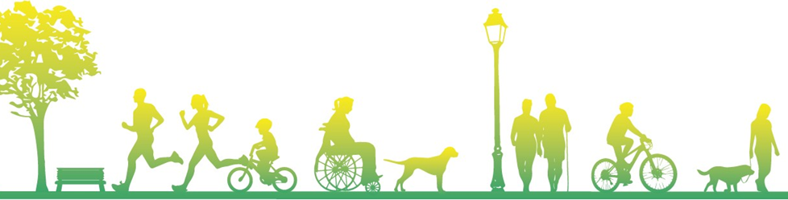
Community Engagement
Stakeholder and Resident engagement via:
  Questionnaires to residents
  Interviews
  Focus Groups
  Attending key meetings/groups

Slide 10

Energize STW
We believe activity improves lives
Our overall purpose as an organisation is to improve quality of life through the benefits of physical activity with our overall ambition to eliminate inactivity.
We want to work collaboratively with partners to create the conditions for an active county.
We will work with those experiencing health inequalities as we know that people experiencing health inequalities are less likely to be active as they face more barriers in achieving an active lifestyle.
Over the next 5 years we’re committed to co-creating place based projects based on insight, providing support to communities most in need to increase movement and activity and reduce inequalities.
The highest positive impact of being active is gained by those who are the least active - we will focus on the 25.2% (68,800) of Shropshire residents who are completely inactive (less than 30 minutes of activity a week) (Sport England, 2022).

Slide 11
Supporting Better Health & Wellbeing
We know that being more active is great for people’s health, but we also know that moving more and being more active is much more than the physical benefits, it enables people to:
access services
meet up with friends and family
connect and be part of the community
access green space and nature
find out what is available and going on in our communities
Seek support
All of which are crucial for better health and wellbeing

Slide 12
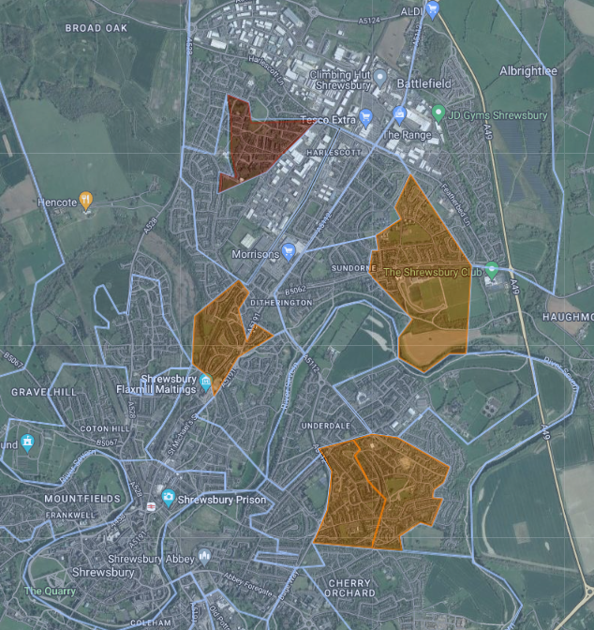
Targeted Working
One of our goals is to create and learn from local projects and programmes where we can have the greatest impact and be able to share learning to influence system change.
We are currently exploring how aspects of an asset-based community development approach and place-based approach, can support us to provide targeted support to the most in need communities.
Data including information health inequalities and IMD identifies that North East of Shrewsbury could benefit from our support and be one of these pilot areas.
We are keen to build on this data and understand further from a whole systems perspective the strengths, opportunities, challenges and barriers in the area and how physical activity can be embedded to encourage better health outcomes.

Slide 13

Shrewsbury Place Plan
Examples of Key Health and Wellbeing Data
Notes:
Intro my role

Slide 14
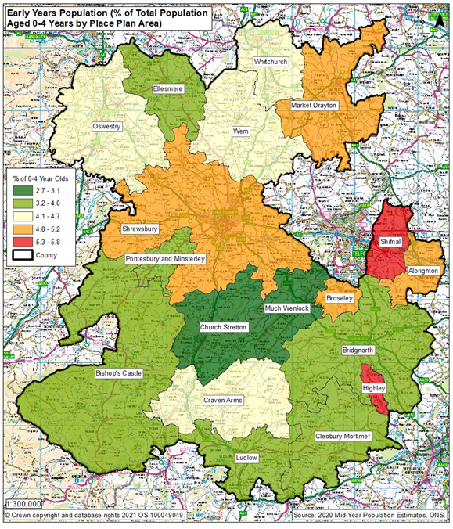
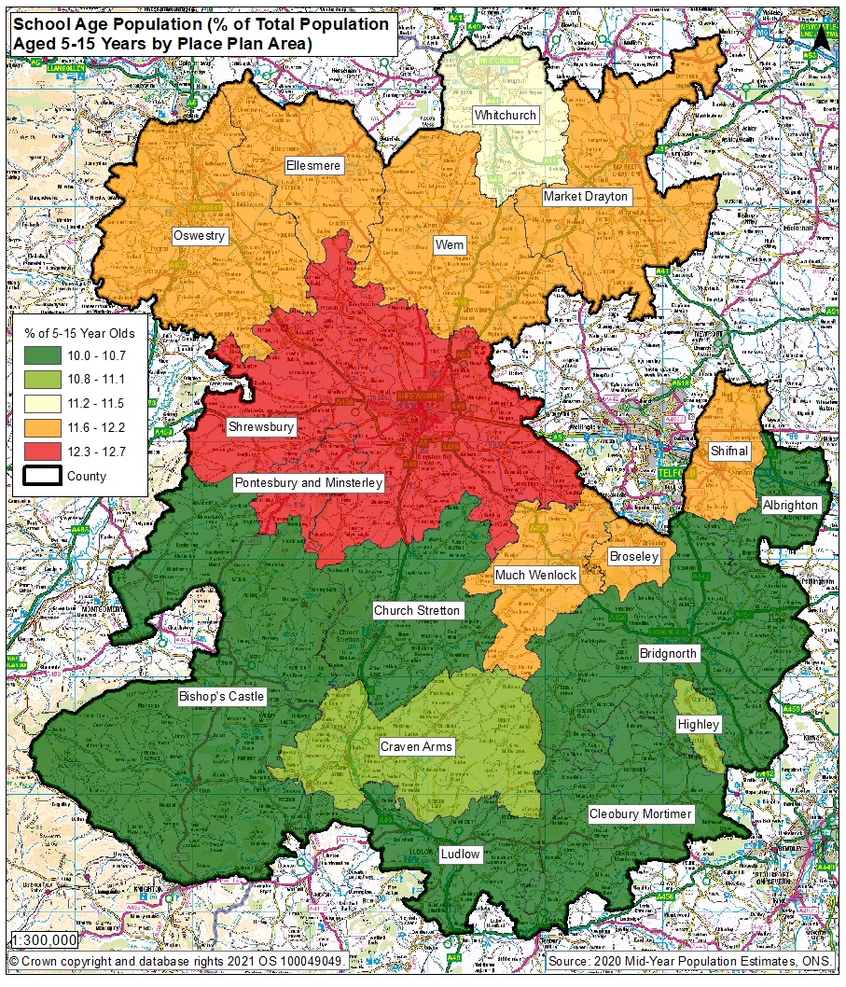
Early Years and School Age Population

Slide 15
Quality & Outcomes Framework (QOF) Indicators 2020/21
Key to colour codes on table
Area is statistically higher for this indicator than Shropshire
Area is statistically similar for this indicator to Shropshire
Area is statistically lower for this indicator than Shropshire
Indicator | Shrewsbury Place Plan Area Eligible population | Shrewsbury Place Plan Area Prevalence for indicator | NHS Shropshire, Telford and Wrekin CCG
AF Prevalence | 105,541 | 2.6% | 2.5%
CHD Prevalence | 105,541 | 3.4% | 3.5%
Heart failure Prevalence | 105,541 | 0.8% | 0.9%
Hypertension Prevalence | 105,541 | 15.0% | 15.6%
Peripheral arterial disease Prevalence | 105,541 | 0.8% | 0.8%
Stroke and transient ischaemic attack Prevalence | 105,541 | 2.4% | 2.4%
COPD Prevalence | 105,541 | 1.7% | 2%
Asthma Prevalence (6+) | 99,525 | 7.7% | 7.1%
Obesity Prevalence (18+) | 85,414 | 6.9% | 7.3%

Slide 16
Smoking in Pregnancy
Source: SATH Maternity Dataset for 2017/18, 2018/19, 2019/20, 2020/21 and 2021/22
Background
Smoking in pregnancy has long been recognised as having significantly negative health impacts for the growth and development of the baby and the health of the mother including complications in labour, miscarriage, still birth, premature birth and low birth weight. Reduced smoking in pregnancy will have health benefits for both mother and child and reduced costs to the NHS.
Methodology
Smoking at time of delivery is the number of mothers known to be smokers at time of delivery as a percentage of all maternities (live or still birth). The Place Plan area figures are based on those mothers who lived in that place plan area who delivered a child at Shrewsbury and Telford Hospitals Trust (SATH). Because there are very few deliveries in some of the place plan areas in one year, these figures are the combination of the last 5 years – 2017/18 to 2021/22. The statistical comparison against Shropshire is a statistical comparison of the two areas to take into account the different number of children in those areas, based on a 95% confidence interval using the Wilson scoring method.
Caveats
The data shown here concerns mothers who delivered a child at SATH only, not mothers from the area who delivered in other hospital providers.
Results
Shrewsbury had 4,213 deliveries in this 5 year period, which is the highest of all place plan areas. The 5 year percentage for smoking at delivery for Shrewsbury (10%) is statistically similar to Shropshire’s (10.7%) – however, digging deeper reveals that the Shrewsbury North East figure was statistically higher than this and Shropshire overall
5 year Smoking at Delivery data for Shropshire and Shrewsbury Place Plan Area, 2017/18 to 2021/22
Indicator | Number of deliveries | Percentage of mothers who were known to be smoking at time of delivery | Statistical comparison against Shropshire
Shrewsbury Place Plan Overall | 4213 | 10.0% | Similar
Shrewsbury North East | 1739 | 14.3% | Higher
Shrewsbury Rural | 713 | 8.0% | Similar
Shrewsbury South | 923 | 7.0% | Lower
Shrewsbury West and Central | 838 | 6.1% | Lower
Shropshire | 9626 | 10.7%

Slide 17
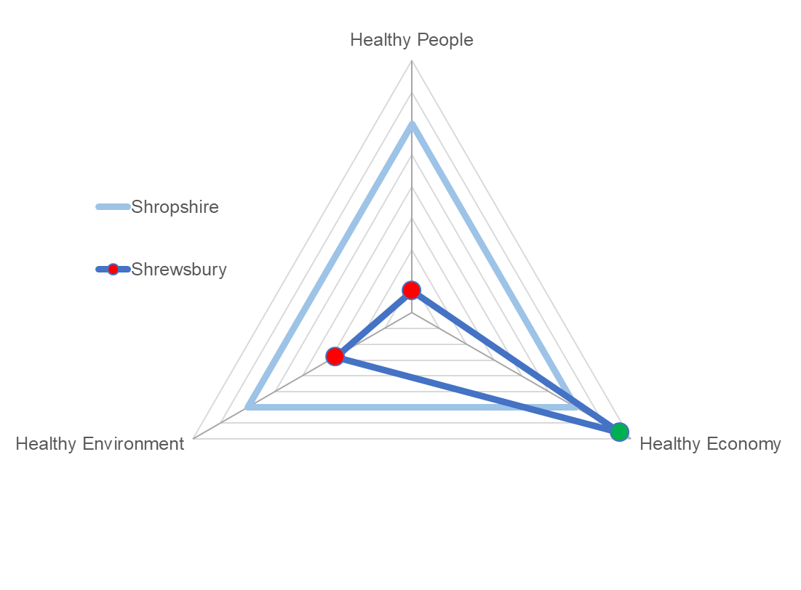

Shrewsbury Health and Wellbeing Index Overview
Compared to Shropshire average:
Better:
Healthy Economy
Worse:
Healthy People
Healthy Environment

Slide 18
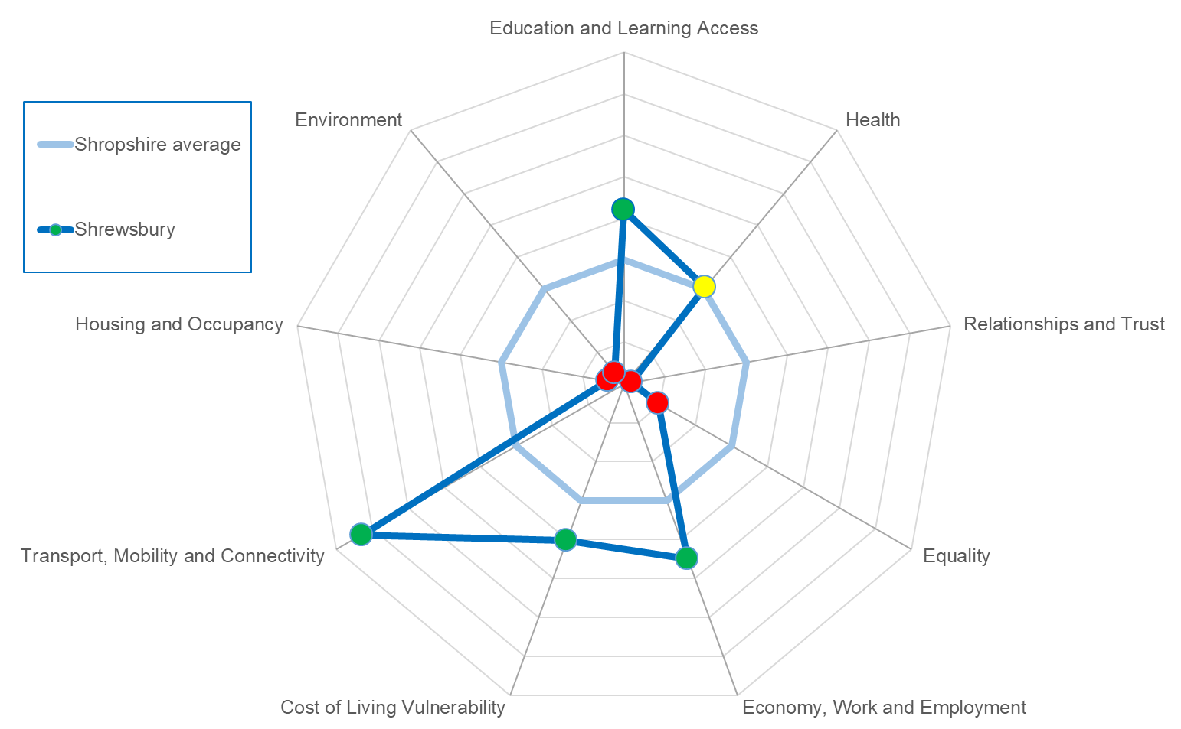
Shrewsbury Health & Wellbeing Index Overview
Identifies where Shrewsbury is stronger or weaker for the specific themes.
Stronger:
Education and learning access
Economy, Work and Employment
Cost of living vulnerability
Transport, Mobility and Connectivity
Weaker:
Housing and occupancy
Environment
Relationships and trust
Equality

Slide 19
Shrewsbury Health and Wellbeing Index Overview

Slide 20
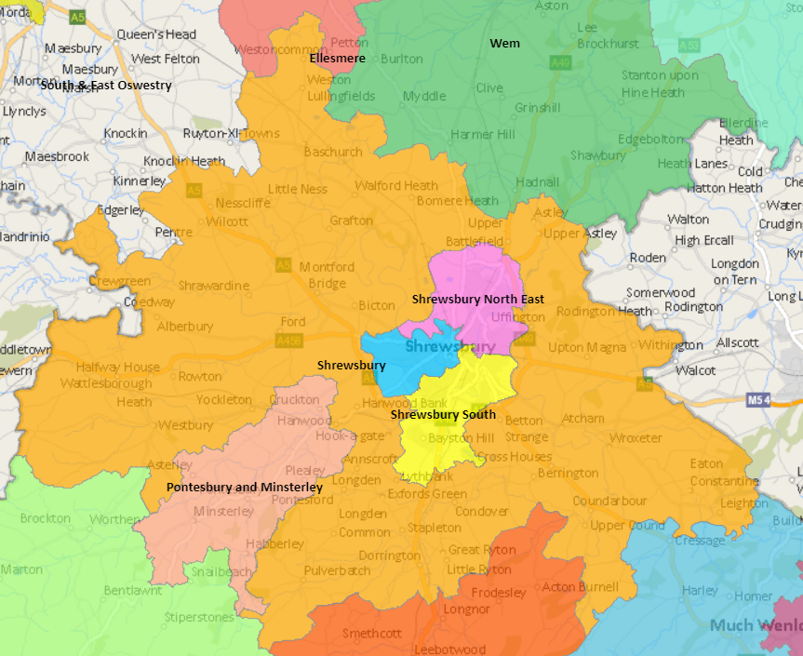
Shrewsbury North East Place Plan Area https://shropshire.maps.arcgis.com/apps/webappviewer/index.html?id=fa75f921e771451382533a854cce6a1e
Notes:
Intro my role

Slide 21
Ranking of Wards in North East Shrewsbury Place Plan Area in metrics
 | Ranking of Ward in Indicator out of 62 wards in Shropshire – lowest number is worse
Indicator | Harlescott | Castlefields and Ditherington | Monkmoor | Sundorne
Unemployment | 1 | 1 | 12 | 3
Child Poverty, English Indices of Deprivation, 2019 | 1 | 2 | 4 | 6
Income deprivation, English Indices of Deprivation, 2019 | 1 | 4 | 2 | 6
IMD Score, 2019 | 1 | 4 | 2 | 5
Long term unemployment | 8 | 4 | 3 | 7
General fertility rate: live births per 1,000 women aged 15-44 years | 2 | 4 | 21 | 5
Low birth weight of live babies | 17 | 24 | 2 | 31
A&E attendances in under 5 years old, three year average | 9 | 20 | 10 | 16
Emergency admissions in under 5s | 13 | 27 | 3 | 11
Emergency hospital admissions for injuries in under 15 years old | 1 | 5 | 39 | 11
RANK OF AVERAGE RANK (lower number is worse) | 1 | 3 | 4 | 5

Slide 22
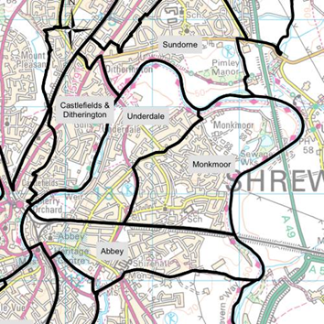
Monkmoor: Report From A Young Resident’s Point
This is a map of Monkmoor and surrounding areas.
It is an area in Shrewsbury that borders Underdale and Abbey. It is built up but also has a large nature reserve with some ponds and a couple of woodlands in which dogs are free to run around.

Slide 23

Monkmoor: Report From A Young Resident’s Point
The Positives
Monkmoor is very close to nature and the outdoors. There are multiple parks and a nature reserve. There is Belvidere secondary school, 2 primary schools and a nursery, it is a well-developed area and I enjoy living there. It is a pleasant area to be in and spend time in, there are many parks to go to, especially with dogs as the parks are quite big and the dogs have space to run around.
The Negatives
However, there are some negatives to living in Monkmoor. The biggest issue is by far teenagers causing anti-social behaviour in and around parks, especially the Upton Lane BMX track which I frequently use. Whilst it’s true that they need somewhere to go to, and the BMX track is a good place, there shouldn’t be littering on the scale that’s it is happening there are more than enough bins, but teenagers do not care. This is likely because no one stops them, they are usually in groups of at least 10 and no one will want to challenge such a large group.

Slide 24
Monkmoor: Report From A Young Resident’s Point
A potential solution to this is getting the police more involved as the police station is just around the corner. If an officer would walk along the main path every hour or so dependent on resources the police has, it would go a long way to helping the problem and would definitely put a lot of faith by the locals into the police.
Another problem is the dealing of drugs, especially marijuana. You do not have to be involved in it to realise it is happening weed when smoked has a distinctive smell which is all to present when around teenagers, especially the older ones. Many of these teens are involved in county line which is the dealing of drugs all throughout the county.
A solution to this is helping these teenagers as victims more than perpetrators. Many of them have gotten into drugs through friends and the main reason why is for money. If we help set up teenagers with jobs, it will help as there won’t be a reason to deal. To overcome addiction, it is best to talk to them and try to break addiction in any way that they are comfortable with. It is worth checking the domestic side of things.
This is because many teenagers have a difficult home life and might struggle with things like school and mental health, possibly parents aren’t supporting their child, or they might be divorced which is harder on the children involved. If teens get the correct support, they need either through school, home or some external place (like professionals, hospitals among many others) it will help them get back into a good life where they can help communities, their family, and the people like them that also need help.

Slide 25
Monkmoor Report From A Young Resident’s Point
Summary
Monkmoor is an amazing place to live and has many opportunities to go outdoors, go to some good schools and feel safe in your community. It is a quiet and peaceful place.
However, like every area in Shrewsbury, it has its flaws. Teenagers need more support from home and from schools to make right choices in life.
The biggest problem in solving this is the problem of resources. Whilst I believe these ideas would solve or at least limit the problems Monkmoor faces, I recognize they would potentially be expensive to fulfil.
If my ideas were used on a small scale and they worked, it would be possible to apply for funding especially as it would stop or at least limit county line.

Slide 26
Community Engagement Survey Results
580 surveys completed during the consultation period
The postcode provided allows us to breakdown the respondent’s home into the smaller Shrewsbury areas:
Wider Place Plan Area | Number of Surveys
Shrewsbury North East | 168
Shrewsbury Rural Area | 62
Shrewsbury South | 150
Shrewsbury West and Central | 135
Postcode blank / unrecognised / out of Shrewsbury place plan area | 65

Slide 27
Survey Respondents: Demographics

Slide 28
Housing by Type: Shrewsbury and North East Shrewsbury Place Plan Areas

Slide 30
England and West Midlands figures from Annual Population Survey, ONS, for year ending March 2022
Shrewsbury figures from local survey

Slide 31
England and West Midlands figures from Annual Population Survey, ONS, for year ending March 2022
Shrewsbury figures from local survey

Slide 32
Thinking generally, which of the things below would you say are the most important in making somewhere a good place to live?
SOME QUOTES
Well funded mental health support
Wages need to be upped
Tight controls on development, new houses architect designed eco houses
Noise pollution of racing cars at night & out of season fireworks
Mental health services and homeless Outreach services
Good communication between local government and the people
Cycling network in Shrewsbury for all ages and abilities
Businesses like Nerdy Coffee Co that provide a safe, welcoming and affordable space for all people, especially vulnerable ones

Slide 33
Thinking about this local area, which things do you think most need improving?
SOME QUOTES
No defibrillators in Meole Brace or Meole Village Traffic congestion at rush hour exiting onto Roman Road from both ends of Meole Village
Houses being built without adequate school places/ GP provision to support the increase in population.

Slide 34
What are the most important factors in making somewhere a good place to live v What needs improving the most in Shrewsbury

Slide 35
What are the most important factors in making somewhere a good place to live v What needs improving the most in North East Shrewsbury

Slide 42
What do you think the biggest issues are regarding health and wellbeing in your area?
SOME QUOTES
Young people’s access to Mental health services
Very poor quality of GP services
If people could include activity in their day eg cycling or walking they would be less sedentary.
Car dependency and lack of sustainable transport options
Car parking at RSH is abysmal, I had to miss an appointment due to nowhere to park. When I returned for the substituted appointment the situation was the same.
Better footpaths, better bike paths

Slide 43
What do you think the biggest health issues are that affect you and your family?
SOME QUOTES
Work stress
Why has the large pool at the Quarry leisure centre still not reopened?
Vaping as above
Supermarket shopping, unhealthy and expensive food
Lack of support for elderly e.g district nurse
Lack of a proper cycle network
Key workers worn down during/since covid.
Finding it hard to walk around the local area to stay active
Access to CAHMS

Slide 44
What do you think the biggest health issues are regarding health and wellbeing in your area v What do you think are the biggest health issues affect you and your family in Shrewsbury

Slide 45
What do you think the biggest health issues are regarding health and wellbeing in your area v What do you think are the biggest health issues affect you and your family in North East Shrewsbury

Slide 46
What do you think are the biggest issues facing children and young people?
Quotes
Children can't cycle to school safely as we used to when we were young - they get driven instead
Crime and feeling unsafe to enjoy the outside
Drugs being all around the town
Lack of respect for society and it’s conventions
Lack of safe cycling routes
Lack of youth provision
Local community hubs needing to close, despite having big huge communities that rely on them
Provide safe cycle routes to give them independence.
Young people not being understood and listened to. They are not involved in development of services which meets their needs. Lack of spaces to access can lead onto issues such as drugs alcohol. exploitation, ASBOs

Slide 47
What needs to be done to support children and young people?
Quotes
Build bike paths so they can get about independently
Improvement in CAHMs & Learning Disability resources
Lack of a proper cycle network
Outside address biodiversity with raised beds fruit trees and seating areas for old people
Schools getting their teachers trained appropriately
Teaching them to be independent
Tell them they are responsible for there own wellbeing not victims of the system or other generations
The fact we are not educating youngsters how to deal with life’s ordeals. We just teach them to say they have mental health issues.
Young people's participation is critical to finding out what they need from their communities

Slide 48
What do you think are the biggest issues facing children and young people v What needs to be done to support children and young people in Shrewsbury

Slide 49
What do you think are the biggest issues facing children and young people v What needs to be done to support children and young people in North East Shrewsbury

Slide 51
Are there challenges for you and your family with regard to being active in your daily life?
OTHER QUOTES
Car park costs for Shrewsbury residents
No local facilities where you can take your child with you while you exercise. Lots of nowhere town's have parent child classes (only for small babies here)
Swimming pool not fit for purpose should of been moved when the price was right delaying projects as such sees the cost spiralling out of control
The Quarry Leisure Centre is in a dire state
Working from home

Slide 52
Group Discussion
What are the key themes for Shrewsbury North East Place Plan Area?
What is already happening around the key themes?
What actions do we need to take to improve the key themes?

