Slide 1

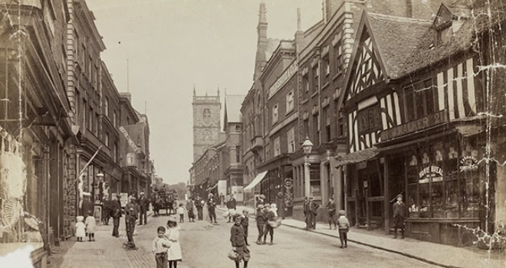
Joint Strategic Needs
Assessment (JSNA) place-based approach
Stakeholder Event – Whitchurch
Notes:
Intro my role

Slide 2


Overview
What is a JSNA
Why and what is a needs assessment?
Initial work to date
Next Steps
Notes:
There are 18 place-based areas through Shropshire, the assets and needs are different in each area and the JSNA process is a way to dig deeper into these needs.
Looking at health data as well as what is on the ground – what agencies say about an area and what people say about area are very different.
We have been working with the Highley area and are formulating an action plan to work with key areas that have arisen i.e. access to services - the Highley GP gave notice on the contract for the current surgery and that has opened an opportunity to work with the PCN to relocate the surgery.

Slide 3

What is a Joint Strategic Needs Assessment?
Local Authorities and CCGs (now ICS) have a legal Statutory Duty to undertake a Joint Strategic Needs Assessment (JSNA), through the health and wellbeing board.
​​
The JSNA seeks to identify current and future health and wellbeing needs in the local population and identify strategic priorities to inform commissioning of services based on those needs. ​
These priorities in turn inform the Health and Wellbeing Strategy and Integrated Care Strategy, key documents as a basis for commissioning health and social care services in the local area. We also believe they should support local partners/communities' priorities.​​
In Shropshire, our JSNA takes three types:​
Web based profiling Tool​
Thematic Needs Assessments - e.g., pharmacy, drug and alcohol and children​
Place Based Needs Assessments

Slide 4

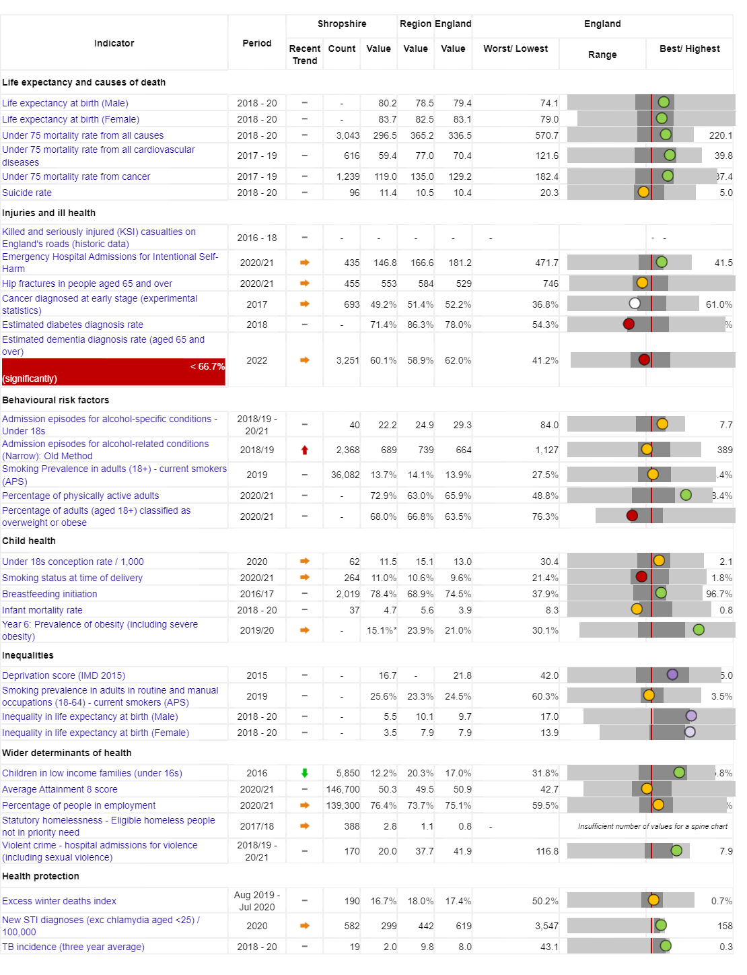
Vision:
For Shropshire people to be the healthiest and most fulfilled in England
Reducing inequalities
Improving Population Health
Working with and building strong and vibrant communities
Joined up working

Slide 5
Today people in Shropshire are living longer, but not necessarily healthier lives…
Measure | England | Shropshire | Range (Ward) | Range (Ward)
IMD Score | 21.7 | 17.2 | 3.7 (Copthorne) | 37.6 (Harlescott)
Life expectancy at birth, (Male) | 79.7 | 80.5 | 75.3 (Sundorne) | 85.8 (Copthorne)
Life expectancy at birth, (Female) | 83.2 | 83.6 | 79.5 (Tern) | 89.6 (Clun)
Deaths all causes, all ages, SMR | 100 | 96.7 | 65.4 (Copthorne) | 145 (Worfield)
Deaths all causes, under 75, SMR | 100 | 89.7 | 55.2 (Clun) | 149 (Sundorne)
Preventable deaths, under 75, SMR | 100 | 85.7 | 48.2 (Corvedale) | 160.6 (Sundorne)
Indicator | Shropshire | England
Healthy Life Expectancy (HLE) Males | 62.8 | 63.1
Inequality in HLE Males | 5.5 | 9.7
HLE Females | 67.1 | 63.9
Inequality in HLE Females | 3.5 | 7.9
Ward | Whitchurch North | Copthorne
Male Life Expectancy | 76.6 years | 85.8 years
Female Life Expectancy | 83.5 years | 87.7 years

Slide 6
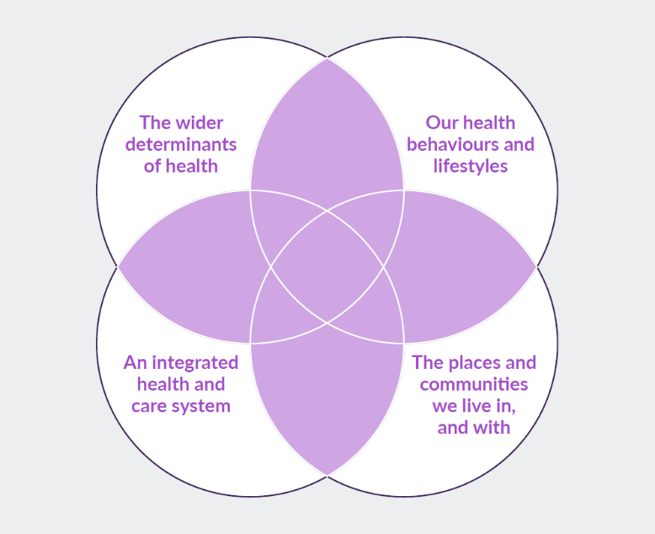
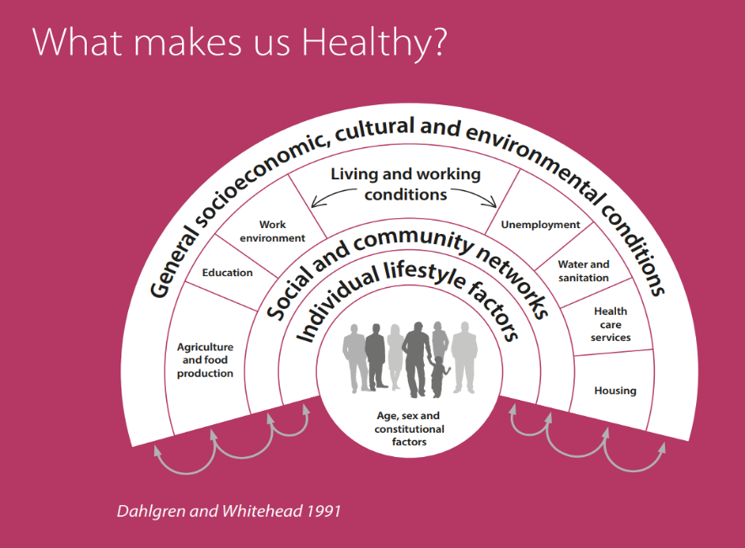
What makes us healthy?
Understanding and Addressing Inequalities
– taking a preventative approach
Health Protection
Understanding our Population Health/Population Health Management (Insight/JSNA)

Slide 7
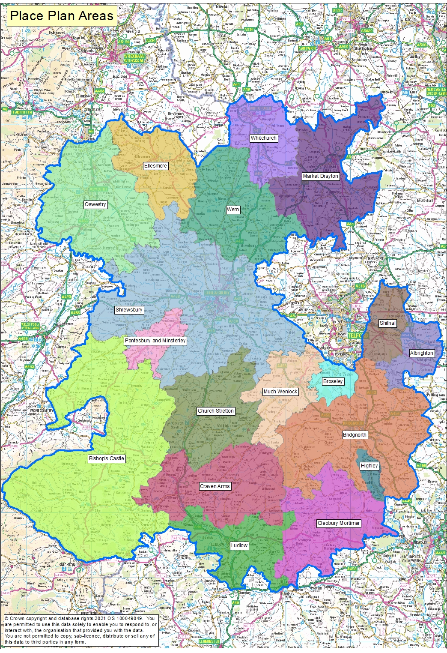
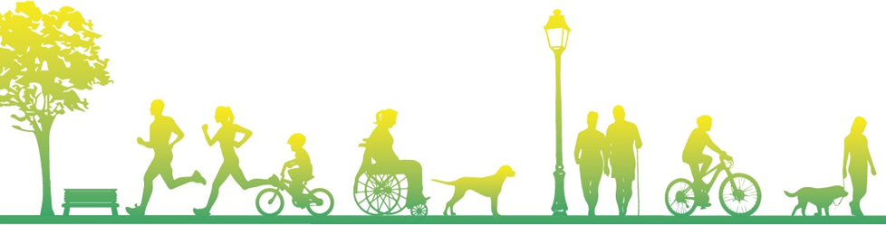
JSNA Place Based Geographies
As well as the overall JSNA for Shropshire, JSNAs are being produced around smaller localities – namely Place Plan Areas
There are 18 place plan areas in Shropshire, usually (not always) focused on a market town and its surrounding rural communities.
Place Plan Areas are based along geographical/communities boundaries rather than political ones
There are enough Place Plan Areas to identify some differences in the areas to help with local planning, but not too many areas where it becomes difficult to identify meaningful differences

Slide 8
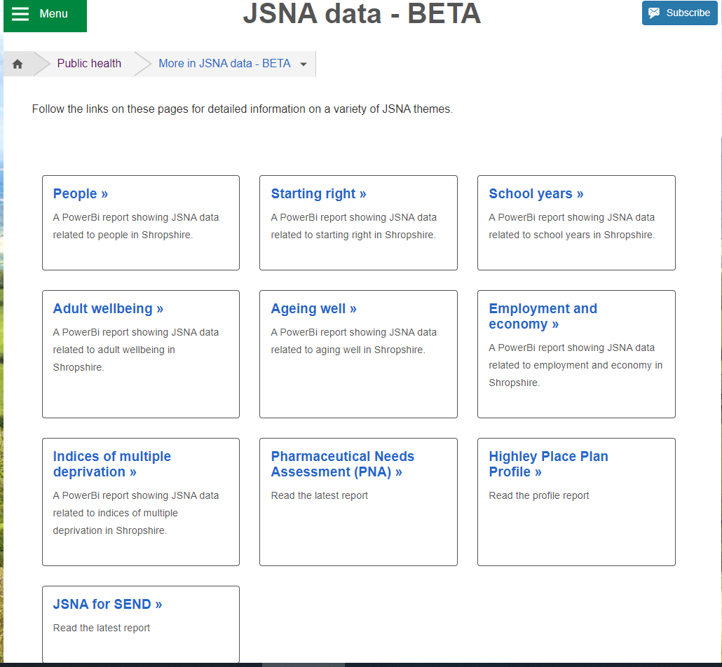
JSNA Web Based Profiler Tool
https://www.shropshire.gov.uk/public-health/jsna-data-beta/
The web-based JSNA is an interactive tool that allows users to explore data relating to health need in Shropshire.

Slide 9

Community Engagement
Stakeholder and Resident engagement via:
  Questionnaires to residents
  Interviews
  Focus Groups
  Attending key meetings/groups

Slide 10

Whitchurch Place Plan
Examples of Key Health and Wellbeing Data
Notes:
Intro my role

Slide 11
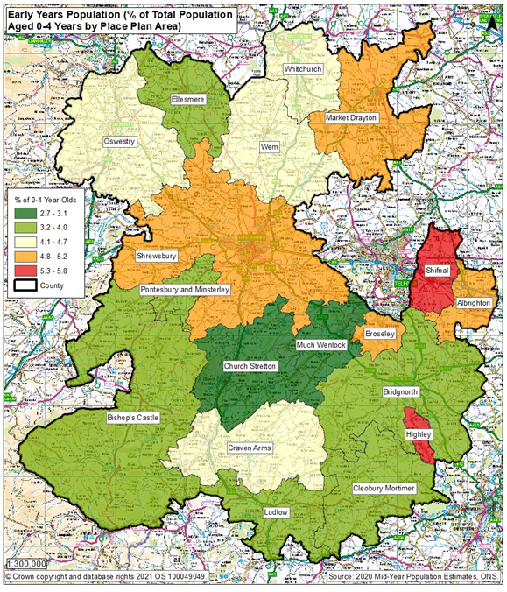
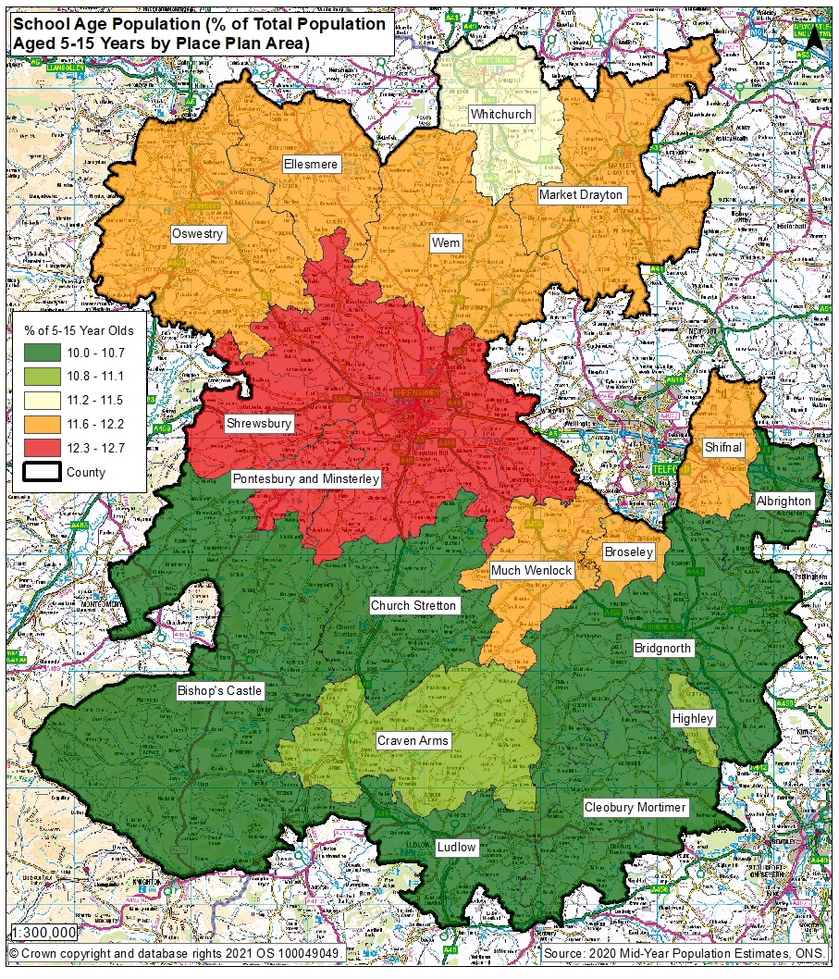
Early Years and School Age Population

Slide 12
Ranking of Wards in Whitchurch Place Plan Area in metrics
 | Ranking of Ward in Indicator out of 62 wards in Shropshire – lowest number is worse
Indicator | Prees | Whitchurch North | Whitchurch South
Unemployment | 33 | 4 | 18
Child Poverty, English Indices of Deprivation, 2019 | 18 | 12 | 37
Income deprivation, English Indices of Deprivation, 2019 | 27 | 11 | 20
IMD Score, 2019 | 7 | 17 | 12
Long term unemployment | 49 | 16 | 30
General fertility rate: live births per 1,000 women aged 15-44 years | 16 | 15 | 26
Low birth weight of live babies | 28 | 12 | 28
A&E attendances in under 5 years old, three year average | 22 | 26 | 39
Emergency admissions in under 5s | 30 | 15 | 26
Emergency hospital admissions for injuries in under 15 years old | 4 | 34 | 37
RANK OF AVERAGE RANK (lower number is worse) | 23 | 16 | 27

Slide 13
Whitchurch Health and Wellbeing Index Overview
The following slides are an attempt to summarise a large amount of data metrics that have been obtained for each place plan area for the JSNA. Due to the wide variety of data obtained, these have been placed into different domains which have had an overall score for each place plan
As time goes on, more data will be obtained to feed into these domains. For example, at present, data on school attainment is not included, only the average distances to get to educational settings.
The two charts on the next slides show whether the domain scores for the place plan area are better or worse than Shropshire.
In the first chart, these domains are “Healthy People”, “Health Environment” and “Healthy Economy”.
The second chart expands these domains further, with the “Healthy People” domain, further broken down to “Education and Learning Access”, “Health” and “Relationships and Trust”. The “Healthy Environment” domain is broken down to “Transport, Mobility and Connectivity”, “Housing and Occupancy” and “Environment”. While the “Healthy Economy” domain feature “Equality”, “Economy, Work and Employment” and “Cost of Living Vulnerability”

Slide 14
Healthy People | Education and Learning | Average Journey Time (Minutes) to Primary school
 | Education and Learning | Average Journey Time (Minutes) to Secondary school
 | Education and Learning | Average Journey Time (Minutes) to Further Education
 | Education and Learning | CYP Sub-domain
 | Education and Learning | Adult Skills
Healthy People | Health | Male LE 2013-17
 | Health | Female LE 2013-17
 | Health | Aggregate conditions for disease prevalence from QOF (AF %CHD %Heart Failure %Hypertension %Peripheral arterial disease %Stroke and transient ischaemic attack %COPD %Asthma (6+) %Obesity (18+) %Musculoskeletal group, osteoporosis (50+) %Musculoskeletal group, rheumatoid arthritis (16+) %)
 | Health | High dependency and other long term conditions score (canc, diab mel, CKD, palliat care)
 | Health | MH and neurology score (dementia, LD, MH, depression, epilepsy)
 | Health | CHILD VAXX AVE UPTAKE %
 | Health | Child weight score
 | Health | Maternal Health score
 | Relationships and Trust | All Crimes Rate per 1,000
 | Relationships and Trust | Pensioners living alone - %
 | Relationships and Trust | % population aged 0-15
Healthy Economy | Equality | Ratio Median/Mean RV
 | Equality | House prices / affordability - Lower Quartile (year end 24th August)
 | Equality | Ratio Income 10/10
 | Equality | IMD: IDAOPI - score
Healthy Economy | Equality | IMD: IDACI - score
 | Economy, Work and Employment | Working age unemployment (%, monthly average)
 | Economy, Work and Employment | Average of Current Rateable Value
 | Economy, Work and Employment | Median Income
 | Economy, Work and Employment | 2020 Dependency Ratio (0-15s and 65+ / 16 to 64 pop)
 | Cost of Living Vulnerability | Income Lower Quartile
 | Cost of Living Vulnerability | September 2021 Claimant Count ONS / DWP
 | Cost of Living Vulnerability | Proportions of households withich are fuel poor 2019, BEIS
Healthy Environment | Transport, Mobility and Connectivity | Local geo barriers score
 | Housing and Occupancy | Median Affordability Ratio
Healthy Environment | Housing and Occupancy | Occupancy rating -1 (%)
 | Housing and Occupancy | Occupancy rating -2 or less (%)
 | Housing and Occupancy | Households with no central heating - per cent
 | Housing and Occupancy | IMD: Barriers to Housing and Services – score
 | Environment | Outdoors sub-domain

Slide 15

Whitchurch Health and Wellbeing Index Overview
Better than the Shropshire average in no measures
Worse than the Shropshire average for measures relating to People, Environment and Economy

Slide 16
Whitchurch Health and Wellbeing Index Overview
This graph provides more detail to the previous slide.
This shows where Whitchurch is stronger or weaker in terms of specific themes within the high-level categories.
For example, whilst overall Whitchurch is weaker specifically in terms of, housing and occupancy; health; relationships and trust; equality and cost of living vulnerability and stronger in measures of environment; education and learning access; economy, work and employment; and Transport, Mobility and Connectivity

Slide 17
Whitchurch Health and Wellbeing Index Overview

Slide 18

Community Engagement Survey Results
236 survey results from the Whitchurch area
179 responses completed in person
57 completed online

Slide 22
England and West Midlands figures from Annual Population Survey, ONS, for year ending March 2022
Whitchurch figures from local survey

Slide 23
England and West Midlands figures from Annual Population Survey, ONS, for year ending March 2022
Whitchurch figures from local survey

Slide 25
“A Whitchurch Sports and Leisure centre with a well-equipped gym, swimming pool, etc would be a huge addition to the town”
“Civic centre is under used”
“There is only one GP practice that is already oversaturated to serve the whole area that’s still growing. There are no cost effective leisure facilities in a reasonable distance/ accessible for the area. “
“We need access to a swimming pool for our children to learn how to swim and for for general health and wellbeing “

Slide 27


Slide 39
Further Comments:
100% better access to local surgery. Better use of our local hospital, which has excellent facilities(new Xray machine) physio dept.etc.
Green spaces an footpaths maintained and not built on or turned into estates.
I feel that Whitchurch, being on the northern edge of the county is often overlooked by Shropshire council, particularly with regard to roads, schools, emergency and health services,
I think it’s time for the council to think about what the locals need rather than what the big businesses want, look after the locals and the locals will look after the town. There is a big community spirit which is being crushed by housing companies not considering the locals it is having a knock on effect on health services and schools and standards are slipping, we could be amazing but instead we are scraping by! Council Tax has risen and we can’t see why we are paying more when we are getting less in return! Our council should be supporting us not making it harder for us to live comfortably
I think making sure the business rates are kept low would also help our town retain their shops, cafes etc which keeps a little hub going. Whitchurch REALLY does require its youth club back, a place they can go, feel safe, maybe talk (especially after covid) and be occupied. The teens at the moment hang about the in the parks, which is fine but then that is where trouble can start.
I would like higher heath to be as considered as much as Whitchurch so that we also get provisions. Signs coming into higher heath from Market Drayton are half hanging, street signs are faded, litter lined all across a41 (I litter pick now to try to limit it), we have 50mph on a41 but were on the ferry route and the noise and vibrations from the speeding lorries is ridiculous, we have no provision here but ongoing houses built, no street lights and yet I believe we pay as much as Whitchurch? I walked down the path to the woods and found a syringe in the bottom area which I didn't know what to do with it as I don't have access to a sharps bin. I've since been back and it's gone. There's dumped waste down there too on the public pathway. Is there any investment proportioned for higher heath?
More doctors. NHS dentist. Swimming pool. Larger supermarket for more choice. Enough nursery places for children
More natural volunteering available for all young and old would be beneficial to help people care for the environment around them reduce litter , improve mental health. Really need something done about dental services but appreciate this is across the regions. I'm not sure how bad the culture of area is in terms of racist views etc as my reference is on community group where you tend to get the loudest speakers so maybe a misrepresentation but it's not always a nice read on there
really value the service from the library but would like longer opening hours.
Swimming pool and leisure centre - why has every other town in England he UK got one?!
The future plan needs to be holistic including all ages and all sectors of the community
There is no money for anything north of Shrewsbury. Whitchurch has no support from the council in terms of housing or infrastructure. There needs to be more bus routes around north Shropshire.
Too much infighting between town councillors, too. Much bullying and not enough transparency
train station not accessible as need to go over a bridge to go to the other side. lack of affordable groups and clubs. opportunities for all levels.

Slide 40
Focus Theme 1 – Health Services
In the survey, the top theme of what is important to Whitchuch residents in terms of making an area a good place to live in was “Health Services”, and this was also the top theme in terms of what can be improved in Whitchurch.
Also, by far the most frequent issue raised around needs at both a community and personal/family level was access to GP services. Issues related to accessing hospital services was often mentioned too. These two had a low number of responses as issues facing children and young people though.
In the top 5 responses for issues in the community and on a personal/family level, as well as issues facing children and young people, that they need support with was around mental health services.
Whilst the health and wellbeing index overview (slide 17) rated Whitchurch as the 2nd worst place plan area for Health, on closer examination of some indicators revealed that the Whitchurch place plan area had the higher prevalence of several diseases according to the GP quality outcomes framework, as well as higher rates of year 6 children being very overweight in the national childhood measurement programme and higher rates of mothers smoking at the time of delivery. Life expectancy in Whitchurch for both males (79.3 years) and females (83.1 years) is below Shropshire’s overall too (80.5 and 84.1 respectively).
"There is only one GP practice that is already oversaturated to serve the whole area that’s still growing"
"Whitchurch cottage hospital is a brilliant facility but the A&e there should be open daily.“
“A persons health also has a knock on effect of job opportunities, although there is supposed to be equal opportunities for all, this doesn’t always seem the case. The support for businesses willing to hire people with hidden disabilities isn’t there which I feel is unfair! “

Slide 41
Focus Theme 2 – Housing and Cost of Living
The health and wellbeing index overview (slide 17) rated Whitchurch as 15th out of 18 for “housing and occupancy” and 16th out of 18 for “cost of living vulnerability”
In the year end up to August 2021, there had been 237 house sales in this area at a median sales price of £222,500, the 5th lowest of the 18 place plan areas, however, median gross household income at this point was £30,395, the 3rd lowest, which gives a median affordability ratio of 7.3 which is the 7th lowest place plan area – i.e. it is slightly easier to buy than it is in Shropshire overall.
However, in the 2011 census, out of all place plan areas, Whitchurch had the joint 3rd highest percentage of households with an occupancy rating of -1 (3.5%) and the joint 2nd highest percentage of households with an occupancy rating of -2 (0.9%) - which implies that a household's accommodation has fewer bedrooms than required),
Whitchurch has the 6th highest percentage of households without central heating at 3.7% compared to 3.3% in Shropshire.
In September 2021, the Whitchurch place plan area had the 3rd highest percentage for claimant count according to the DWP at 4.1%, compared to Shropshire’s 3.3%
In the survey data, the 2nd most mentioned issue in the community and personally/family was the rising costs of living, and this was also mentioned frequently for issues affecting children and younger people.
“'House prices and rent prices go up huge amounts every year but the wags people are on doesn't go up by enough to cover this extra expense. I am lucky enough to have affordable housing scheme where we brought half the house and rent the rest which helped us get onto the ladder. I think we need more opportunities like this and more options for rent to keep the prices affordable..”
“better council housing there's is so many family struggle inadequate housing from either poor maintenance or overcrowding”

Slide 42
Focus Theme 3 – Lack of Activities
While “Activities for Teenagers” was only down as the 4th most selected areas that most needs improving in Whitchurch according to the respondents, in the subsequent question regarding the biggest issues facing children and young people, the most mentioned things were around there being a lack of activities or youth services or out of school, and in the subsequent question about what needs to be done to support children and young people, again the issues related to the lack of activities were the most mentioned, with issues around youth services being the second most mentioned.
Overwhelming response from the survey as the biggest issue facing children and young people was a lack of activities and things to do out of school. In addition, there were a lot of mentions for the lack of youth clubs / youth workers and there needing to be more, and issues to do with sports facilities and also for there to be safe places for them to go. Several people also mentioned that boredom led to unsociable / criminal behaviour..
Whilst over two thirds of respondents said they did not face challenges to being active in their daily life, some of the ones who did have challenges mentioned said that the lack of local facilities in the local area was the second biggest reason, behind the time issue..
“Youth services and access to activities with financial aid to do so..”
" More outdoor activity facilities“
" More facilities such as a swimming pool and youth club activities”
" Facilities lacking since closure of Centre North East in Whitchurch.”

Slide 43
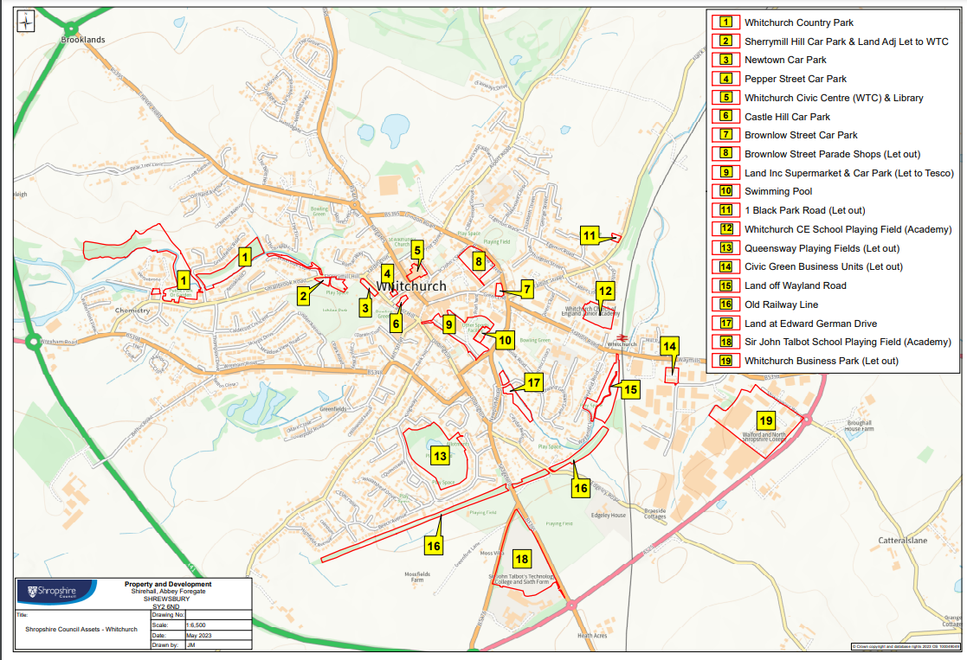

Slide 44
Group Discussion
1. What is happening around each theme already?
2. How are we working with the local population?
3. Recommendations?

