Slide 1

Joint Strategic Needs Assessment (JSNA) Place-based Approach
Stakeholder Event:
Highley

Slide 2


Welcome
Mark Williams – Shropshire Councillor for Highley
Notes:
Intro my role

Slide 3

Overview & Context
Rachel Robinson – Director of Public Health
Notes:
Intro my role

Slide 4

Overview
Why are we all here?
Why and what is a needs assessment?
Why are you here?
Today and moving forward
Notes:
Intro my role

Slide 5
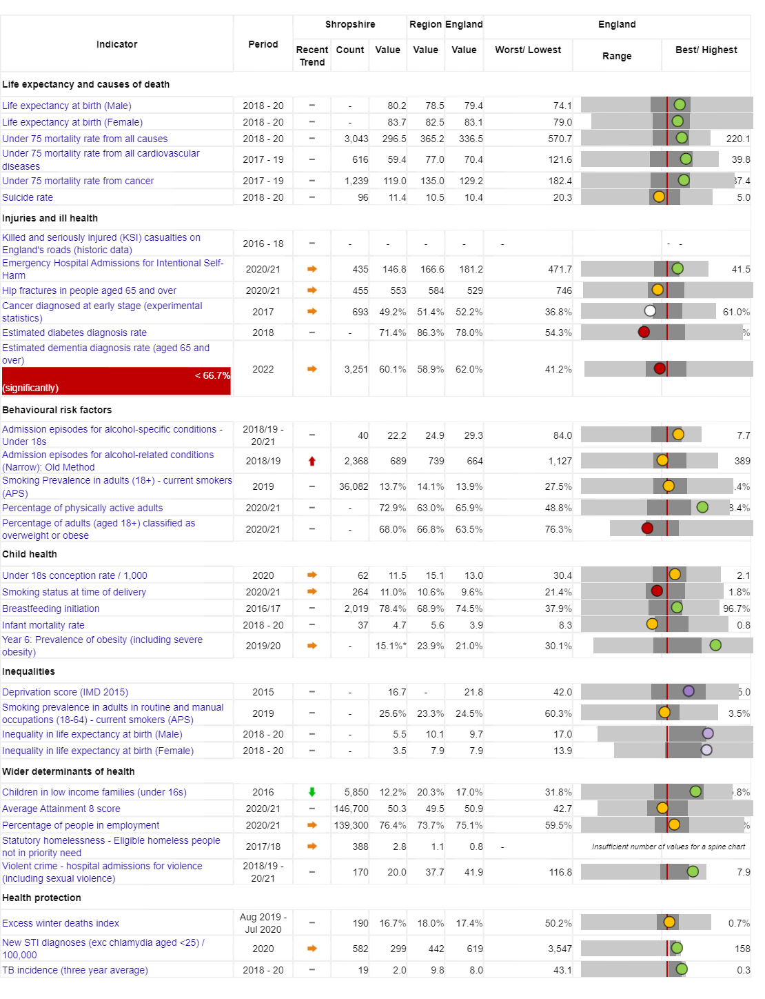

Vision: For Shropshire people to be the healthiest and most fulfilled in England
Reducing inequalities
Improving Population Health
Working with and building strong and
vibrant communities
Joined up working

Slide 6
Today people in Highley are living longer,
but not necessarily healthier lives…
Measure | England | Shropshire | Range (Ward) | Range (Ward)
IMD Score | 21.7 | 17.2 | 3.7 (Copthorne) | 37.6 (Harlescott)
Life expectancy at birth, (Male) | 79.7 | 80.5 | 75.3 (Sundorne) | 85.8 (Copthorne)
Life expectancy at birth, (Female) | 83.2 | 83.6 | 79.5 (Tern) | 89.6 (Clun)
Deaths all causes, all ages, SMR | 100 | 96.7 | 65.4 (Copthorne) | 145 (Worfield)
Deaths all causes, under 75, SMR | 100 | 89.7 | 55.2 (Clun) | 149 (Sundorne)
Preventable deaths, under 75, SMR | 100 | 85.7 | 48.2 (Corvedale) | 160.6 (Sundorne)
Indicator | Shropshire | England
Healthy Life Expectancy (HLE) Males | 62.8 | 63.1
Inequality in HLE Males | 5.5 | 9.7
HLE Females | 67.1 | 63.9
Inequality in HLE Females | 3.5 | 7.9

Slide 7
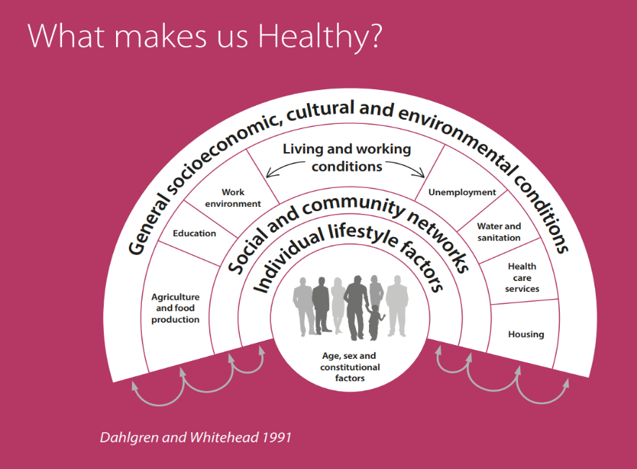
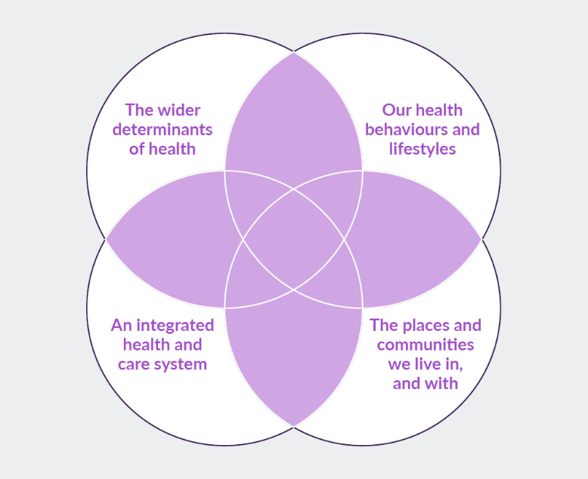
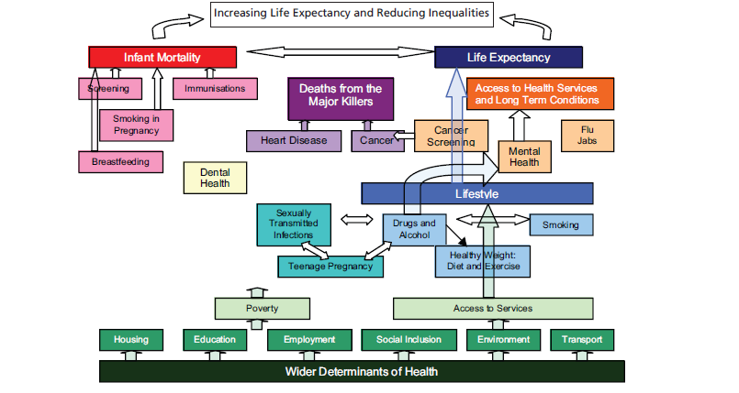
What makes us healthy?
Understanding and Addressing Inequalities – taking a preventative approach
Health Protection
Understanding our Population Health/Population Health Management (Insight/JSNA)

Slide 8
Highley: Joint Strategic Needs Assessment
Local Authorities and CCGs (now ICS) have a legal Statutory Duty to undertake a Joint Strategic Needs Assessment (JSNA), through the health and wellbeing board.
The JSNA seeks to identify current and future health and wellbeing needs in the local population and identify strategic priorities to inform commissioning of services based on those needs.
These priorities in turn inform the Health and Wellbeing Strategy and Integrated Care Strategy, key documents as a basis for commissioning health and social care services in the local area.
The JSNA aims to achieve the following through an evidence base and consultation:
  Identify the health and wellbeing needs of the population of Highley;
  Map the services/assets in the area;
  Define achievable improvements in health and wellbeing outcomes for the local community.
  Target services and resources where there is most need
  Support commissioners, stakeholders and communities to deliver better health and wellbeing outcomes for the local community by making recommendations for how services can be improved / redesigned to make sure they are being delivered to the people who need them most.

Slide 9
Strategic priorities in 2019 and 2020 are highlighted below:
Starting well
Smoking in pregnancy and local
maternity services
Child and adolescent mental health
Educational outcomes for vulnerable
children and young people
School Readiness
LD and Autism
Oral Health
Living well
Alcohol
Healthy Weight including healthy eating,
nutrition and Physical activity
Diabetes
Smoking Cessation
Cardio-vascular Disease
Cancer
Road Traffic Collisions
Mental Health and Suicide
Ageing well
Dementia
Falls and MSK - Link to Physical Activity
End of Life
Isolation
Carers
Frailty
Vulnerable communities
Youth Unemployment
Low Workplace Earnings
Food Poverty
Homelessness
County Lines
Domestic Abuse
Adverse Childhood Experiences
Wider Determinants
Needs assessments were/are produced for those priorities for which a demonstrable and imminent commissioning decision needed to be made.

Slide 10
Shropshire's JSNA – Place based
Priorities place-based from 2019 onwards, focusing on local places/ localities/communities. Why?
Common/shared and best available evidence base
Collectively understand the health and wellbeing needs of communities
Understand the unique needs of people in a given location by working together to gain local knowledge and insight.
Asset-based approach that seeks to highlight the strengths, capacity and
knowledge of all those involved.

Slide 11








“The JSNA should be the source of the spring from which everything flows”
as we are not the providr of this service
The JSNA should be the single source of evidence for place based activity

Slide 12
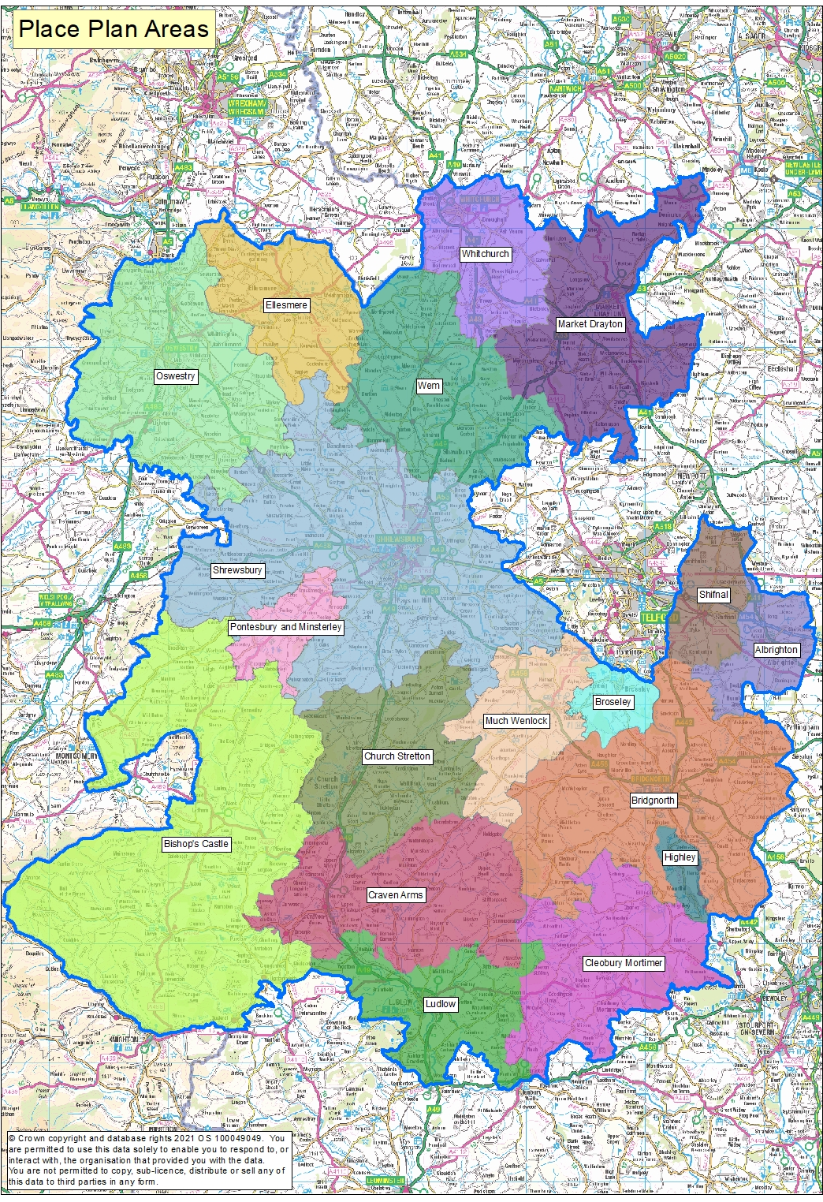
Phase 1: Place Based
As well as the overall JSNA for Shropshire, JSNAs are being produced around smaller localities – namely Place Plan Areas
There are 18 place plan areas in Shropshire, usually (not always) focused on a market town and its surrounding rural communities.
Place Plan Areas are based along geographical/communities boundaries rather than political ones
There are enough Place Plan Areas to identify some differences in the areas to help with local planning, but not too many areas where it becomes difficult to identify meaningful differences
As you can see from the map – Highley is one of the smallest place plan areas

Slide 13
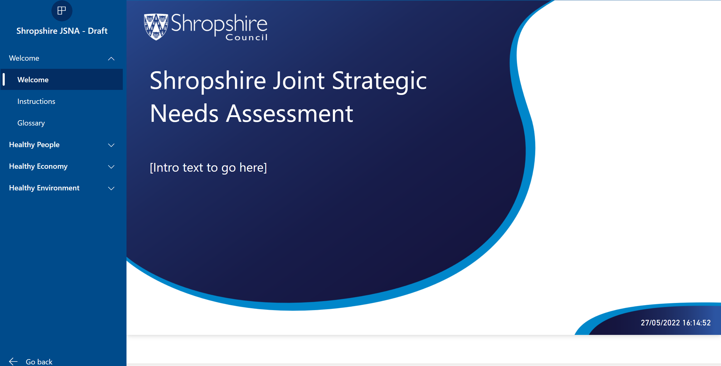
Phase 2 - JSNA Place-based profiler tool

Slide 14




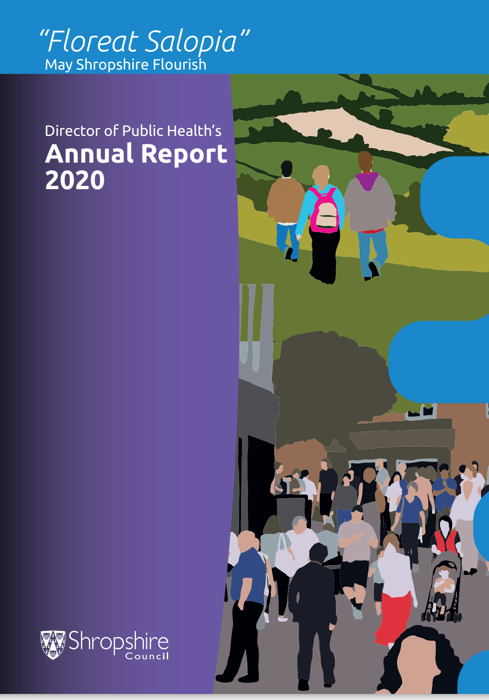
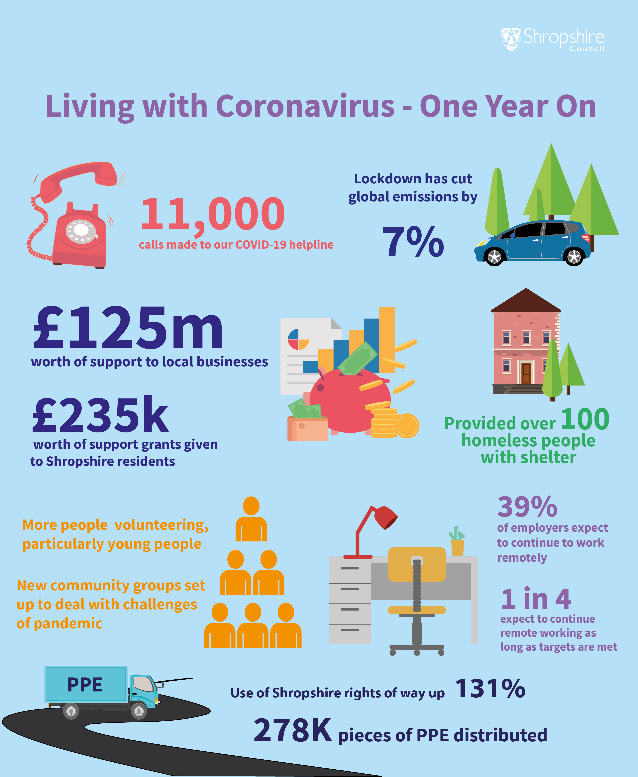
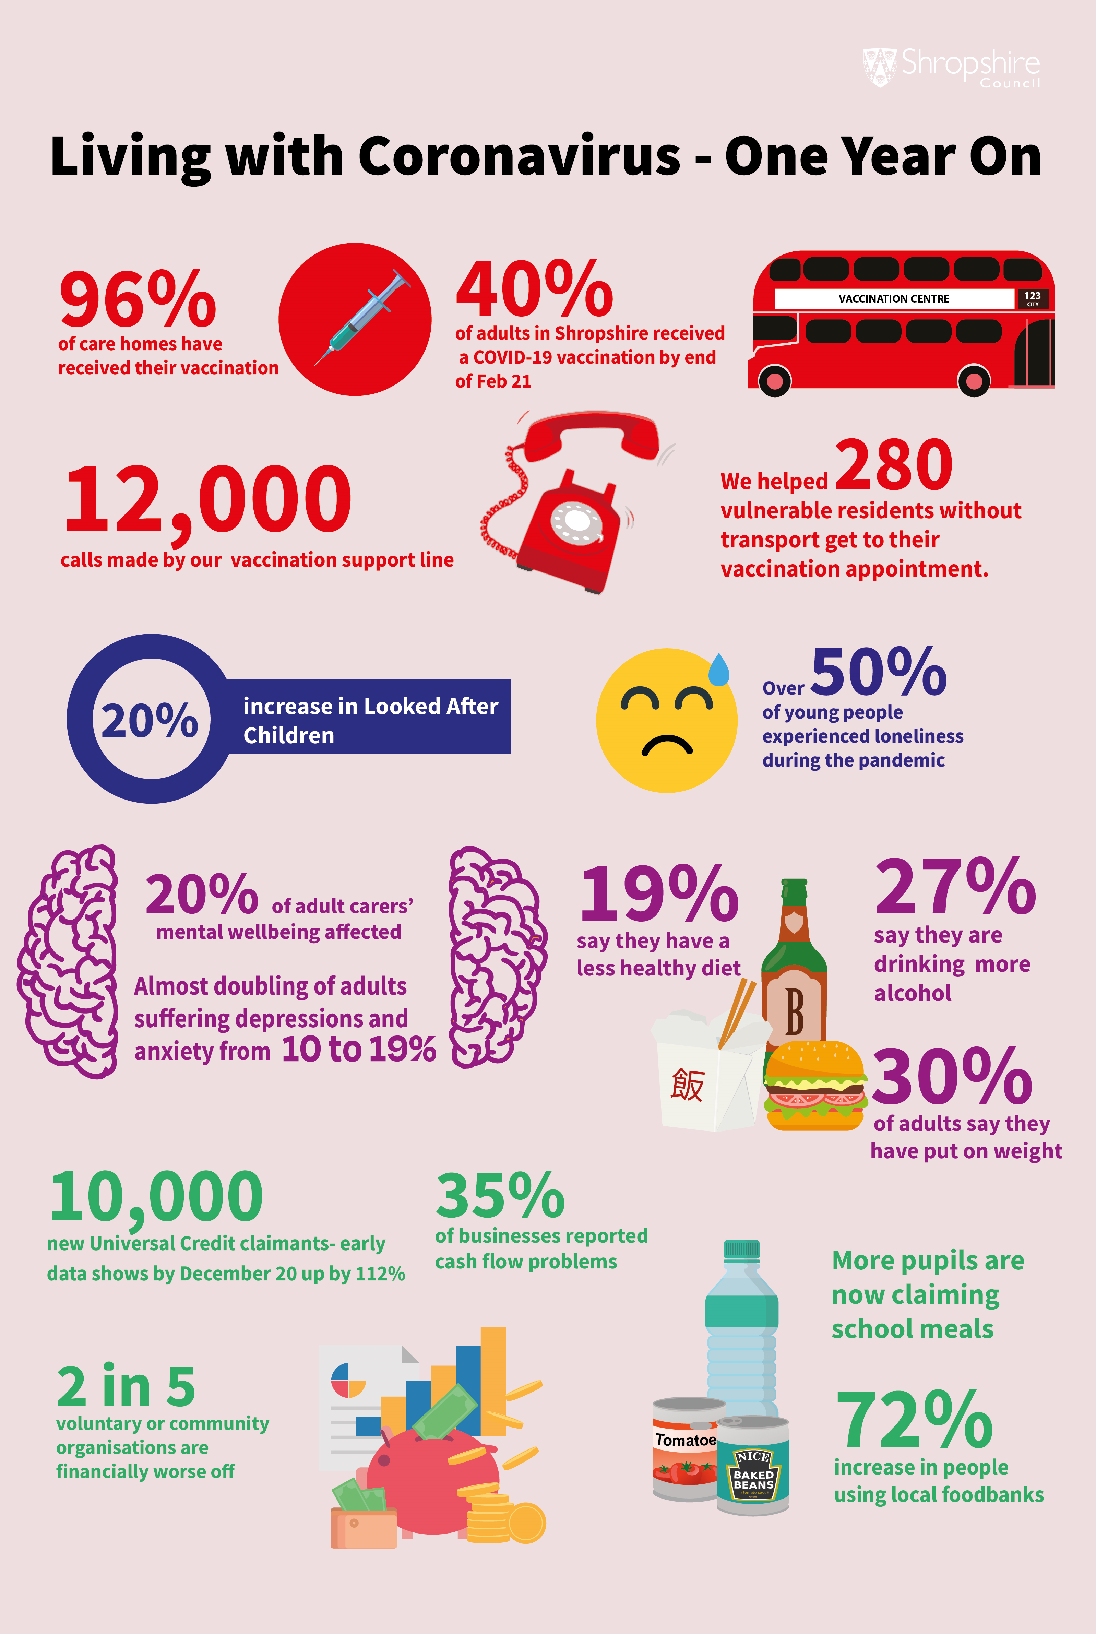
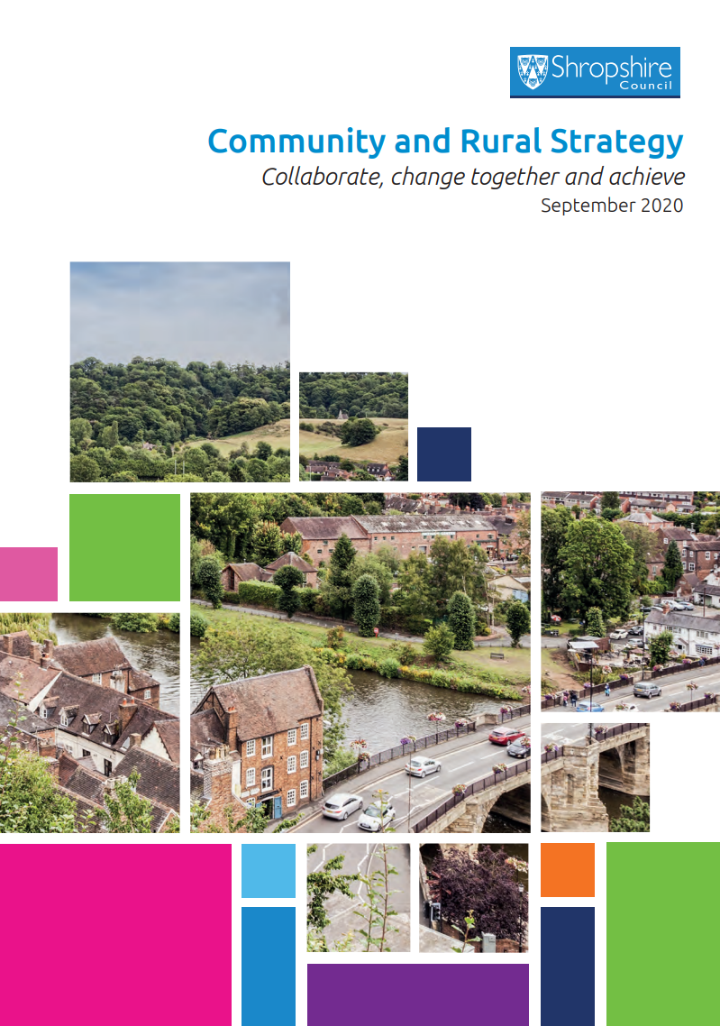
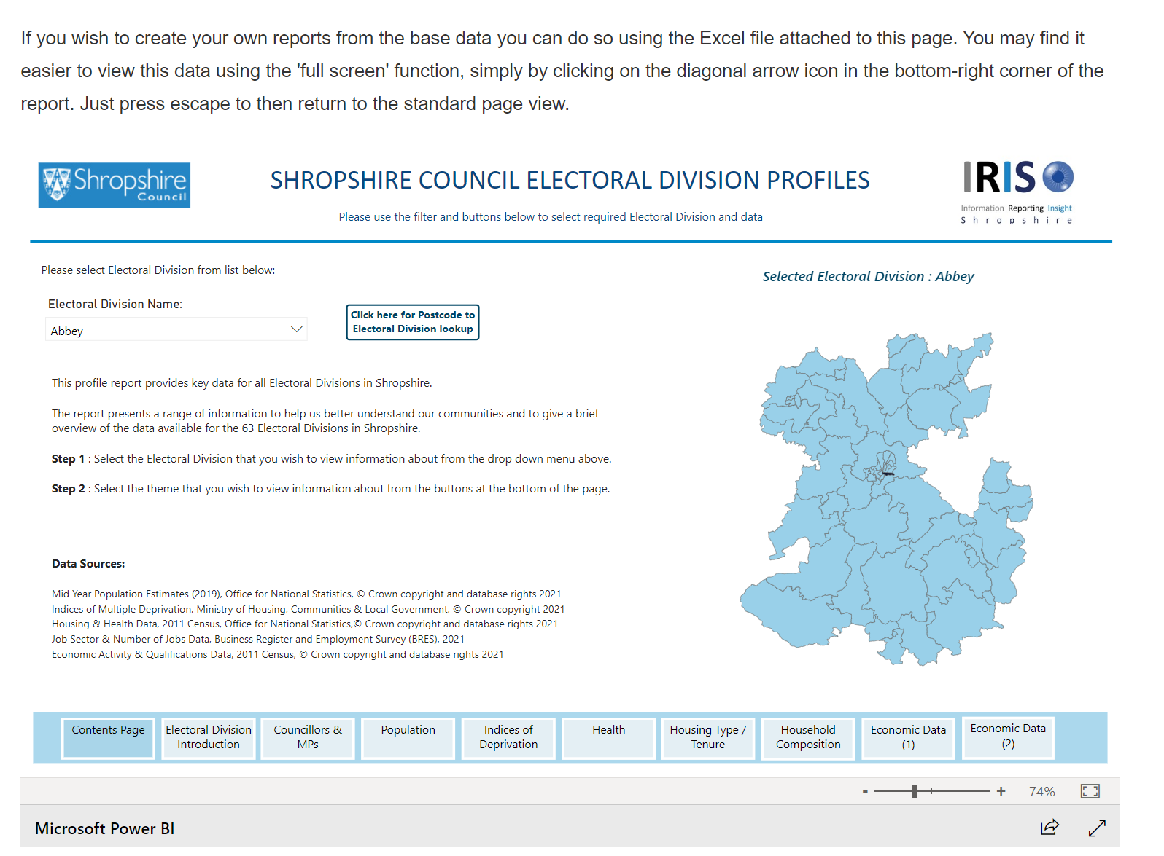
The evidence
Facts & figures

Slide 15
Phase 3 - Place-based Needs Assessments
Production of a set of detailed needs assessments for each JSNA area
  providing strategic planners and commissioners with an in-depth understanding of the specific local needs of each community
  approach is being piloted in Highley
The next step is to agree the most effective method for delivering the detailed needs assessment phase of work
  Including prioritisation, content, resource and ownership
Complete Pilot and agree documentation and approach
  Needs Assessments
  Issues and Recommendations
  Working draft action plan

Slide 16
Phase 3 – 2 Roll Out
This will be a two-year work programme with the main work restarting in summer 2022:
  Highley
  Oswestry (and surrounding)
  Whitchurch(and surrounding)
  Bishops Castle (and surrounding)
  Shrewsbury (and surrounding)
  Ludlow (and surrounding)
  Market Drayton (and surrounding)
  Bridgenorth (and surrounding)

Slide 17
Why are you here?
The evidence
You!! - The key stakeholders
  people with an interest in the area
  Know what's happening in Highley
  Additions – are there gaps?
  Identify key themes
  Develop recommendations for action
Targeted work arising from Needs Assessment
Learning about place based approach & lessons learnt
Starting Point

Slide 18
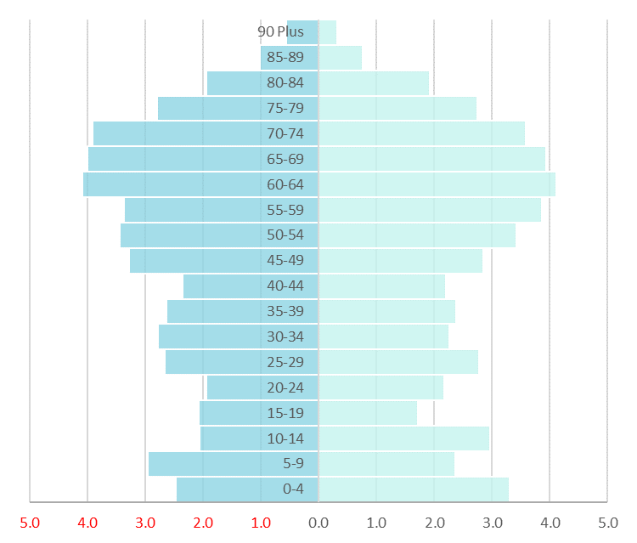
Highley 2020 Population
Female Population
Male Population
Age Group (years) | Highley Place Plan Area |  | Shropshire | England
 | No. | % | % | %
Early Years (0-4) | 250 | 5.8 | 5.7 | 5.7
School Age (5-15) | 481 | 11.1 | 11.8 | 13.5
Working Age (16-64) | 2,405 | 55.6 | 58.7 | 62.3
Older Active (65-84) | 1,805 | 24.8 | 21.7 | 16.0
Older (65 Plus) | 1,189 | 27.5 | 25.0 | 18.5
Elderly (85 Plus) | 115 | 2.7 | 3.3 | 2.5
Total | 4,325
Males | 2,147 (49.6%)
Females | 2,178 (50.4%)
Average Age (mean) | 46 years
Dependency Ratio | 100 independent : 80 dependent
Population Density | 2.2 persons per hectare
Area (Hectares) | 1,965
Urban (hectares) Rural (hectares) | 76.6 (3.9%) 1,888.4 (96.1%)
Notes:
In 2020, highley had very similar % of 0-4 as Shropshire & England, but % in the next too age groups were behind, whilst it has an older population in general – besides 85+ pop – perhaps due to lack of care homes in boundary

Slide 19
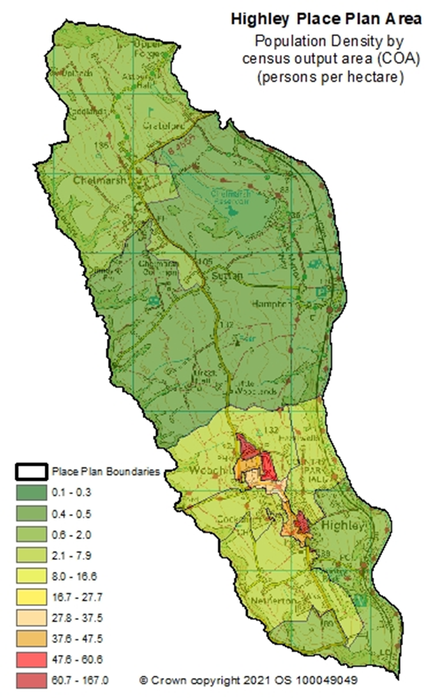
Highley Population Change
 | 2001 pop | 2020 pop | % change in Highley PPA 2001-20 | % change in Shropshire 2001-20 | % of Highley’s population | % of Shropshire’s population
0-4 | 228 | 250 | 9.6% | -2.6% | 5.8% | 5.7%
5-15 | 544 | 481 | -11.6% | -1.2% | 11.1% | 11.8%
18-24 | 215 | 232 | 7.9% | 4.2% | 5.4% | 6.3%
16-64 | 2,386 | 2,405 | 0.8% | 7.4% | 55.6% | 58.7%
65+ | 583 | 1,189 | 103.9% | 58.3% | 27.6% | 25%
65-84 | 543 | 1,074 | 97.8% | 56.4% | 24.8% | 21.7%
85+ | 40 | 115 | 187.5% | 71.5% | 2.7% | 3.3%
Notes:
Small population, although in the 20 year period a 9.6% in 0-4s, a 11.6% drop in 5-15s, 7.9% rise in 18-24s, but most strikingly a 103.9% rise in 65+, 97.8% rise in 65-84 and 85+ - Rise in those older age groups far bigger than Shropshire & England
Highley has a slightly higher % of its population 65+, than Shropshire

Slide 20
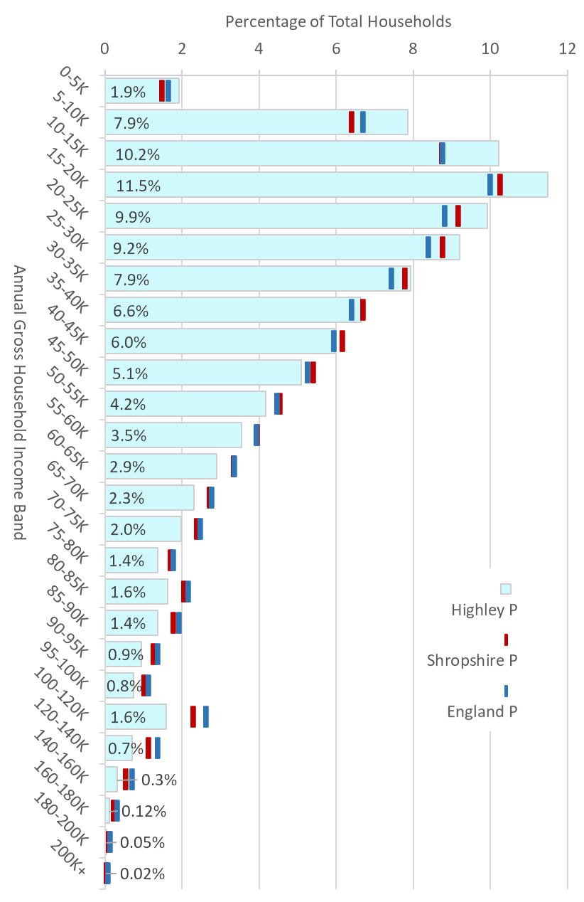
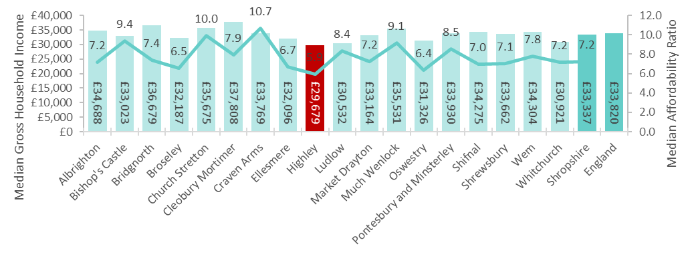
Highley Income Levels
Highley Place Plan Area has a significantly higher percentage of households in the lower income bands between 0-30k. The highest percentage of households (11.5%) fall into the 15-20k household income band.
Highley Place Plan Area has a much lower percentage of households in all income bands exceeding £40k, when compared with Shropshire and nationally. This is most noticeable in the higher income bands.
Highley Place Plan Area has the lowest median housing affordability ratio (5.9) when compared to the least affordable areas in the south west of Shropshire (exceeding 10). This reflects lower median house prices in Highley, combined with the lowest median gross household income levels (£29,679) in Shropshire.
Source: CACI Paycheck Gross Household Income Data, 2020.
Housing affordability is generally measured by using ‘affordability ratios’. These reveal the gap between income / earnings and housing costs in an area. The higher the ratio, the less affordable housing is for households with lower income levels.
Notes:
Annual gross household income levels have a major impact on households having equal access to health and social care services and on their health outcomes. Access to high quality housing options are significantly affected by a households ability to afford suitable housing.
Housing affordability is generally measured by using ‘affordability ratios’. These reveal the gap between income / earnings and housing costs in an area. The higher the ratio, the less affordable housing is for households with lower income levels.

Slide 21
Child Health
Data
Area is statistically similar for this indicator to Shropshire
Indicator | Highley Place Plan Area | Shropshire Overall
Number of deliveries | 194 | 10,282
Percentage of mothers who were known to be smoking at time of delivery | 16.0% | 12.8%
Percentage of mothers who were known to be smoking at time of booking | 17.5% | 14.0%
Percentage of mothers who initiated breastfeeding in first 48 hours | 73.6% | 79.3%
% of mothers of healthyweight at booking | 39.9% | 43.8%
% of mothers obese at booking | 25.9% | 24.1%
% of mothers overweight at booking | 31.1% | 29.8%
% of mothers overweight or obese at booking | 57.0% | 53.9%
Source: SATH Maternity Dataset for 2016/17, 2017/18, 2018/19, 2019/20 and 2020/21
Reception | Highley Place Plan Area | Shropshire Overall
Number of children measured | 242 | 12,908
Healthyweight | 76.4% | 77.3%
Very Overweight | 8.3% | 8.4%
Overweight or Very Overweight | 22.7% | 22.1%
Year 6 | Highley Place Plan Area | Shropshire Overall
Number of children measured | 235 | 12,817
Healthyweight | 73.6% | 68.2%
Very Overweight | 14.0% | 16.5%
Overweight or Very Overweight | 26.0% | 30.7%
Source: National Childhood Measurement Programme for 2014/15, 2015/16, 2016/17, 2017/18 and 2018/19
 | 1 year old |  |  |  |  |  | 2 years old |  |  |  |  |  | 5 years old
Area | Eligible children | DTaP/ IPV / Hib / Hep B % | Men B % | PCV1 % | PCV2 % | Rota % | Eligible children | DTaP/ IPV / Hib / Hep B % | MMR1 % | Hib / Men C % | PCV booster % | Men B % | Eligible children | DTaP/ IPV / Hib % | Hib / Men C % | DTaP IPV booster% | MMR1% | MMR2%
Highley PPA – 19/20 | 50 | 97.7% | 97.7% | N/A | 97.7% | 93.3% | 51 | 97.0% | 98.3% | 98.7% | 98.8% | 98.0% | 52 | 93.9% | 91.9% | 90.9% | 91.5% | 89.1%
Shropshire CCG – 19/20 | 2670 | 96.3% | 96.2% | N/A | 96.9% | 94.3% | 2794 | 96.9% | 94.5% | 94.6% | 94.4% | 93.2% | 2991 | 97.4% | 96.6% | 90.6% | 97.0% | 91.1%
Highley PPA – 20/21 | 49 | 95% | 95% | 96.8% | 94.7% | 93.9% | 50 | 97.8% | 93.4% | 93.4% | 93.5% | 93.5% | 59 | 97.7% | 95.4% | 93.3% | 97.1% | 93.3%
Shropshire CCG – 20/21 | 2597 | 96.6% | 96.5% | 98% | 96.9% | 94.5% | 2715 | 97.2% | 95.0% | 94.9% | 95.0% | 94.5% | 3124 | 97.6% | 95.7% | 90.8% | 96.4% | 91.4%
Source: COVER data 2019/20 and 2020/21, Public Health England

Slide 22
Children’s Data by Family Hub Area
 |  | South East | South West | Central North | Central South | North East | North West | Shropshire
 | No Children 2020/21 | 9,725 | 5,315 | 9,765 | 8,530 | 9,660 | 8,730 | 51,725
Deprivation | CYP aged 5 to 18 living in 20% most deprived quintile relative to Shropshire | 972 | 1,097 | 1,473 | 1,742 | 2,375 | 1,698 | 9,357
 | CYP aged 5 to 18 living in 20% most deprived quintile relative to England | 0 | 203 | 753 | 1,112 | 326 | 339 | 2,733
 | Deprivation (IMD) | 15.1 | 19.5 | 15.5 | 17.1 | 20.2 | 18.3 | 17.1
Safeguarding | Children in need | 113 | 65 | 158 | 177 | 147 | 175 | 835
 | Child protection | 66 | 50 | 135 | 123 | 114 | 126 | 620
 | Looked after children | 74 | 67 | 92 | 114 | 96 | 115 | 563
 | Total | 253 | 182 | 385 | 414 | 357 | 416 | 2,018
Troubled Families | Families | 45 | 32 | 29 | 48 | 43 | 50 | 247
 | Children | 208 | 154 | 136 | 229 | 203 | 226 | 1,156
 | Rate per 1,000 aged 0-18 | 17.3 | 24.6 | 13 | 18.7 | 17.3 | 21.1 | 18.2
Crime | Crime No | 2,490 | 1,508 | 2,599 | 3,913 | 2,579 | 2,294 | 15,383
 | Crime Rate per 1,000 pop | 37.9 | 40.2 | 52.4 | 65.9 | 43.9 | 43.8 | 47.6
 | ASB | 1125 | 560 | 1,111 | 1651 | 996 | 928 | 6,371
 | ASB Rate per 1,000 pop | 14.9 | 17.7 | 22.4 | 27.8 | 19.7 | 17 | 17.1
Domestic Violence | Count | 531 | 297 | 560 | 680 | 644 | 503 | 3,215
 | Rate per 1,000 pop | 8.1 | 7.9 | 11.3 | 11.5 | 11 | 9.6 | 9.9

Slide 23
GP Health Prevalence
Indicator | Highley Place Plan Area | NHS Shropshire, Telford and Wrekin CCG
AF Prevalence | 3.2% | 2.5%
CHD Prevalence | 3.9% | 3.5%
Heart failure Prevalence | 1.2% | 0.9%
Heart failure due to LVSD Prevalence | 0.7% | -
Hypertension Prevalence | 17.9% | 15.6%
Peripheral arterial disease Prevalence | 0.9% | 0.8%
Stroke and transient ischaemic attack Prevalence | 2.7% | 2.4%
COPD Prevalence | 2.4% | 2%
Asthma Prevalence (6+) | 6.1% | 7.1%
Obesity Prevalence (18+) | 4.5% | 7.3%
High dependency and other long term conditions group, cancer Prevalence | 5.1% | 4%
High dependency and other long term conditions group, palliative care Prevalence | 0.3% | 0.4%
Mental health and neurology group, dementia Prevalence | 0.9% | 0.9%
Mental health and neurology group, learning disabilities Prevalence | 0.4% | 0.5%
Mental health and neurology group, mental health Prevalence | 0.5% | 0.8%
Musculoskeletal group, rheumatoid arthritis Prevalence (16+) | 0.8% | 0.9%
High dependency and other long term conditions group, diabetes mellitus Prevalence (17+) | 7.9% | 7.3%
High dependency and other long term conditions group, chronic kidney disease Prevalence (18+) | 5.4% | 5.7%
Mental health and neurology group, depression Prevalence (18+) | 15.8% | 14.5%
Mental health and neurology group, epilepsy Prevalence (18+) | 0.8% | 0.9%
Non-diabetic hyperglycaemia group, non-diabetic hyperglycaemia Prevalence (18+) | 4.8% | 4.6%
Musculoskeletal group, osteoporosis Prevalence (50+) | 0.7% | 0.9%
Key to colour codes on table
Area is statistically higher for this indicator than Shropshire
Area is statistically similar for this indicator to Shropshire
Area is statistically lower for this indicator than Shropshire

Slide 24
COVID Cases Data
Covid 19 - Indicator | Highley Place Plan Area | Shropshire Overall | Highley % v Shropshire
Total Cases | 1,398 | 92,523
Case rate per 1,000 population | 250.4 | 284.3 | Lower
Cases in under 20 population | 404 | 25.314
Case rate per 1,000 population aged under 20 | 369.6 | 382.0 | Lower
Cases in under 60 population | 1,172 | 77,740
Case rate per 1,000 population aged under 60 | 327.1 | 350.8 | Lower
Cases in Over 60 population | 225 | 14,780
Case rate per 1,000 population aged over 60 | 112.5 | 142.4 | Lower
Source: UKHSA Covid-19 situational awareness explorer, specimen dates up to 31/3/22

Slide 25
Index of Multiple Deprivation 2019
The indices of deprivation 2019 provide A set of relative measures of deprivation for small areas (lower-layer super output areas) across England, based on seven different domains of deprivation:
· Income deprivation
· Employment deprivation
· Education, skills and training deprivation
· Health deprivation and disability
· Crime
· Barriers to housing and services
· Living environment deprivation
The index of multiple deprivation overall 2019 combines information from the seven domains to produce an overall relative measure of deprivation.
It is important to note that not all deprived people live in areas with high levels of deprivation and, conversely, not everyone living in a highly deprived area is deprived.
Estimated Population (Mid year estimates 2020) within each National Quintile
Area | Quintile 1 (most deprived) | Quintile 2 | Quintile 3 | Quintile 4 | Quintile 5 (least deprived)
Highley PPA Population | 0 | 2,045 | 527 | 1,753 | 0
Highley PPA Percentage of Total Population | 0% | 47% | 12% | 41% | 0%
Shropshire Population | 15,082 | 69,014 | 117,193 | 79,758 | 44,368
Shropshire Percentage of Total Population | 5% | 21% | 36% | 25% | 14%
Data Sources: Indices of Multiple Deprivation, Ministry of Housing, Communities & Local Government, © Crown copyright 2021
Mid Year Population Estimates 2020, Office for National Statistics, © Crown copyright 2021

Slide 26
Economic Data
Attendance Allowance is paid to people who are ill or disabled after their 65th birthday and who need someone to help them with their personal care.
Area | Highley | Shropshire Council Area | West Midlands | England | Great Britain
Attendance Allowance February 2020 | 128 | 8,781 | 140,181 | 1,211,833
Attendance Allowance February 2021 | 149 | 8,742 | 135,095 | 1,172,543
% Change February 2020 to February 2021 | 16.4% | -0.4% | -3.6% | -3.2%
Number of persons aged 16+ in receipt of carers allowance Feb 2020 | 69 | 3,242 | 94,348 | 761,436
Number of persons aged 16+ in receipt of carers allowance Feb 2021 | 73 | 3,404 | 98,650 | 794,816
% change February 2020 to February 2021 | 6% | 5% | 5% | 4%
Proportion of Households which are fuel poor, 2019 (Source BEIS) | 15.2% | 12.3%
Proportion of 16-64 population claiming universal credit, September 2021 | 10.6% | 10.5% | 15.8% | 14.3%
Number of households on universal credit, May 2021 | 14.5% | 12% |  | 18.4%
Growth in households on universal credit, March 2020 – May 2021 | 90.5% | 86.9% | 76.1% |  | 84.2%
Median Household earnings 2020 (CACI paycheck data) | £29,679 | £33,820 |  | £33,337
Claimant Count for principle reason of unemployment, September 2021 | 4.8% | 3.3% | 6.1% |  | 5%
Source: Department for Work and Pensions

Slide 27
Crime Data

Slide 28
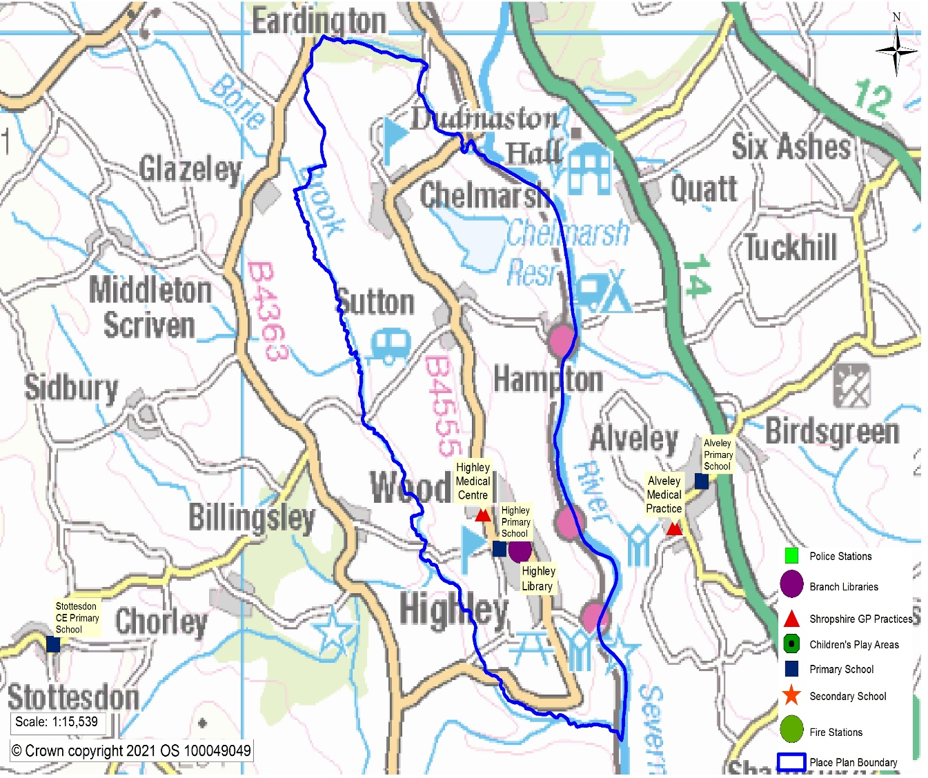
Transport Data
Average Journey Time (Minutes) | Area | Highley | Shropshire | England
Primary school | Public Transport/On foot | 19.5 | 13.1 | 9.3
 | Cycling | 13.6 | 10.4 | 8.7
 | By Car | 8.8 | 8.1 | 7.7
Secondary school | Public Transport/On foot | 36.5 | 29.3 | 18.4
 | Cycling | 40.6 | 22.3 | 14.2
 | By Car | 18 | 12.7 | 10.5
Further education | Public Transport/On foot | 35.5 | 36.7 | 21.4
 | Cycling | 41.9 | 33.7 | 17.1
 | By Car | 19.3 | 17.1 | 11.8
GP surgery | Public Transport/On foot | 18 | 20.5 | 12.9
 | Cycling | 13.5 | 15.8 | 10.9
 | By Car | 9 | 10.2 | 8.6
Hospital | Public Transport/On foot | 57.5 | 64 | 39
 | Cycling | 77.9 | 71.5 | 33.9
 | By Car | 30.8 | 28.6 | 19.6
Food store | Public Transport/On foot | 16.8 | 15.7 | 8.9
 | Cycling | 12.5 | 12.2 | 8.8
 | By Car | 8.1 | 8.4 | 7.4
Town centre | Public Transport/On foot | 35.9 | 29.9 | 20.6
 | Cycling | 41.6 | 26.8 | 17.4
 | By Car | 19.4 | 14.6 | 12.1

Slide 29
Reviewing Community Engagement
Hannah Thomas – Community Wellbeing Manager
Chris Hirons – Community Wellbeing Outreach Officer
Notes:
The Health and Well-being Board has membership from Shropshire Council, Shropshire Clinical Commissioning Group (CCG), Healthwatch Shropshire, the Voluntary and Community Sector Assembly (VCSA) and the NHS Local Area Team. The Board is Co-chaired by Cllr. Lee Chapman and Dr Julian Povey from the CCG

Slide 30
Q1. How are people feeling?
81% of respondents are satisfied with their lives (8 and above)
78% of respondents feel their lives are worthwhile (8 and above)
59% of respondents felt happy yesterday (8 and above)
16% of respondents felt anxious yesterday
Notes:
Satisfaction with their life – 15 replies gave rating of 7 or below for satisfaction
Have a worthwhile activities – 7 replied gave rating of 7 or below

Slide 31
Q2. What’s A Nice Place to Live?
Top 3 things that make somewhere a nice place to live –
  Shopping Facilities
  Health Services
  Access to Nature
Notes:
Intro my role

Slide 32
Q3. Where can Highley Improve?
Top three things that respondents want to see improved in Highley –
  Road and Pavements
  Health Services
  Activities for Teenagers
Notes:
Intro my role

Slide 33
Key Stakeholder comments on where can Highley Improve?
“Health services should come first; particularly the capacity of the system in Highley”
“Shrewsbury is 20 mile away and there is no direct service to this location – Highley is served by Diamond Buses which are based in the West Midlands – it is easier for residents to travel out of the county than it is to travel within Shropshire for healthcare, education and employment.”
“The main hubs or Highley residents are Bridgnorth and Kidderminster due to where C&YP attend school”

Slide 34
Q4. The Biggest Health & Well-being
Issues In Highley
Overwhelmingly consistent issue raised is access to health services
(GP & Specialist Care)
The next highest issues, with equal ranking are:
  Mental Health
  Lack of Exercise Opportunities
  COVID
Notes:
Intro my role

Slide 35
Key Stakeholder comments on The Biggest Health & Well-being Issues In Highley
“Many patients go to Cleobury”
“A fundamental part of positive health & wellbeing is the need to feel safe & secure in your home and local environment; driven by perceived risk of harm and the reality of crime rates in the village”
“For the past 2 years the school has bought into external services that offer mental health help & advice and can fast track some issues to be able to access specialist services. We also have a trained mental health lead that deals with low level mental health issues. We feel that this is very important, especially in the teaching sector where stress is the highest factor for absence.”
Notes:
Intro my role

Slide 36
Q5. Biggest Personal Health & Wellbeing Challenges
The biggest health issues that affect respondents and their families
  COVID
  Mental Health
  Access to GP
Notes:
Intro my role

Slide 37
Key Stakeholder comments on the Biggest Personal Health & Well-being Challenges
“We are aware of the increased need to support our community with MH related issues and are aware that this demand puts a strain on agencies in Shropshire.”
Regarding Mental Health – “Services for young children are overwhelmed and it is difficult to get immediate advice. Waiting lists are getting longer & longer & therefore the children & parents are not getting the help they need.”
Notes:
Intro my role

Slide 38
Q6. Biggest Issues facing Young People
The top three issues raised by Respondents are:
  Lack of groups & things to do
  Social Media Influence
  Mental Health
Notes:
Intro my role

Slide 39
Key Stakeholder comments on the Biggest Issues facing
Young People
“Youth ASB issues can be perceived issues, based on the mere presence of youths rather than their behaviour”
“Teenage boredom can lead to disruptive behaviour… …though those responsible are a very small minority”
“Highley has a higher-than-average number of SEN students and those eligible for free school meals”
Notes:
Intro my role

Slide 40
Q7. What Improvements are needed for Children
& Young People?
Overwhelming response identified perceived need for more affordable activities
Respondents also suggested:
  Improving Public Transport
  Opportunities for them to be listened to
Notes:
Intro my role

Slide 41
Key Stakeholder comments on What Improvements are needed for Children & Young People?
“A great thing about Highley is its strong team of volunteers,”
“Highley lacks safe places for young people to relax, be themselves and just hang out”
“Social Media issues and Mental Health for C&YP go hand in hand – many YP’s mental health is impacted by their engagement with social media, however they are more likely to become dependent on social media if the provision of alternative activities is inadequate.”
“Children need to get outside more but then there needs to be activities & facilities available to them to allow this”
Notes:
Intro my role

Slide 42
Healthy Eating
The overwhelming majority of respondents shared that they do not face challenges in eating healthily – 64%
Challenges faced by some respondents include:
  Cost – 6.8%
  Preferring unhealthy food – 5.5%
Notes:
Intro my role

Slide 43
Challenges to Being active
64% of respondents do not face challenges to being active in their daily life
An underlying health condition is a barrier to an active daily live for 11% of respondents
Notes:
Intro my role

Slide 44
Other Stakeholder Comments
“the concerns raised in the survey by the community mirror the feedback I received on the door while campaigning”
“The primary school is community led & tries to engage with parents & the wider community as much as possible. Each year the school relies on seeking grants and external funding to purchase the enhanced equipment for teaching & learning.”
Notes:
Intro my role

Slide 45
Emerging Trends & Priorities
Notes:
Intro my role

Slide 46
Transport
Primary Care
Children and Young People
Mental Health
Notes:
Intro my role

Slide 47
Group Discussion
What is already happening around each priority?
Recommendations?
Notes:
Intro my role

Slide 48
Closing Remarks
& Next Steps
Notes:
Intro my roleContinue to roll out the JSNA
Learning and feedback on the session is very important too

Slide 49
Thank you
Notes:
Intro my role

