Slide 1

Joint Strategic Needs
Assessment (JSNA) place-based approach
Stakeholder Event: Bishop’s Castle
Notes:
Intro my role

Slide 2


Overview
What is a JSNA
Why and what is a needs assessment?
Initial work to date
Next Steps
Notes:
There are 18 place-based areas through Shropshire, the assets and needs are different in each area and the JSNA process is a way to dig deeper into these needs.
Looking at health data as well as what is on the ground – what agencies say about an area and what people say about area are very different.
We have been working with the Highley area and are formulating an action plan to work with key areas that have arisen i.e. access to services - the Highley GP gave notice on the contract for the current surgery and that has opened an opportunity to work with the PCN to relocate the surgery.

Slide 3

What is a Joint Strategic Needs Assessment?
Local Authorities and CCGs (now ICS) have a legal Statutory Duty to undertake a Joint Strategic Needs Assessment (JSNA), through the health and wellbeing board.
​​
The JSNA seeks to identify current and future health and wellbeing needs in the local population and identify strategic priorities to inform commissioning of services based on those needs. ​
These priorities in turn inform the Health and Wellbeing Strategy and Integrated Care Strategy, key documents as a basis for commissioning health and social care services in the local area. We also believe they should support local partners/communities' priorities.​​
In Shropshire, our JSNA takes three types:​
Web based profiling Tool​
Thematic Needs Assessments - e.g., pharmacy, drug and alcohol and children​
Place Based Needs Assessments

Slide 4
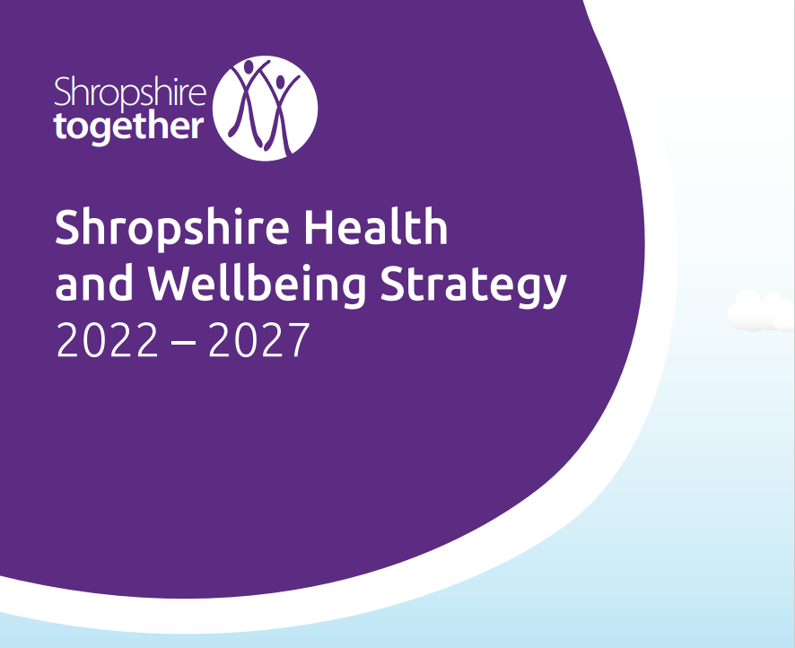
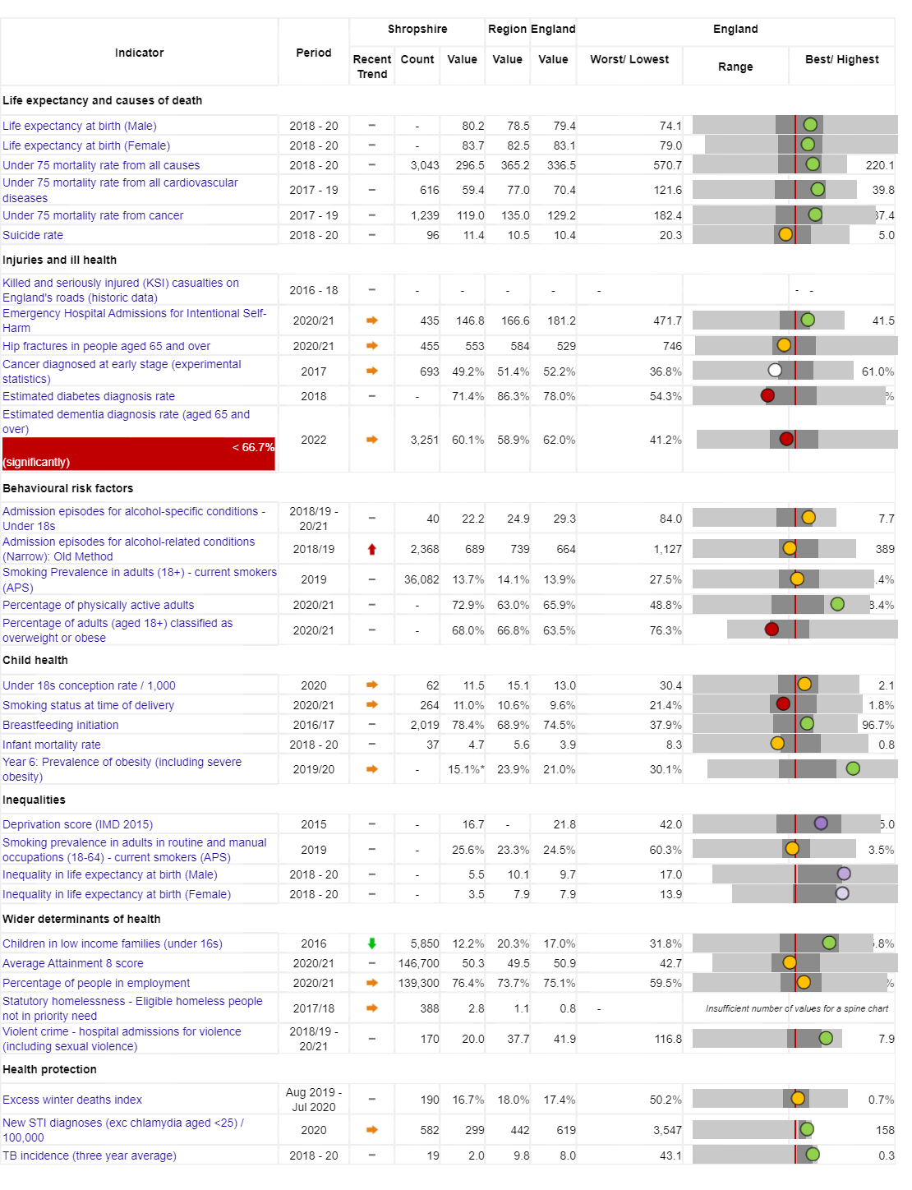
Vision:
For Shropshire people to be the healthiest and most fulfilled in England
Reducing inequalities
Improving Population Health
Working with and building strong and vibrant communities
Joined up working

Slide 5
Today people in Shropshire are living longer, but not necessarily healthier lives…
Measure | England | Shropshire | Range (Ward) | Range (Ward)
IMD Score | 21.7 | 17.2 | 3.7 (Copthorne) | 37.6 (Harlescott)
Life expectancy at birth, (Male) | 79.7 | 80.5 | 75.3 (Sundorne) | 85.8 (Copthorne)
Life expectancy at birth, (Female) | 83.2 | 83.6 | 79.5 (Tern) | 89.6 (Clun)
Deaths all causes, all ages, SMR | 100 | 96.7 | 65.4 (Copthorne) | 145 (Worfield)
Deaths all causes, under 75, SMR | 100 | 89.7 | 55.2 (Clun) | 149 (Sundorne)
Preventable deaths, under 75, SMR | 100 | 85.7 | 48.2 (Corvedale) | 160.6 (Sundorne)
Indicator | Shropshire | England
Healthy Life Expectancy (HLE) Males | 62.8 | 63.1
Inequality in HLE Males | 5.5 | 9.7
HLE Females | 67.1 | 63.9
Inequality in HLE Females | 3.5 | 7.9
Ward | Bishop’s Castle | Copthorne
Male Life Expectancy | 80.3 years | 85.8 years
Female Life Expectancy | 88.1 years | 87.7 years

Slide 6
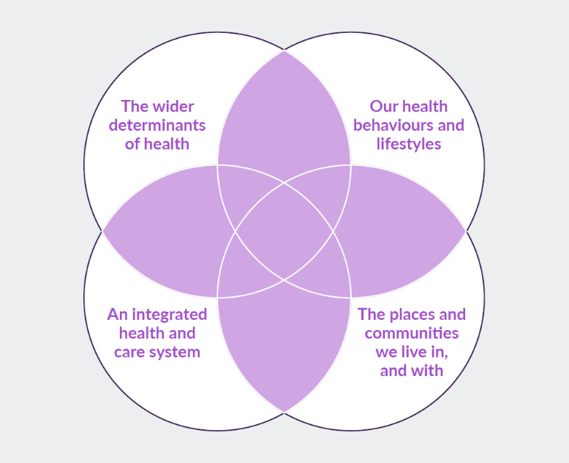
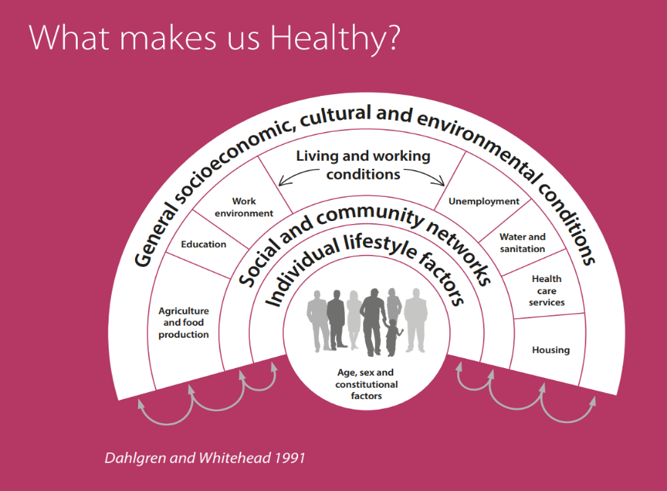
What makes us healthy?
Understanding and Addressing Inequalities
– taking a preventative approach
Health Protection
Understanding our Population Health/Population Health Management (Insight/JSNA)

Slide 7
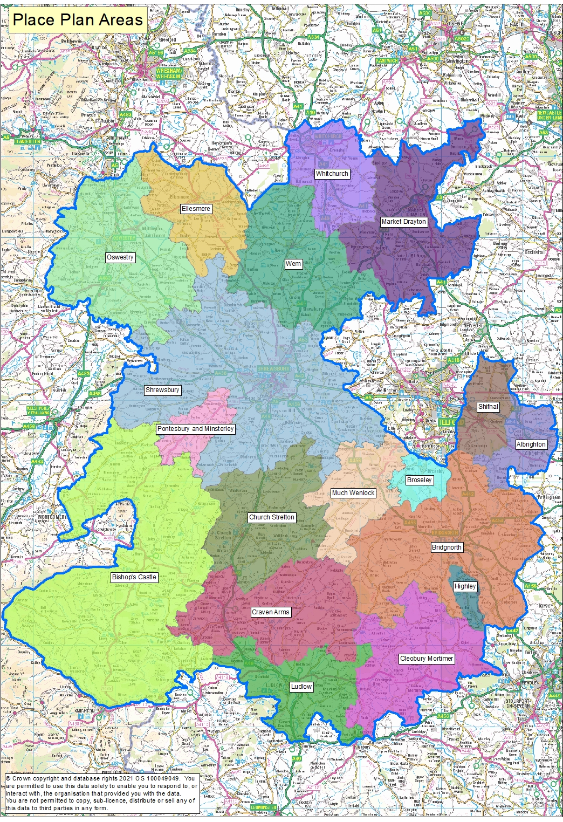
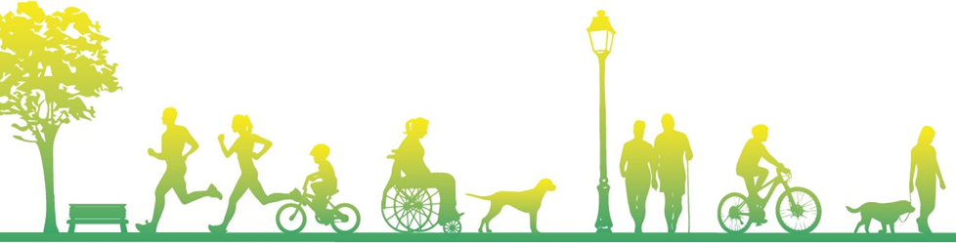
JSNA Place Based Geographies
As well as the overall JSNA for Shropshire, JSNAs are being produced around smaller localities – namely Place Plan Areas
There are 18 place plan areas in Shropshire, usually (not always) focused on a market town and its surrounding rural communities.
Place Plan Areas are based along geographical/communities boundaries rather than political ones
There are enough Place Plan Areas to identify some differences in the areas to help with local planning, but not too many areas where it becomes difficult to identify meaningful differences

Slide 8
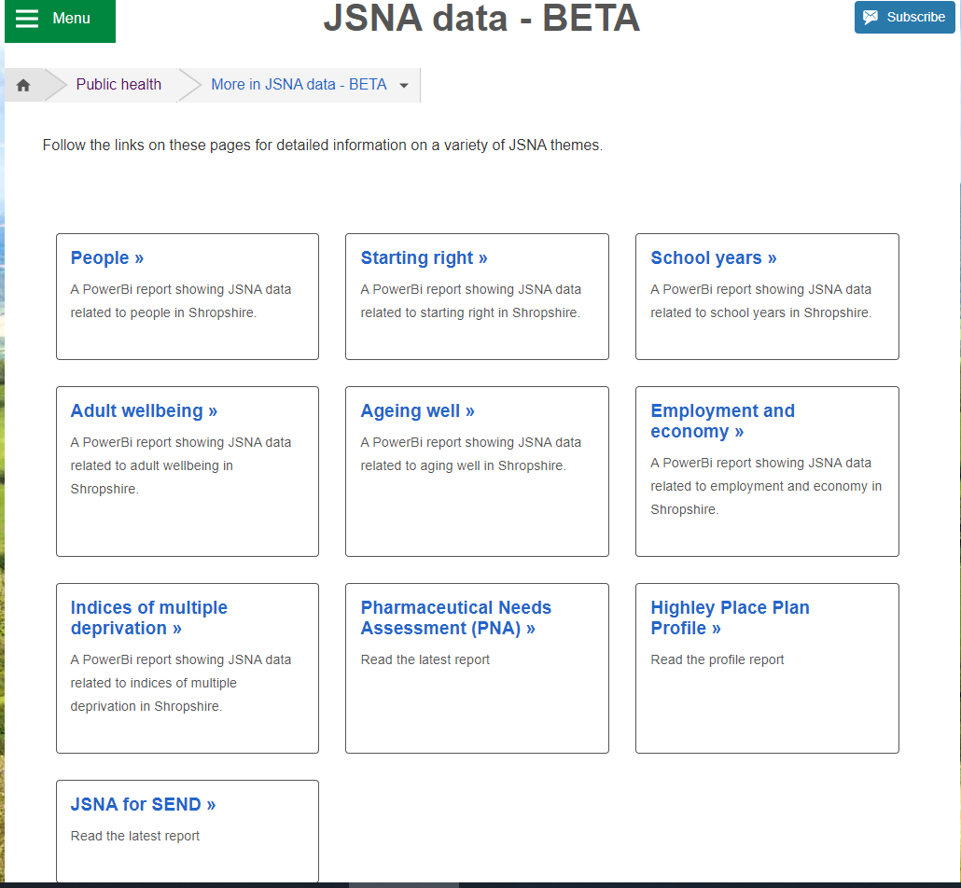
JSNA Web Based Profiler Tool
https://www.shropshire.gov.uk/public-health/jsna-data-beta/
The web-based JSNA is an interactive tool that allows users to explore data relating to health need in Shropshire.

Slide 9

Community Engagement
Stakeholder and Resident engagement via:
  Questionnaires to residents
  Interviews
  Focus Groups
  Attending key meetings/groups

Slide 10

Bishop’s Castle Place Plan
Examples of Key Health and Wellbeing Data
Notes:
Intro my role

Slide 11
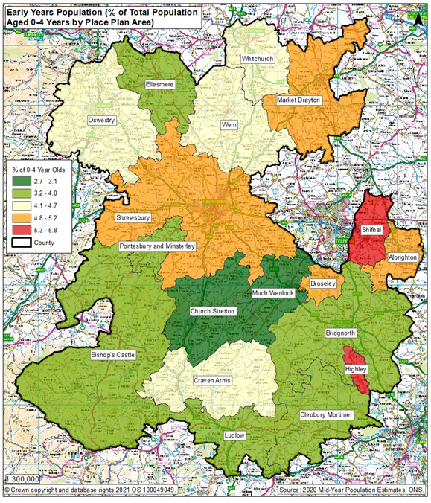
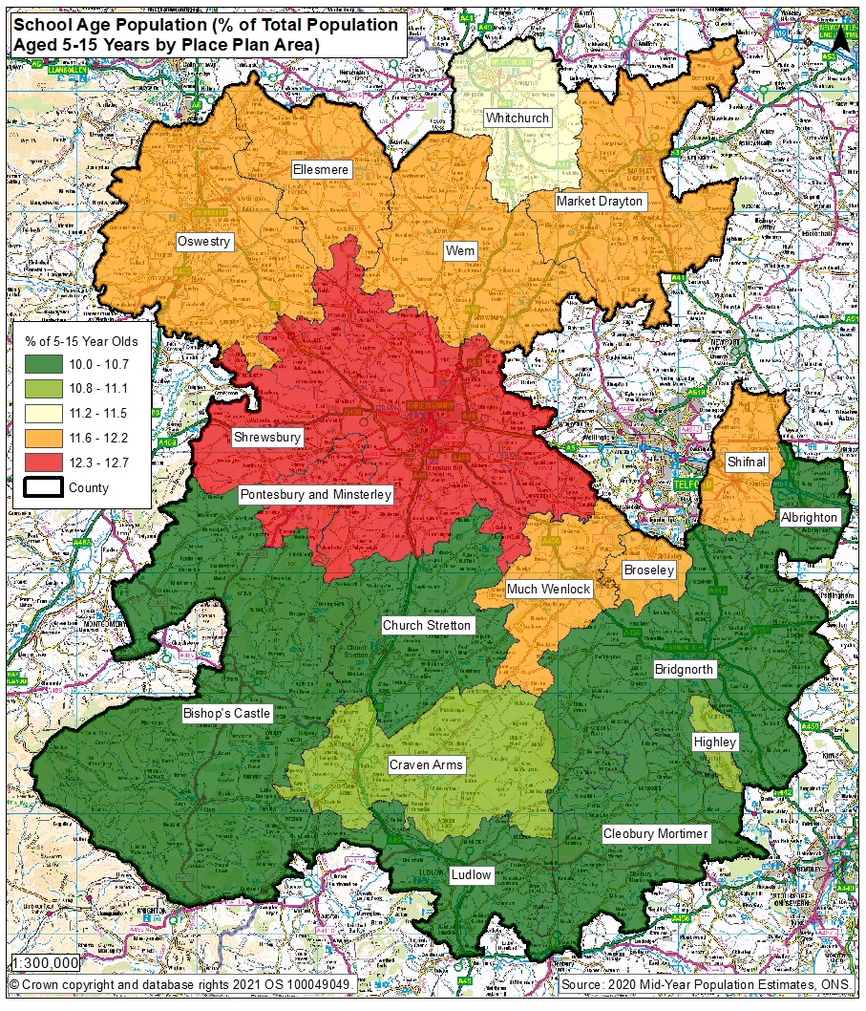
Early Years and School Age Population

Slide 12
Ranking of Wards in Bishop’s Castle Place Plan Area in metrics
 | Ranking of Ward in Indicator out of 62 wards in Shropshire – lowest number is worse
Indicator | Bishop's Castle | Chirbury and Worthen | Clun
Unemployment | 41 | 60 | 60
Child Poverty, English Indices of Deprivation, 2019 | 17 | 42 | 56
Income deprivation, English Indices of Deprivation, 2019 | 25 | 45 | 43
IMD Score, 2019 | 10 | 11 | 14
Long term unemployment | 50 | 42 | 55
General fertility rate: live births per 1,000 women aged 15-44 years | 36 | 50 | 60
Low birth weight of live babies | 37 | 4 | 59
A&E attendances in under 5 years old, three year average | 59 | 56 | 44
Emergency admissions in under 5s | 38 | 23 | 50
Emergency hospital admissions for injuries in under 15 years old | 2 | 18 | 12
RANK OF AVERAGE RANK (lower number is worse) | 28 | 34 | 60

Slide 13
Smoking in Pregnancy
Source: SATH Maternity Dataset for 2016/17, 2017/18, 2018/19, 2019/20 and 2020/21
Background
Smoking in pregnancy has long been recognised as having significantly negative health impacts for the growth and development of the baby and the health of the mother including complications in labour, miscarriage, still birth, premature birth and low birth weight. Reduced smoking in pregnancy will have health benefits for both mother and child and reduced costs to the NHS.
Methodology
Smoking at time of delivery is the number of mothers known to be smokers at time of delivery as a percentage of all maternities (live or still birth). The Place Plan area figures are based on those mothers who lived in that place plan area who delivered a child at Shrewsbury and Telford Hospitals Trust (SATH). Because there are very few deliveries in some of the place plan areas in one year, these figures are the combination of the last 5 years – 2016/17 to 2020/21. The Bishop’s Castle % v Shropshire is a statistical comparison of the two areas to take into account the different number of children in those areas, based on a 95% confidence interval using the Wilson scoring method.
Caveats
The data shown here concerns mothers who delivered a child at SATH only, not mothers from the area who delivered in other hospital providers.
Results
Bishop's Castle had 267 deliveries in this 5 year period, which is the 9th highest of all place plan areas. The 5 year percentage for smoking at delivery for Bishop's Castle (10.9%) is statistically similar to Shropshire’s (12.8%) – 5 place plan areas had a lower percentage of mothers smoking at delivery. For this same cohort of mothers, the percentage known to be smokers at time of booking who lived in Bishop's Castle was 13.1%, statistically similar to the Shropshire figure of 14%.
5 year Smoking at Delivery and at Booking data for Shropshire and Bishop’s Castle Place Plan Area, 2016/17 to 2020/21
Indicator | Bishop’s Castle Place Plan Area | Shropshire Overall | Bishop’s Castle % v Shropshire
Number of deliveries | 267 | 10,289
Percentage of mothers who were known to be smoking at time of delivery | 10.9% | 12.8% | Similar
Percentage of mothers who were known to be smoking at time of booking | 13.1% | 14.0% | Similar

Slide 14
Quality & Outcomes Framework (QOF) Indicators 2020/21
Key to colour codes on table
Area is statistically higher for this indicator than Shropshire
Area is statistically similar for this indicator to Shropshire
Area is statistically lower for this indicator than Shropshire
Indicator | Bishop's Castle Place Plan Area Eligible population | Bishop's Castle Place Plan Area Prevalence for indicator | NHS Shropshire, Telford and Wrekin CCG
AF Prevalence | 10,928 | 3.1% | 2.5%
CHD Prevalence | 10,928 | 4.1% | 3.5%
Heart failure Prevalence | 10,928 | 1.0% | 0.9%
Heart failure due to LVSD Prevalence | 10,928 |  | -
Hypertension Prevalence | 10,928 | 17.9% | 15.6%
Peripheral arterial disease Prevalence | 10,928 | 0.8% | 0.8%
Stroke and transient ischaemic attack Prevalence | 10,928 | 2.9% | 2.4%
COPD Prevalence | 10,928 | 1.8% | 2%
Asthma Prevalence (6+) | 10,452 | 7.8% | 7.1%
Obesity Prevalence (18+) | 9,236 | 8.8% | 7.3%

Slide 15
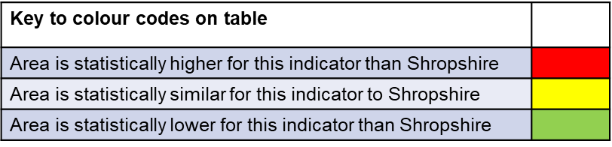
QOF Indicators 2020/21
Indicator | Bishop's Castle Place Plan Area Eligible population | Bishop's Castle Place Plan Area Prevalence for indicator | NHS Shropshire, Telford and Wrekin CCG
High dependency and other long term conditions group, cancer Prevalence | 10,928 | 5.1% | 4%
High dependency and other long term conditions group, palliative care Prevalence | 10,928 | 0.6% | 0.4%
Mental health and neurology group, dementia Prevalence | 10,928 | 1.1% | 0.9%
Mental health and neurology group, learning disabilities Prevalence | 10,928 | 0.7% | 0.5%
Mental health and neurology group, mental health Prevalence | 10,928 | 0.9% | 0.8%
Musculoskeletal group, rheumatoid arthritis Prevalence (16+) | 9,469 | 1.0% | 0.9%
High dependency and other long term conditions group, diabetes mellitus Prevalence (17+) | 9,358 | 6.5% | 7.3%
High dependency and other long term conditions group, chronic kidney disease Prevalence (18+) | 9,236 | 8.0% | 5.7%
Mental health and neurology group, depression Prevalence (18+) | 9,236 | 12.2% | 14.5%
Mental health and neurology group, epilepsy Prevalence (18+) | 9,236 | 0.7% | 0.9%
Non-diabetic hyperglycaemia group, non-diabetic hyperglycaemia Prevalence (18+) | 9,236 | 4.5% | 4.6%
Musculoskeletal group, osteoporosis Prevalence (50+) | 6,134 | 1.4% | 0.9%

Slide 16

Bishop’s Castle Health and Wellbeing Index Overview
Better than the Shropshire average in no measures
Worse than the Shropshire average for measures relating to People, Environment and Economy

Slide 17
Bishop’s Castle Health and Wellbeing Index Overview
This graph provides more detail to the previous slide.
This shows where Bishop’s Castle is stronger or weaker in terms of specific themes within the high-level categories.
For example, whilst overall Bishop’s Castle is around average for measures of Health, it is weaker specifically in terms of education and learning, housing and occupancy, Transport, Mobility and Connectivity, cost of living vulnerability, economy, work and employment and stronger in measures of equality, relationships and trust, and environment.

Slide 18
Bishop’s Castle Health and Wellbeing Index Overview

Slide 19
Bishop's Castle Place Plan Area 2020 Mid Year Population Estimate Pyramid

Slide 20
Bishop’s Castle Additional Indicators
INDICATOR | Bishop's Castle PPA | Shropshire
Demographics
Resident population | 10,856 | 325,415
% Population aged 16 to 64 males/59 females | 50.9 | 53.7
% Population aged 65 and over for males and 60 and over for females | 35.3 | 30.5
Mean age | 45 | 43.4
IMD: Overall – score (High = worse) | 21.46 | 17.0
Average household size | 2.32 | 2.4
2020 Dependency Ratio (0-15s and 65+ / 16 to 64 pop) | 0.8 | 0.7
Patients at Shropshire practices 2021 | 9,058 | 302,749
Area - hectares | 52,416 | 319,728
2020 Population Density | 0.2 | 1.0
Pensioners living alone - % | 26.5 | 27.6
% population aged 0-15 | 13.8 | 15.8
General Practice Mental Health
Mental health and neurology group, dementia % | 1.1% | 0.9%
Mental health and neurology group, learning disabilities % | 0.7% | 0.5%
Mental health and neurology group, mental health % | 0.9% | 0.8%
Mental health and neurology group, depression (18+) % | 12.2% | 14.5%
Mental health and neurology group, epilepsy (18+) % | 0.7% | 0.9%

Slide 21
Bishop’s Castle Additional Indicators
INDICATOR | Bishop's Castle PPA | Shropshire
Business
Ratio Median/Mean RV | 0.465 | 0.369
Rateable Businesses - August 2022 - Count of Property References | 132 | 5624
Total Sum of all Current Rateable Value | £1,718,590.00 | £149,334,721.00
Average of Current Rateable Value | £13,019.62 | £26,553.12
Median average of Current Rateable Value | £6,050.00 | £9,800.00
Work
Working age unemployment (%, monthly average) | 31.03 | 27.5
Median Income | £33,023 | £33,337
Lower Quartile | £19,428 | £19,089
September 2021 Claimant Count ONS / DWP | 2.9% | 3.3%
Median Gross Household Income 2021 | £31,849 | £32,808
Lower Quartile Gross Household Income 2021 | £18,480 | £18,602
Housing
House prices / affordability (household income) - Lower Quartile (year-end 24th August) | 10.28 | 9.4
Median Affordability Ratio | 9.7 | 7.4
Median House Prices Paid (year-end 24th Aug) | £310,000 | £241,500
Lower Quartile House Prices Paid (year-end 24th Aug) | £189,950 | £175,000
Proportions of households which are fuel poor 2019, BEIS | 20.3% | 12.3%
Occupancy rating -1 (%) | 2.6 | 2.8
Occupancy rating -2 or less (%) | 0.7 | 0.6
Households with no central heating - percent | 6 | 3.3
IMD: Barriers to Housing and Services – score (High = bad) | 38.5 | 26.6
Carers
Total number of claimants of Attendance allowance - Quarter Feb 21 (DWP) | 282 | 8742
Total number of persons 16+ in recept of carers allowance - Quarter Feb 21 (DWP) | 93 | 3404

Slide 22
Bishop’s Castle Additional Indicators
Some 2021 census data is available at Local Authority Level, but not at a lower level yet, but some of this data for Shropshire reveals:
Under the equality act | % of Shropshire | Number of Bishop’s Castle residents if Shropshire figures extrapolated
are disabled - day to day activities limited a lot | 6.7% | 727
are disabled - day to day activities limited a little | 10.2% | 1107
not disabled | 83% | 9010
Of people aged 5 years and over in Shropshire
provide no unpaid care | 90.9% | 9868
prove 19 or less hours unpaid care a week | 4.9% | 532
provide 20 to 49 hours unpaid care a week | 1.7% | 185
provide 50 hours or more unpaid care a week | 2.5% | 271

Slide 23
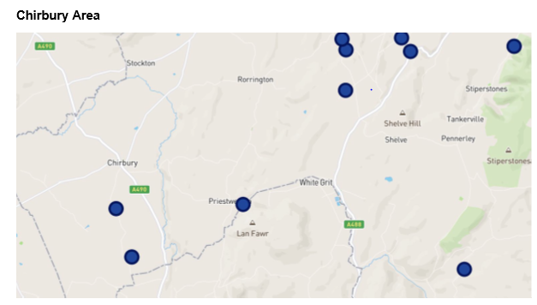
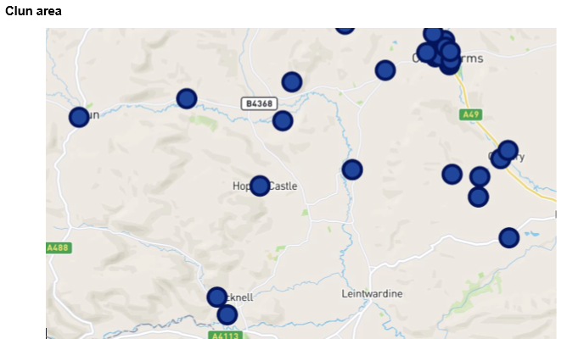
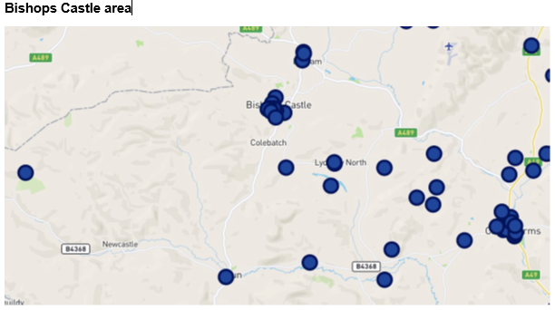
“Mobilise” Data – Digital support for Carers
These maps show where carers are managing to access online support - Mobilise have advised that 72% of carers in Shropshire access their service via their mobile phone

Slide 24

Community Engagement Survey Results
185 survey results from the Bishop’s Castle area
146 responses completed in person
39 completed online

Slide 28
England and West Midlands figures from Annual Population Survey, ONS, for year ending March 2022
Bishop's Castle figures from local survey

Slide 29
England and West Midlands figures from Annual Population Survey, ONS, for year ending March 2022
Bishops Castle figures from local survey

Slide 33


Slide 45
Focus Theme 1 – Health Services
The top theme of what is important to Bishop’s Castle residents in terms of making an area a good place to live in was “Health Services”, and this was the second top theme in term of what can be improved in Bishop’s Castle.
Also, the most frequent issue raised around needs at both a community and personal/family level was access to GP services and secondly issues related to accessing hospital services, with number of respondents mentioning the closure of the local hospital and the long distance in order to get to the nearest hospital. Ambulance times were also mentioned quite often.
The third most mentioned issue for both in the area, and for yourself and your family, was around mental health services.
When it came to the biggest issues affecting young people, access to GPs, hospital services, or ambulance times, or access to dental care were not mentioned at all, however mental health issues were the third most mentioned issue.
Whilst the health and wellbeing index overview (slide 19) rated Bishop’s Castle as the 6th best place plan area for Health, on closer examination of some indicators revealed that the Bishop’s Castle place plan area had the longest average journey time in minutes to a GP and also to a hospital, which is not helped by it being the largest place plan area at over 52,000 hectares so not everyone has the same level of access.
Bishop’s Castle has the 2nd highest percentage of it’s population that are above pension age – 35.3% compared to 30.5% in Shropshire overall
"Closure of local hospital due to staff shortages delays & access to hospital services in Shrewsbury distance from Bishops Castle to hospital services lack of local mental health services"
"Distance from services. Too many retirees moving into the area putting pressure
on health services and housing for young people "

Slide 46
Focus Theme 2 – Housing and Cost of Living
The health and wellbeing index overview (slide 19) rated Bishop’s Castle as 17th out of 18 for “housing and occupancy” and “cost of living vulnerability”
In the year end up to August 2021, there had been 93 house sales in this area at a median sales price of £310,000, the 4th highest of the 18 place plan areas, however, median gross household income at this point was £31,849, the 13th highest, which gives a median affordability ratio of 9.7 which is the third highest place plan area – i.e. it is harder to buy.
Out of all place plan areas, Bishop’s Castle has the highest percentage of households without central heating at 6% compared to 3.2% in Shropshire and the 4th highest percentage of one person households at 29%, with the 7th highest percentage of households that are one person aged 65 or over at 14.4%.
In the Index of multiple deprivation domain around barriers to housing and services, Bishop’s Castle was the place plan area with the 2nd highest score, which indicates problems.
Data also showed that 20.3% of Bishop’s Castle households were fuel poor, which was the highest area – the next highest was 17.4%, while Shropshire overall was 12.3%.
In the survey data, the 2nd most mentioned issue that was affecting younger people was around housing, with there being many mentions of housing prices being too high for those people to be able to buy or even rent in the area.
“No “affordable” housing being built driving people out into the towns and cities when we don’t want to.“
“Cannot afford to live here”
“My four children are grown up and have left the area (and country) because work is
very limited and housing too expensive.”

Slide 47
Focus Theme 3 – Lack of Activities
While “Activities for Teenagers” was only down as the 5th most selected areas that most needs improving in Bishop’s Castle according to the respondents, in the subsequent question regarding the biggest issues facing children and young people, the most mentioned things were around there being a lack of activities or youth services or out of school, and in the subsequent question about what needs to be done to support children and young people, again the issues related to the lack of activities were the most mentioned, with issues around youth services being the second most mentioned.
Overwhelming response from the survey as the biggest issue facing children and young people was a lack of activities and things to do, with a lack of out of school activities, lack of youth clubs / youth workers, lack of support and safe places to go also heavily mentioned. Several people also mentioned that boredom led to unsociable / criminal behaviour. Several people also mentioned the lack of activities in their rural area. Issues with accessing sport / leisure facilities were also mentioned separately and there were also numerous mentions of how people had to travel long distances to access things.
Whilst 66% of all respondents said they did not face challenges to being active in their daily life, some of the ones who did have challenges mentioned the lack of local facilities or transport issues or the time it takes to get to them.
“Access to a space, just to meet and talk. Promotion of affordable, accessible activities. Education looking at a more child/young person approach rather than results driven. Lack of facilities and activities. There is nothing at all in our village and we are wholly reliant on schools for activities.”
"Time as you often have to travel to Shrewsbury for decent facilities“
"Yes, nothing easy to get too, having to fit your exercise around the school commitment at the sports centre also not enough activities for older people. No safe places to cycle“
"Apart from walking, cycling, running and horse riding there really isn’t anything to do with out travelling 10 miles or more“
“Youth workers in BC. Using funding from Sport England or similar to provide a better range of clubs.
There is very little for my six year old“

Slide 48
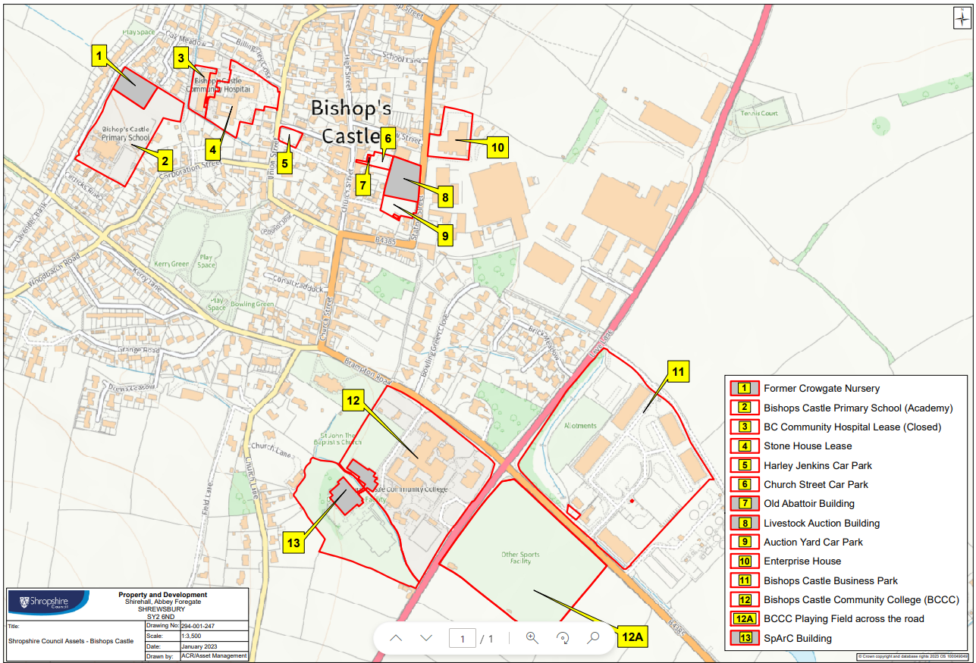

Slide 49
Group Discussion
1. What is happening around each theme already?
2. How are we working with the local population?
3. Recommendations?

