Slide 1

Joint Strategic Needs Assessment (JSNA) Place-based Approach
Stakeholder Event:
Oswestry

Slide 2

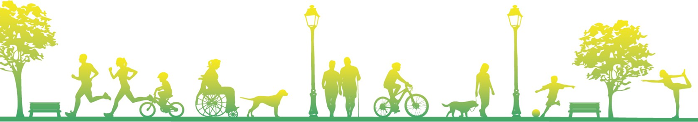
Overview
Why are we all here?
Why and what is a needs assessment?
Why are you here?
Today and moving forward
Notes:
The evidence​
You!! - The key stakeholders ​
people with an interest in the area​
Know what's happening in Highley​
Additions – are there gaps?​
Identify key themes​
Develop recommendations for action​
Targeted work arising from Needs Assessment​
Learning about place based approach & lessons learnt​
Starting Point​

Slide 3
Oswestry: Joint Strategic Needs Assessment
Local Authorities and CCGs (now ICS) have a legal Statutory Duty to undertake a Joint Strategic Needs Assessment (JSNA), through the health and wellbeing board.
The JSNA seeks to identify current and future health and wellbeing needs in the local population and identify strategic priorities to inform commissioning of services based on those needs.
These priorities in turn inform the Health and Wellbeing Strategy and Integrated Care Strategy, key documents as a basis for commissioning health and social care services in the local area.
The JSNA aims to achieve the following through an evidence base and consultation:
  Identify the health and wellbeing needs of the population of Highley;
  Map the services/assets in the area;
  Define achievable improvements in health and wellbeing outcomes for the local community.
  Target services and resources where there is most need
  Support commissioners, stakeholders and communities to deliver better health and wellbeing outcomes for the local community by making recommendations for how services can be improved / redesigned to make sure they are being delivered to the people who need them most.

Slide 4
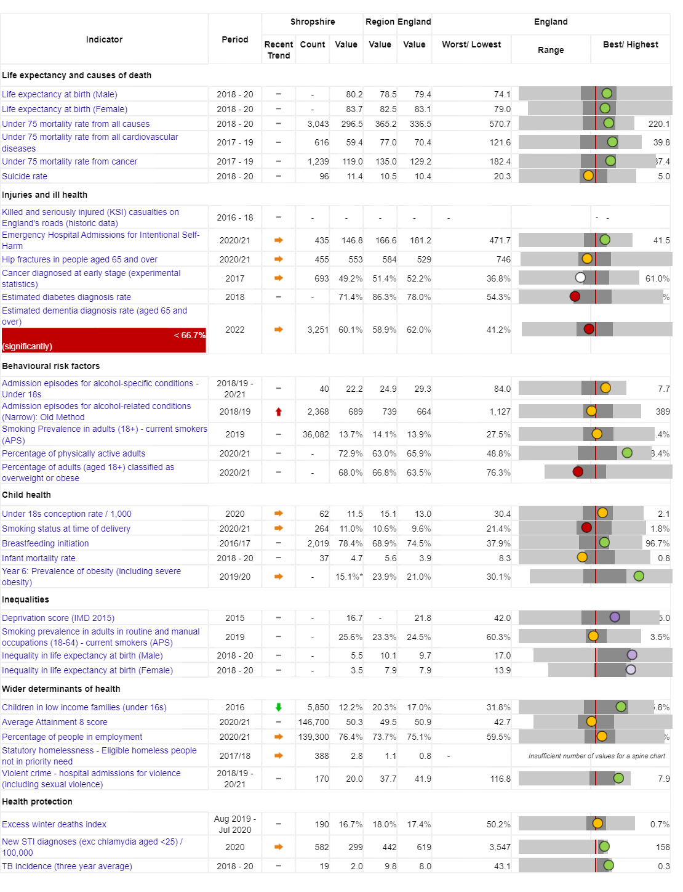
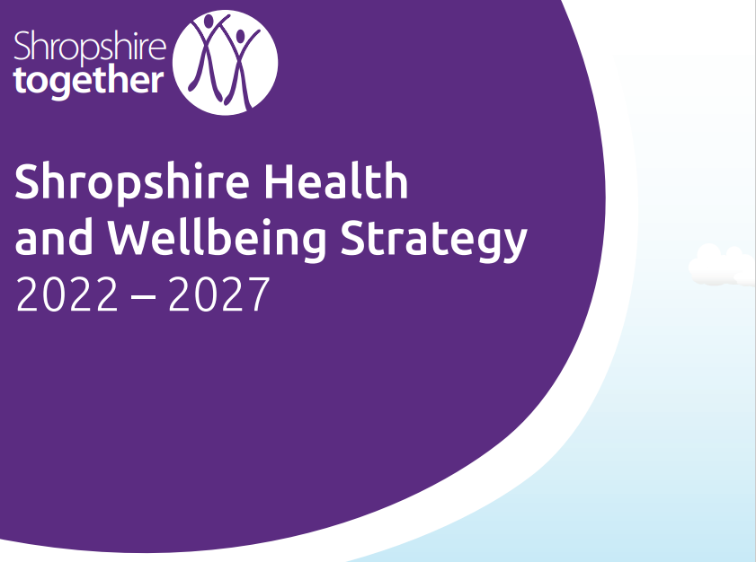
Vision: For Shropshire people to be the healthiest and most fulfilled in England
Reducing inequalities
Improving Population Health
Working with and building strong and
vibrant communities
Joined up working

Slide 5
Shropshire's JSNA – Place based
Priorities place-based from 2019 onwards, focusing on local places/ localities/communities. Why?
    Common/shared and best available evidence base
    Collectively understand the health and wellbeing needs of communities
    Understand the unique needs of people in a given location by working together to gain local knowledge and insight
    Asset-based approach that seeks to highlight the strengths, capacity and knowledge of all those involved

Slide 6
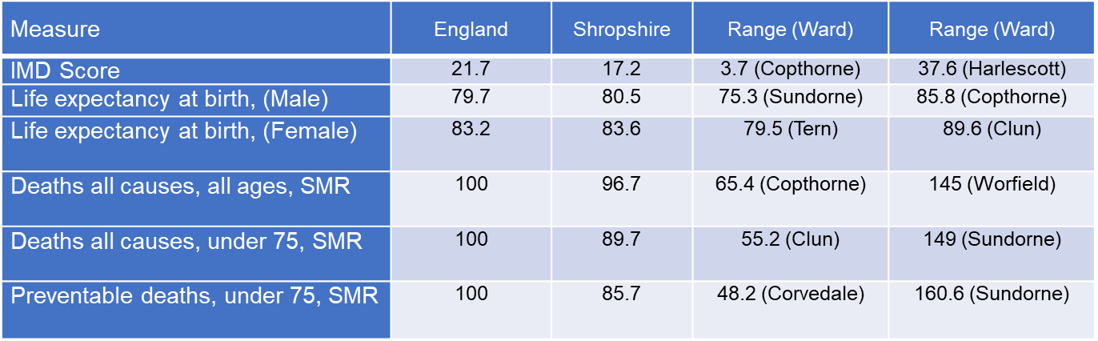
Today people in Oswestry are living longer, but not necessarily healthier lives…
Indicator | Shropshire | England
Healthy Life Expectancy (HLE) Males | 62.8 | 63.1
Inequality in HLE Males | 5.5 | 9.7
HLE Females | 67.1 | 63.9
Inequality in HLE Females | 3.5 | 7.9
Area | Oswestry | Shrewsbury
Healthy Life Expectancy | 66.1 years | 72.7 years
Life Expectancy | 82.1 years | 84.4 years
Notes:
Intro my role

Slide 7
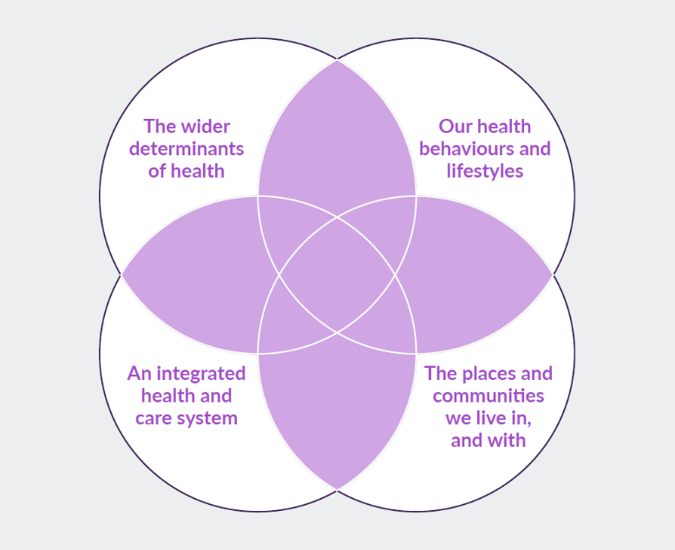
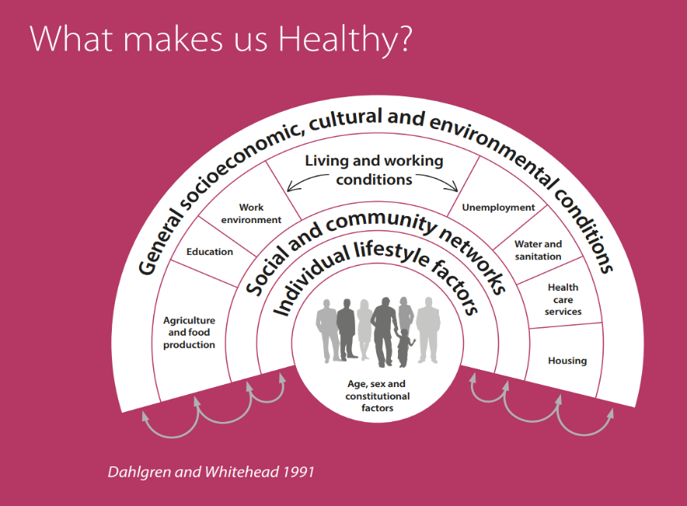
What makes us healthy?
Understanding and Addressing Inequalities – taking a preventative approach
Health Protection
Understanding our Population Health/Population Health Management (Insight/JSNA)

Slide 8
Place Based
As well as the overall JSNA for Shropshire, JSNAs are being produced around smaller localities – namely Place Plan Areas​
There are 18 place plan areas in Shropshire, usually (not always) focused on a market town and its surrounding rural communities
Based along geographical/communities boundaries rather than political ones​
Stakeholder and Resident engagement via:
​
Questionnaires to residents​
Interviews​
Focus Groups​
Attending key meetings/groups​
Community
Engagement​
Web based JSNA
https://www.shropshire.gov.uk/public-health/jsna-data-beta/
The web-based JSNA is an interactive tool that allows users to explore data relating to health need in Shropshire.

Slide 9
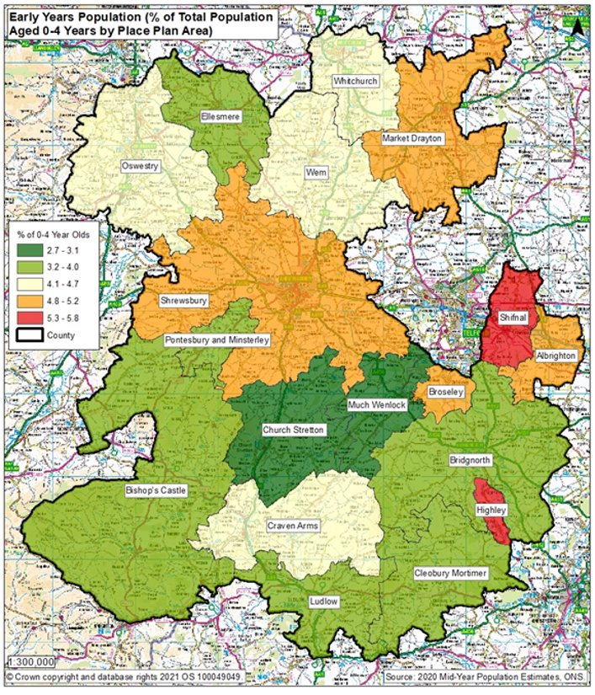
Oswestry Place Plan ​
Examples of Key Health and Wellbeing Data​

Slide 10
​ | Ranking of Ward in Indicator out of 62 wards in Shropshire – lowest number is worse​
Indicator​ | Oswestry East​ | Oswestry West​ | St Martin's​ | Oswestry South​ | St Oswald​ | Gobowen, Selattyn and Weston Rhyn​ | Llanymynech​ | Ruyton and Baschurch​
Unemployment​ | 16​ | 9​ | 29​ | 5​ | 41​ | 25​ | 54​ | 47​
Child Poverty, English Indices of Deprivation, 2019​ | 10​ | 8​ | 12​ | 41​ | 32​ | 20​ | 38​ | 54​
Income deprivation, English Indices of Deprivation, 2019​ | 8​ | 9​ | 12​ | 18​ | 32​ | 18​ | 50​ | 59​
IMD Score, 2019​ | 19​ | 15​ | 24​ | 26​ | 37​ | 28​ | 24​ | 60​
Long term unemployment​ | 9​ | 5​ | 30​ | 2​ | 48​ | 40​ | 27​ | 53​
General fertility rate: live births per 1,000 women aged 15-44 years​ | 23​ | 34​ | 19​ | 57​ | 20​ | 44​ | 40​ | 38​
Low birth weight of live babies​ | 8​ | 31​ | 11​ | 22​ | 9​ | 45​ | 55​ | 34​
A&E attendances in under 5 years old, three year average​ | 45​ | 54​ | 62​ | 57​ | 61​ | 60​ | 46​ | 36​
Emergency admissions in under 5s​ | 58​ | 57​ | 63​ | 59​ | 60​ | 61​ | 45​ | 36​
Emergency hospital admissions for injuries in under 15 years old​ | 57​ | 61​ | 62​ | 60​ | 58​ | 63​ | 38​ | 35​
RANK OF AVERAGE RANK (lower number is worse)​ | 14​ | 24​ | 30​ | 33​ | 50​ | 52​ | 53​ | 59​

Slide 11
Smoking in Pregnancy
Background
Smoking in pregnancy has long been recognised as having significantly negative health impacts for the growth and development of the baby and the health of the mother including complications in labour, miscarriage, still birth, premature birth and low birth weight. Reduced smoking in pregnancy will have health benefits for both mother and child and reduced costs to the NHS.
Methodology
Smoking at time of delivery is the number of mothers known to be smokers at time of delivery as a percentage of all maternities (live or still birth). The Place Plan area figures are based on those mothers who lived in that place plan area who delivered a child at Shrewsbury and Telford Hospitals Trust (SATH). Because there are very few deliveries in some of the place plan areas in one year, these figures are the combination of the last 5 years – 2016/17 to 2020/21. The Oswestry % v Shropshire is a statistical comparison of the two areas to take into account the different number of children in those areas, based on a 95% confidence interval using the Wilson scoring method.
Caveats
The data shown here concerns mothers who delivered a child at SATH only, not mothers from the area who delivered in other hospital providers.
Results
Oswestry had 940 deliveries in this 5 year period, which is the 2nd highest of all place plan areas behind Shrewsbury. The 5 year percentage for smoking at delivery for Oswestry (16.5%) is statistically higher than Shropshire’s (12.8%) – 3 place plan areas had a higher percentage of mothers smoking at delivery. For this same cohort of mothers, the percentage known to be smokers at time of booking who lived in Oswestry was 17.6%, statistically higher than the Shropshire figure of 14%.
5 year Smoking at Delivery and at Booking data for Shropshire and Oswestry Place Plan Area, 2016/17 to 2020/21
Indicator | Oswestry Place Plan Area | Shropshire Overall | Highley % v Shropshire
Number of deliveries | 940 | 10,289
Percentage of mothers who were known to be smoking at time of delivery | 16.5% | 12.8% | Higher
Percentage of mothers who were known to be smoking at time of booking | 17.6% | 14.0% | Higher
Source: SATH Maternity Dataset for 2016/17, 2017/18, 2018/19, 2019/20 and 2020/21

Slide 12
Quality & Outcomes Framework (QOF)
Indicators 2020/21
Key to colour codes on table
Area is statistically higher for this indicator than Shropshire
Area is statistically similar for this indicator to Shropshire
Area is statistically lower for this indicator than Shropshire
Indicator | Oswestry Place Plan Area Eligible population | Oswestry Place Plan Area Prevalence for indicator | NHS Shropshire, Telford and Wrekin CCG
AF Prevalence | 39,650 | 2.7% | 2.5%
CHD Prevalence | 39,650 | 3.4% | 3.5%
Heart failure Prevalence | 39,650 | 1.0% | 0.9%
Heart failure due to LVSD Prevalence | 39,650 | 0.4% | -
Hypertension Prevalence | 39,650 | 16.9% | 15.6%
Peripheral arterial disease Prevalence | 39,650 | 0.8% | 0.8%
Stroke and transient ischaemic attack Prevalence | 39,650 | 2.5% | 2.4%
COPD Prevalence | 39,650 | 2.1% | 2%
Asthma Prevalence (6+) | 37,496 | 7.2% | 7.1%
Obesity Prevalence (18+) | 32,387 | 6.6% | 7.3%

Slide 13
QOF Indicators 2020/21
Key to colour codes on table
Area is statistically higher for this indicator than Shropshire
Area is statistically similar for this indicator to Shropshire
Area is statistically lower for this indicator than Shropshire
Indicator | Oswestry Place Plan Area Eligible population | Oswestry Place Plan Area Prevalence for indicator | NHS Shropshire, Telford and Wrekin CCG
High dependency and other long term conditions group, cancer Prevalence | 39.650 | 4.0% | 4%
High dependency and other long term conditions group, palliative care Prevalence | 39.650 | 0.5% | 0.4%
Mental health and neurology group, dementia Prevalence | 39.650 | 1.0% | 0.9%
Mental health and neurology group, learning disabilities Prevalence | 39.650 | 0.6% | 0.5%
Mental health and neurology group, mental health Prevalence | 39.650 | 0.8% | 0.8%
Musculoskeletal group, rheumatoid arthritis Prevalence (16+) | 33,319 | 1.0% | 0.9%
High dependency and other long term conditions group, diabetes mellitus Prevalence (17+) | 32,846 | 7.1% | 7.3%
High dependency and other long term conditions group, chronic kidney disease Prevalence (18+) | 32,387 | 6.7% | 5.7%
Mental health and neurology group, depression Prevalence (18+) | 32,387 | 16.0% | 14.5%
Mental health and neurology group, epilepsy Prevalence (18+) | 32,387 | 1.0% | 0.9%
Non-diabetic hyperglycaemia group, non-diabetic hyperglycaemia Prevalence (18+) | 32,387 | 5.6% | 4.6%
Musculoskeletal group, osteoporosis Prevalence (50+) | 18,325 | 1.9% | 0.9%

Slide 14
Deprivation 2020/21
 | CYP aged 5 to 18 living in 20% most deprived quintile relative to Shropshire | CYP aged 5 to 18 living in 20% most deprived quintile relative to England | Deprivation (IMD)
Central South | 1742 | 1112 | 17.1
Central North | 1473 | 753 | 15.5
North East | 2375 | 326 | 20.2
North West | 1698 | 339 | 18.3
South East | 972 | 0 | 15.1
South West | 1097 | 203 | 19.5
Shropshire | 9357 | 2733 | 17.1

Slide 15
Overview of
Survey Results
Ward based on the postcode supplied
Chirk North (Wrexham) | 2
Chirk South (Wrexham) | 1
Ellesmere Urban | 2
Gobowen, Selattyn and Weston Rhyn | 38
Ketley & Overdale | 1
Llandysilio (Powys) | 4
Llangyniew and Meifod (Powys) | 1
Llanrhaeadr-ym-Mochnant and Llansilin (Powys) | 1
Llanymynech | 22
Loton | 1
Oswestry East | 25
Oswestry South | 15
Oswestry West | 18
Ruyton and Baschurch | 3
St Martin's | 89
St Oswald | 25
Tern | 1
Whittington | 22
Wrenbury (Cheshire) | 1
#N/A | 83
Grand Total | 355

Slide 20
England and West Midlands figures from Annual Population Survey, ONS, for year ending March 2022
Oswestry figures from local survey
Notes:
Intro my role

Slide 21
England and West Midlands figures from Annual Population Survey, ONS, for year ending March 2022
Oswestry figures from local survey
Notes:
Intro my role

Slide 22
England and West Midlands figures from Annual Population Survey, ONS, for year ending March 2022
Oswestry figures from local survey
Notes:
Intro my role

Slide 23
England and West Midlands figures from Annual Population Survey, ONS, for year ending March 2022
Oswestry figures from local survey
Notes:
Intro my role

Slide 24
Notes:
Intro my role

Slide 25
Notes:
Intro my role

Slide 26

Notes:
Intro my role

Slide 33
Note – 89 respondents supplied their postcode, which identified them as being in the Saint Martin’s ward – Saint Martin’s had a branch surgery of Chirk medical practice that closed in May 2022
"No maternity services in Oswestry, had to deliver in Telford. No NHS dentistry in Oswestry."
"No surgery in the village - To get to chirk on public transport you have to go to Oswestry then chirk. 4000 people in Shropshire registered at Chirk"
"No surgery. If you need any hospital attention you need to go to Shrewsbury or Telford. Impossible if you don’t drive. If your a widow it’s a bit grim. Closed the cottage hospital in Oswestry. Not many buses and expenses "

Slide 34
Note – 89 respondents supplied their postcode, which identified them as being in the Saint Martin’s ward – Saint Martin’s had a branch surgery of Chirk medical practice that closed in May 2022
"Lack of doctors surgery and public transport. Nearest surgery Chirk - nearest bus stop for Chirk around a mile. I am 78 years old, suffering from arthritis and cancer and cannot walk more than a few yards with the aid of a stick. I am not alone - many local residents have similar problems. It is not acceptable in a village of this size not to have access to medical facilities, particularly with the number of new houses currently being built. Why wasn't the provision of surgery premises mandated in the plans of one of these new estates in order to attract or retain a GP practice? The introduction of telephone consultations - particularly difficult for the elderly with hearing problems."
“Public transport bus cut from half hourly to hourly”
“The stress of rising costs of living and impact on emotional health“

Slide 35
Note – 89 respondents supplied their postcode, which identified them as being in the Saint Martin’s ward – Saint Martin’s had a branch surgery of Chirk medical practice that closed in May 2022
“Access to services that keep them engaged and learn life skills. Access. Bullying”
“Lack of early intervention and youth services. This leads to bigger problems which cost more to tackle and wastes young people's lives. Also poverty.”
“Lack of jobs in the area. Covid having an effect. Not being able to do what they want to do, depression and mental health issues”
“Safe environments to build resilience away from family”

Slide 36
Note – 89 respondents supplied their postcode, which identified them as being in the Saint Martin’s ward – Saint Martin’s had a branch surgery of Chirk medical practice that closed in May 2022
"More activities for young people, maybe based around getting young people together to solve issues in their community, to help them feel invested in their town? “
“More counsellors in community rather than reliance on schools”
"Need to accept that all children aren't academic, have more things in place for those that aren't. Apprentices are a great idea but a lot of the time they're just used for cheap labour with no job progression“
"Refund youth activities - always seems to be the first thing that gets cut.“
"Total overhaul in education so that the child is the centre and that their needs are met. Also more youth organisations as services have been decimated. Plus involve them in make decisions in local communities.“
"Youth outreach work, pro active policing going into schools to educate on dangers of crime/ drugs, sessions for parents as well "

Slide 37
"Cost of more healthy food - Junk food is cheaper than healthy food"
"Cost and time. I feel like I work all the time to make a below average wage and don’t have the time or energy to scratch cook all the time."
"No - we are vegan and eat healthily. We are lucky to be able to afford that"

Slide 38
"We’re both disabled. No gyms in St Martins. Have to go to Oswestry or Chirk to go to a gym or swimming pool."
"With two full time working parents on shift patterns family time is normally late evenings or one day a week we struggle to do family active activities together. On an individual basis we are all quite active when we have time."
"Yes- lack of access to affordable sports facilities e.g. indoor sports court hire/ classes "

Slide 39

Group Discussion
What do you think of the data you have seen? Does it match what you thought it would be? Have we missed anything?
2. Are there priorities or themes that should be
considered?

Slide 40
Next Steps
Use information from today to complete the locality needs assessment
2. Work together with Stakeholders to produce an action plan based on the key themes
3. Continue to work together to deliver actions

