Slide 1

Joint Strategic Needs
Assessment (JSNA):
Place-based approach
Stakeholder Event – Ludlow
Notes:
Intro my role

Slide 2


Overview
What is a JSNA
Why and what is a needs assessment?
Initial work to date
Next Steps
Notes:
There are 18 place-based areas through Shropshire, the assets and needs are different in each area and the JSNA process is a way to dig deeper into these needs.
Looking at health data as well as what is on the ground – what agencies say about an area and what people say about area are very different.
We have been working with the Highley area and are formulating an action plan to work with key areas that have arisen i.e. access to services - the Highley GP gave notice on the contract for the current surgery and that has opened an opportunity to work with the PCN to relocate the surgery.

Slide 3

What is a Joint Strategic Needs Assessment?
Local Authorities and CCGs (now ICS) have a legal Statutory Duty to undertake a Joint Strategic Needs Assessment (JSNA), through the health and wellbeing board.
​​
The JSNA seeks to identify current and future health and wellbeing needs in the local population and identify strategic priorities to inform commissioning of services based on those needs. ​
These priorities in turn inform the Health and Wellbeing Strategy and Integrated Care Strategy, key documents as a basis for commissioning health and social care services in the local area. We also believe they should support local partners/communities' priorities.​​
In Shropshire, our JSNA takes three types:​
Web based profiling Tool​
Thematic Needs Assessments - e.g., pharmacy, drug and alcohol and children​
Place Based Needs Assessments

Slide 4
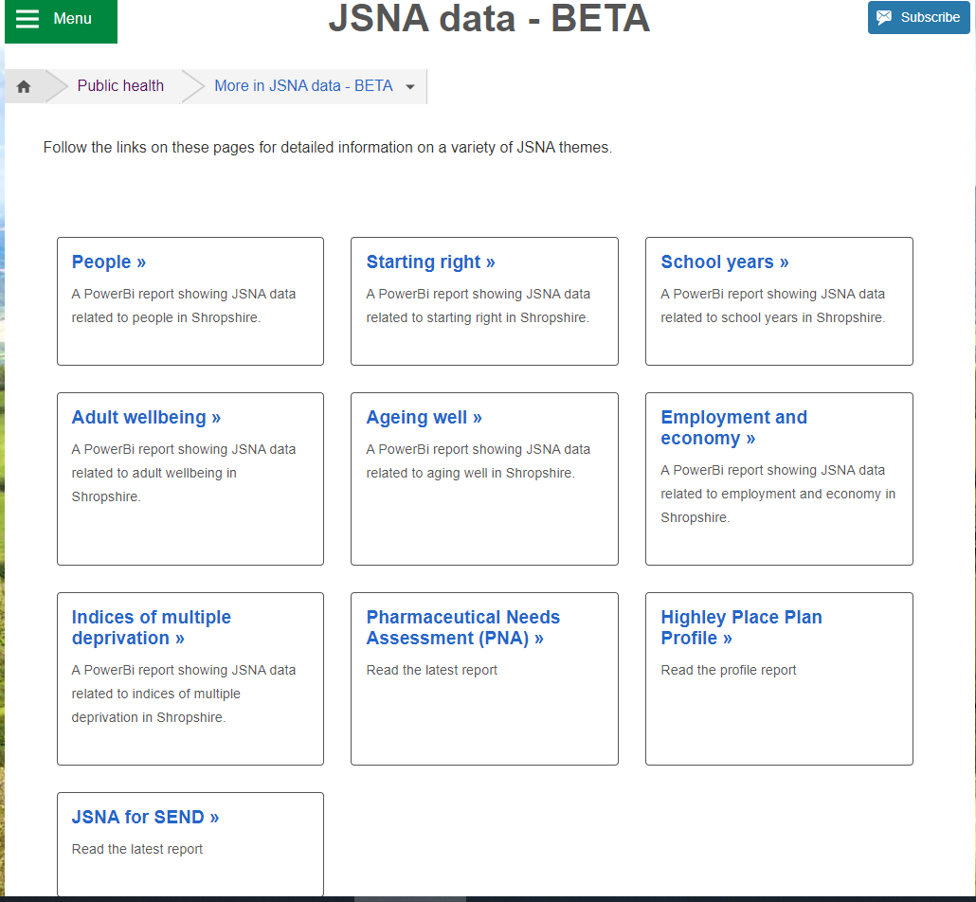
JSNA Web Based Profiler Tool
https://www.shropshire.gov.uk/public-health/jsna-data-beta/
The web-based JSNA is an interactive tool that allows users to explore data relating to health need in Shropshire.

Slide 5
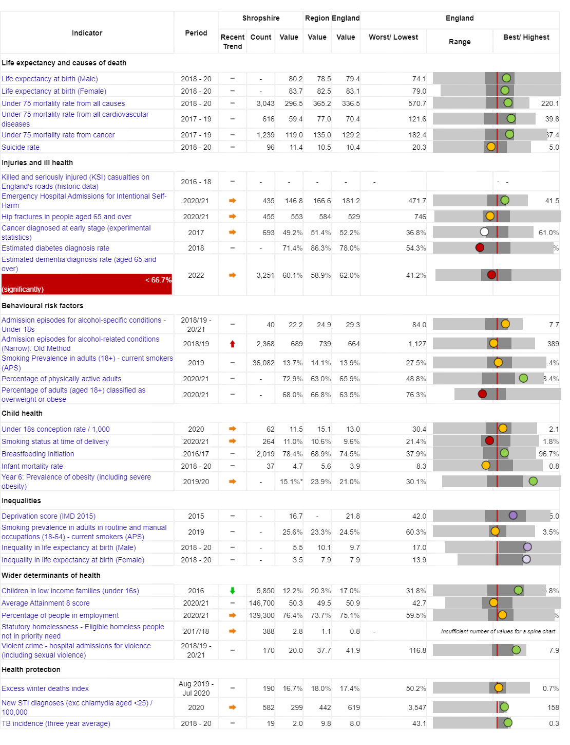

Vision:
For Shropshire people to be the healthiest and most fulfilled in England
Reducing inequalities
Improving Population Health
Working with and building strong and vibrant communities
Joined up working

Slide 6
People in Shropshire are living longer, but not necessarily healthier lives…
Measure | England | Shropshire | Range (Ward) | Range (Ward)
IMD Score (higher score = more deprivation) | 21.7 | 17.2 | 3.7 (Copthorne) | 37.6 (Harlescott)
Life expectancy at birth, (Male) | 79.5 | 80.3 | 75.6 (Sundorne) | 85.4 (Copthorne)
Life expectancy at birth, (Female) | 83.2 | 83.6 | 78.7 (Sundorne) | 89.2 (Clun)
Deaths all causes, all ages, SMR | 100 | 95.7 | 62.8 (Copthorne) | 141 (Worfield)
Deaths all causes, under 75, SMR | 100 | 88.3 | 45.9 (Clun) | 144.6 (Sundorne)
Preventable deaths, under 75, SMR | 100 | 84.3 | 41.9 (Clun) | 157.0 (Underdale)
Indicator | Shropshire | England
Healthy Life Expectancy (HLE) Males | 62.8 | 63.1
Inequality in HLE Males | 5.5 | 9.7
HLE Females | 67.1 | 63.9
Inequality in HLE Females | 3.5 | 7.9
Ward | Ludlow North | Clee
Male Life Expectancy | 77.8 years | 83.0 years
Female Life Expectancy | 82.2 years | 86.2 years
Fingertips, Local Health, Public Health Data for small geographic areas

Slide 7
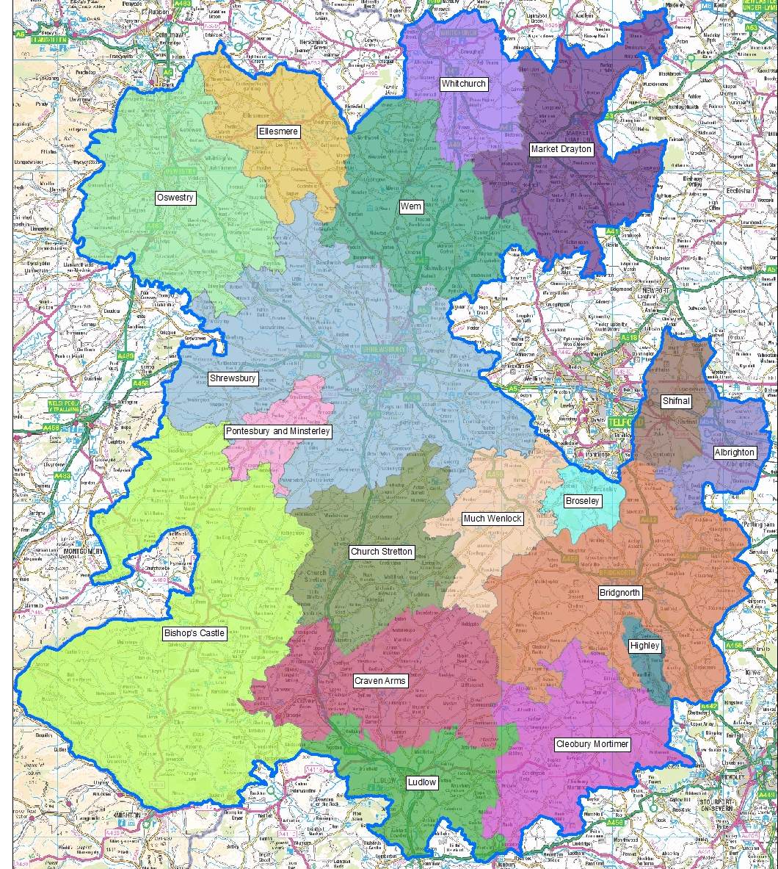
JSNA Place Based Geographies
JSNA’s for Shropshire and Place Plan Areas (PPA)
18 PPA focused mainly on a market town and its surrounding rural communities.
PPA’s are based along geographical/communities' boundaries not political ones.
Capture the uniqueness of the areas in Shropshire.
Identify meaningful local differences and areas of need.

Slide 8
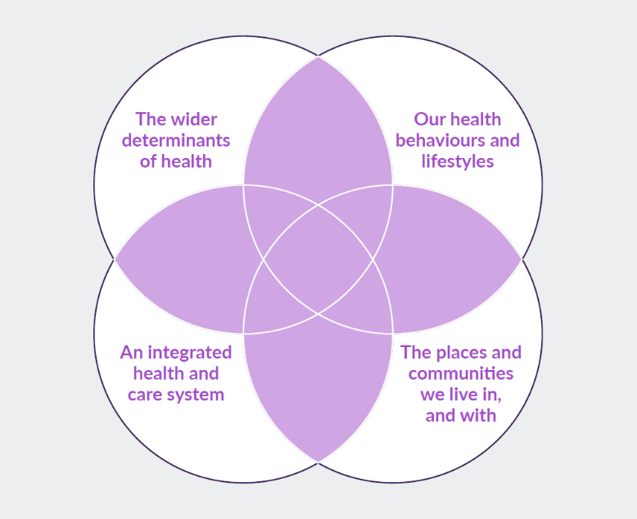
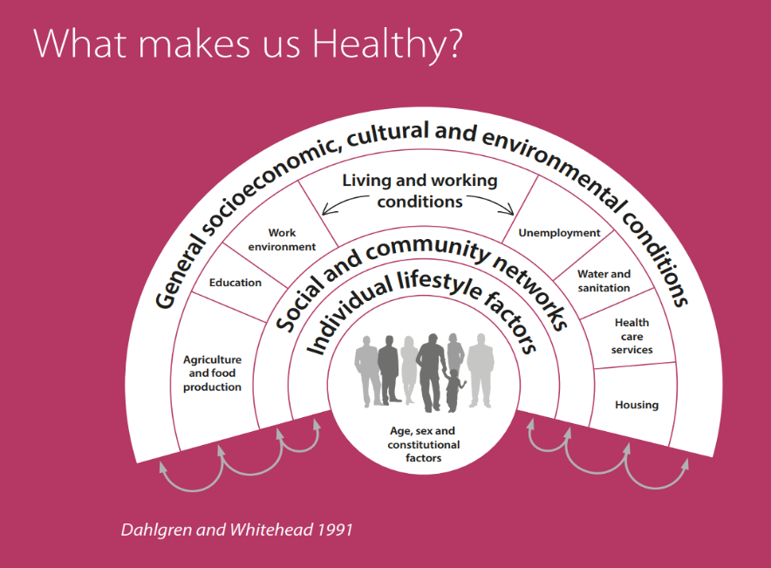
What makes us healthy?
Understanding and Addressing Inequalities
– taking a preventative approach
Health Protection
Understanding our Population Health/Population Health Management (Insight/JSNA)

Slide 9
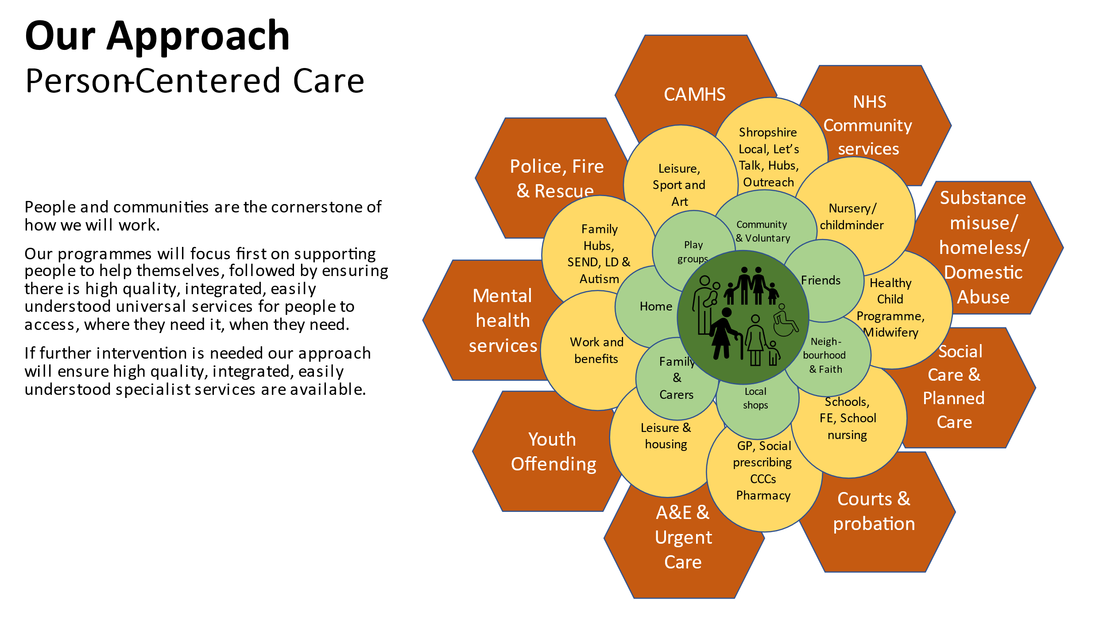
Ludlow and Area Community Partnership (LACP)

Slide 10
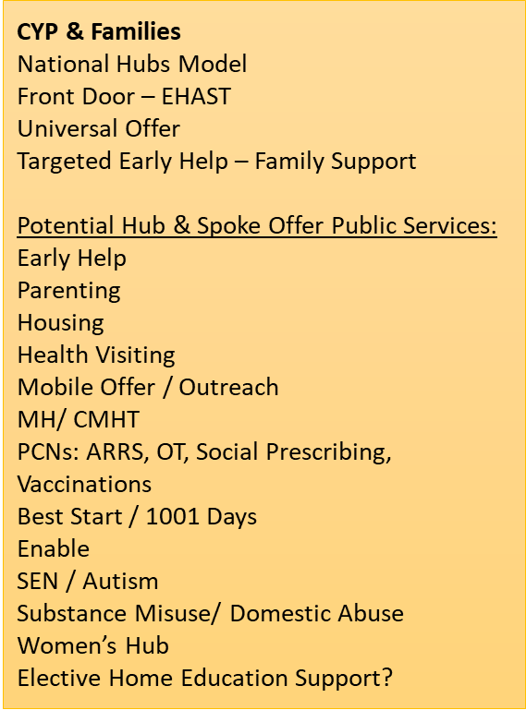
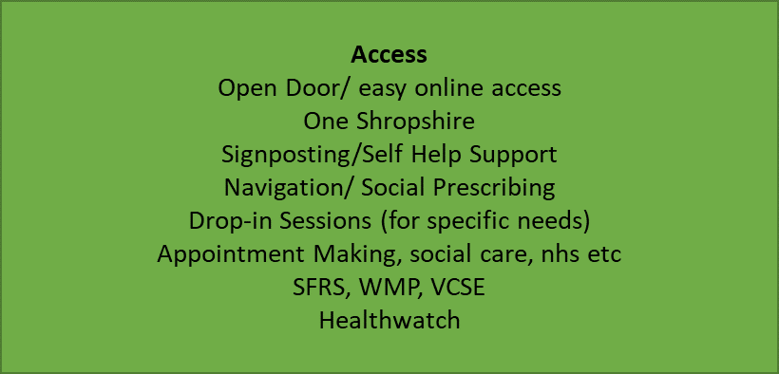
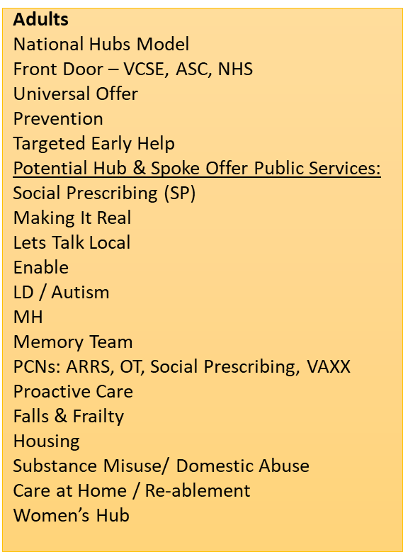
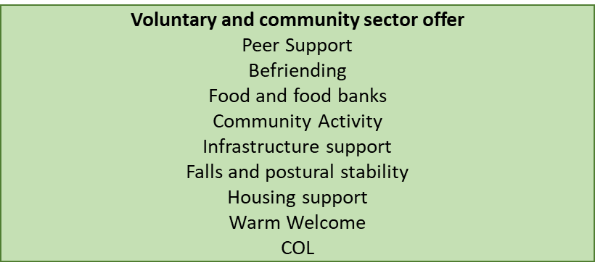

Slide 11

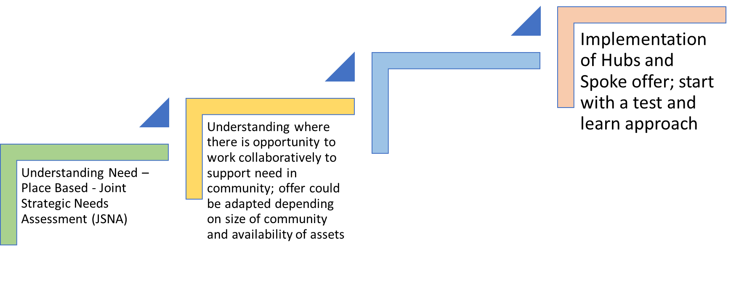


Slide 12

Community Engagement
Stakeholder and Resident engagement via:
  Questionnaires to residents
  Interviews
  Focus Groups
  Attending key meetings/groups

Slide 13

Ludlow Place Plan
Examples of Key Health and Wellbeing Data
Notes:
Intro my role

Slide 14
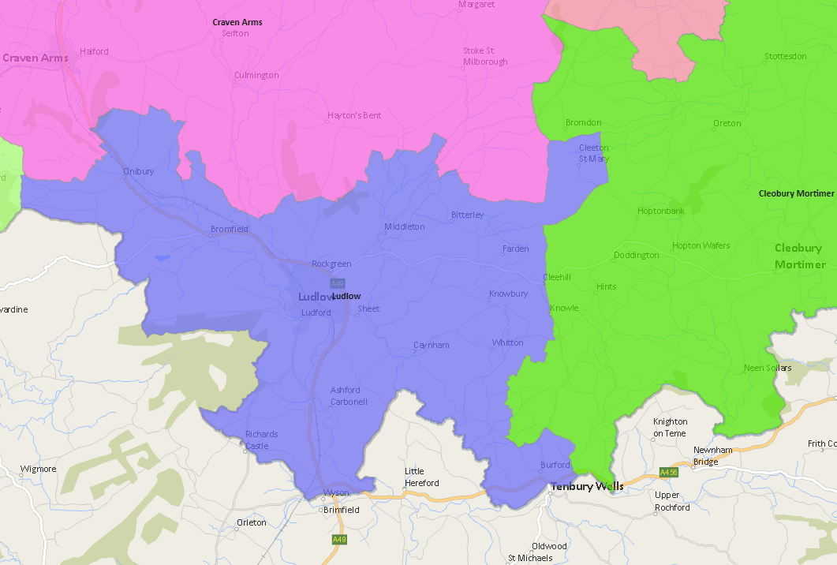

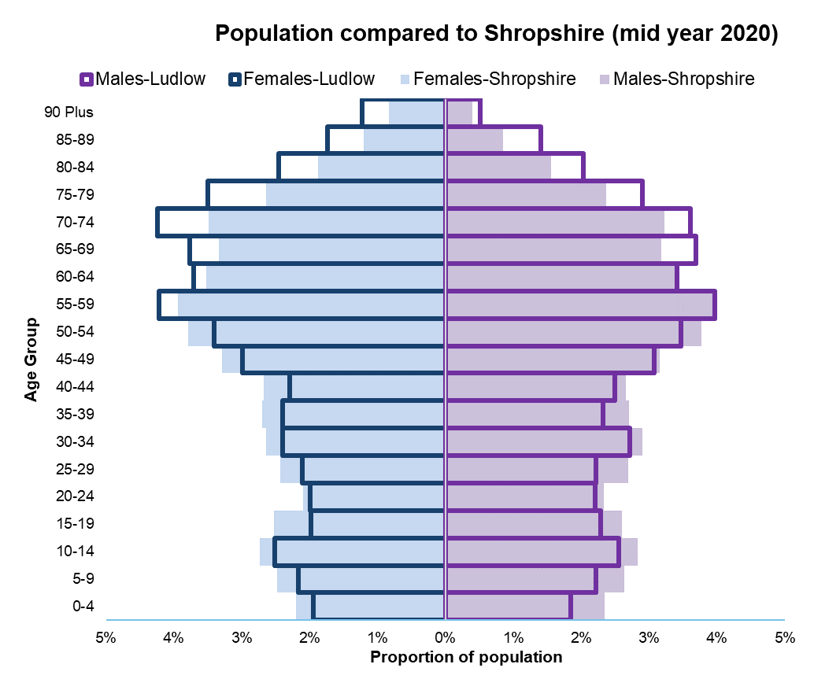
Ludlow Place Plan Area
Interactive map here: https://shropshire.maps.arcgis.com/apps/webappviewer/index.html?id=fa75f921e771451382533a854cce6a1e
16,969
Population estimate
(all ages)
Notes:
Intro my role

Slide 15
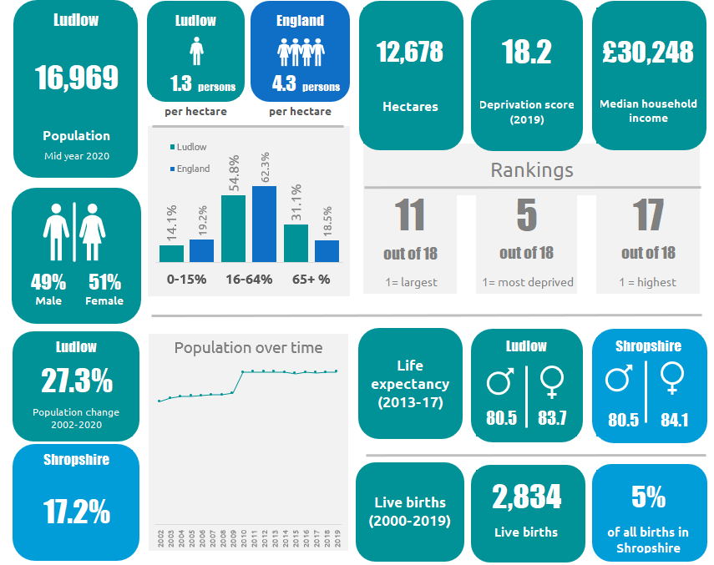
Ludlow Place Plan Area
Interactive map here: https://shropshire.maps.arcgis.com/apps/webappviewer/index.html?id=fa75f921e771451382533a854cce6a1e
Notes:
Intro my role

Slide 16
Ludlow Place Plan Area
We collected various data indicators locally
The metrics were based on nationally collected data where it is possible to break down to a smaller geography
Same metrics have been used in the previous place plan events (Highley, Oswestry, Bishop’s Castle, Whitchurch and Shrewsbury)
This is a starting point. These metrics will be revisited and expanded to take into account further data sources
These metrics are data based and completely unrelated to the engagement survey shown later!
We have grouped these data metrics together in order to give an overview of each place plan area – breakdown on following slides
Notes:
Intro my role

Slide 17
Healthy People
Education
How far to people need to travel?
What are the needs of adults?
Health
How long are people living?
How many people have a long-term illness?
Relationships & Trust
What is the crime rate?
How many people older people are living alone?
How are school children performing?
How well are people living?

Slide 18
Healthy Economy
Equality
Economy
Cost of living
Are houses affordable?
Is the income of residents similar?
Are some areas wealthier than others?
How many working age people are unemployed?
What’s the medium income?
How many people have a dependent?
How many people claim benefits?
Can people heat their homes?
How many households are on low income?

Slide 19
Healthy Environment
Transport & mobility
Housing
Environment
Are houses affordable for residents?
Is the housing suitable for people's needs
Do people have access to green space?
How far is the nearest supermarket?
How close is the local primary school?
How close is the GP?
What is quality of the houses in the area?
What is the air quality like?
How many road traffic accidents are there?

Slide 20
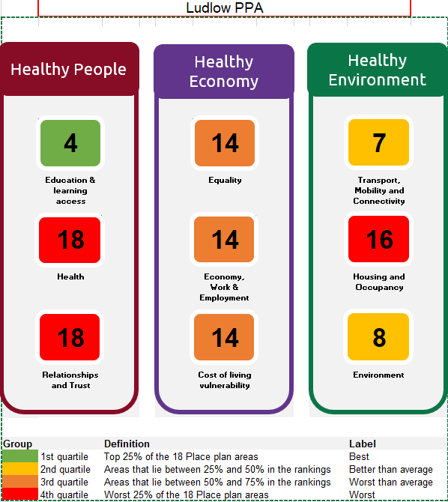
How does Ludlow overall compare to the 17 other areas?
Strengths
Education and Learning Access e.g. Average journey time to Further Education
Environment e.g. Access to Outdoors
Transport, Mobility and Connectivity e.g. Local Geographical barriers
Challenges
Relationships and Trust e.g. Crime Rate
Housing and Occupancy e.g. Affordability
Health e.g. Disease Prevalence

Slide 21
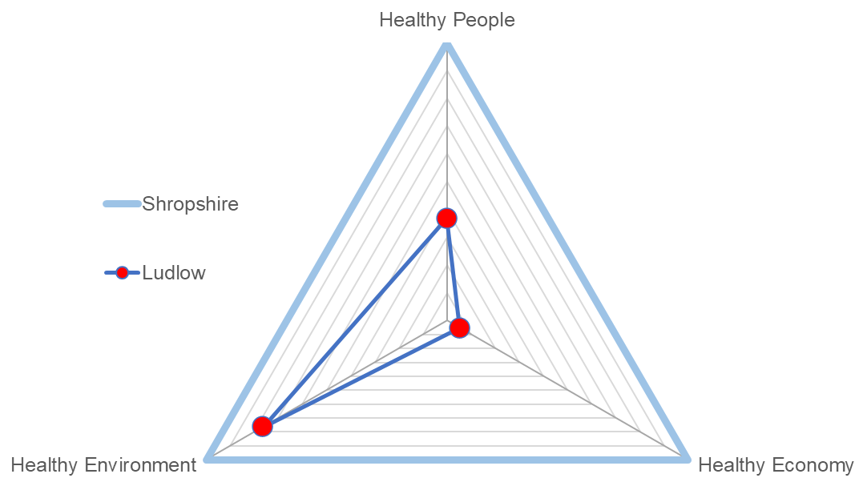

Ludlow Health & Wellbeing Index: Overview
Healthy People
Compared to Shropshire average:
Better:
None
Worse:
Healthy People
Healthy Environment
Healthy Economy
Healthy Environment
Healthy Economy

Slide 22
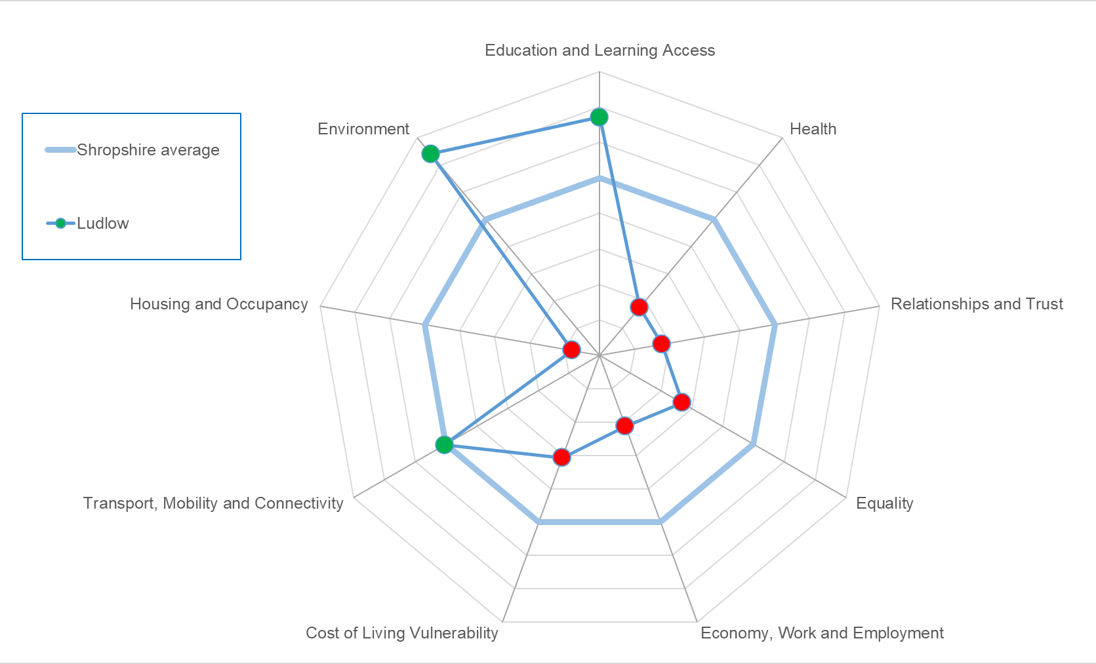
Ludlow Health & Wellbeing Index: Sub-themes
Identifies where Ludlow is stronger or weaker for the specific themes.
Stronger:
Education and learning access
Transport, Mobility and Connectivity
Environment
Weaker:
Health
Relationships and trust
Equality
Economy, Work and Employment
Cost of living vulnerability
Housing and occupancy

Slide 23



Smoking at time of delivery
Source: SATH Maternity Dataset for 2017/18, 2018/19, 2019/20, 2020/21 and 2021/22
Ludlow had 249 deliveries between 2017/18 and 2021/22, which is the 9th highest of the 18 place plan areas.
1 in 11 mothers were smoking at delivery for Ludlow, statistically similar to Shropshire’s (10.7%)
Smoking at Delivery data for Shropshire and Ludlow Place Plan Area, 2017/18 to 2021/22
Area name | Number of deliveries | Percentage of mothers who were known to be smoking at time of delivery | Statistical comparison against Shropshire
Ludlow Place Plan Overall | 249 | 11.2% | Similar
Shropshire | 9,626 | 10.7% | -
England |  | 10.1%

Slide 24
Disease Prevalence
There are differences in disease prevalence within the Ludlow area. RAG rating place plan area against Shropshire, Telford and Wrekin CCG prevalence
Disease or condition | Ludlow Place Plan Area | NHS Shropshire, Telford and Wrekin CCG | ENGLAND
Atrial Fibrillation Prevalence | 3.6% | 2.5% | 2.1%
Asthma Prevalence (6+) | 7.3% | 7.1% | 6.5%
CHD Prevalence | 4.6% | 3.5% | 3.0%
COPD Prevalence | 2.4% | 2.0% | 1.9%
Dementia Prevalence | 1.4% | 0.9% | 0.7%
Depression Prevalence (18+) | 17.8% | 14.5% | 12.7%
Heart Failure Prevalence | 1.5% | 0.9% | 1.0%
Hypertension Prevalence | 20.2% | 15.6% | 14.0%
Learning disabilities Prevalence | 0.6% | 0.5% | 0.5%
Mental health Prevalence | 0.9% | 0.8% | 0.95%
Obesity Prevalence (18+) | 8.1% | 7.3% | 9.7%
Peripheral arterial disease Prevalence | 1.0% | 0.8% | 0.6%
Stroke and transient ischaemic attack Prevalence | 3.1% | 2.4% | 1.8%
Quality & Outcomes Framework (QOF) Indicators 2020/21

Slide 25
Wider determinants of health
There are differences between wards within the Ludlow area across a number of wider determinants, Ranking : 1 = worst, 63 = best)
Ward (2022) | Unemployment, 2021-22 | Child Poverty, English Indices of Deprivation, 2019 | Income deprivation, English Indices of Deprivation, 2019 | IMD Score, 2019 | Long term unemployment, 2021-22 | General fertility rate: live births per 1,000 women aged 15-44 years, 2016-20 | A&E attendances in under 5 years old, three year average | Emergency admissions in under 5s, 2016/17 to 2020/21
Clee | 48 | 57 | 49 | 28 | 45 | 36 | 12 | 42
Cleobury Mortimer | 40 | 29 | 40 | 37 | 38 | 32 | 38 | 40
Corvedale | 61 | 38 | 52 | 9 | 45 | 28 | 29 | 22
Ludlow East | 12 | 24 | 23 | 41 | 8 | 52 | 2 | 56
Ludlow North | 34 | 29 | 34 | 46 | 45 | 51 | 11 | 18
Ludlow South | 17 | 7 | 7 | 8 | 41 | 35 | 1 | 49
Quality & Outcomes Framework (QOF) Indicators 2020/21

Slide 26
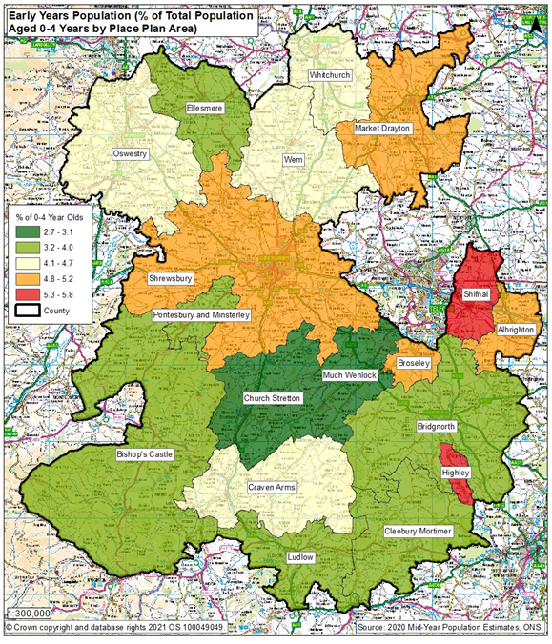
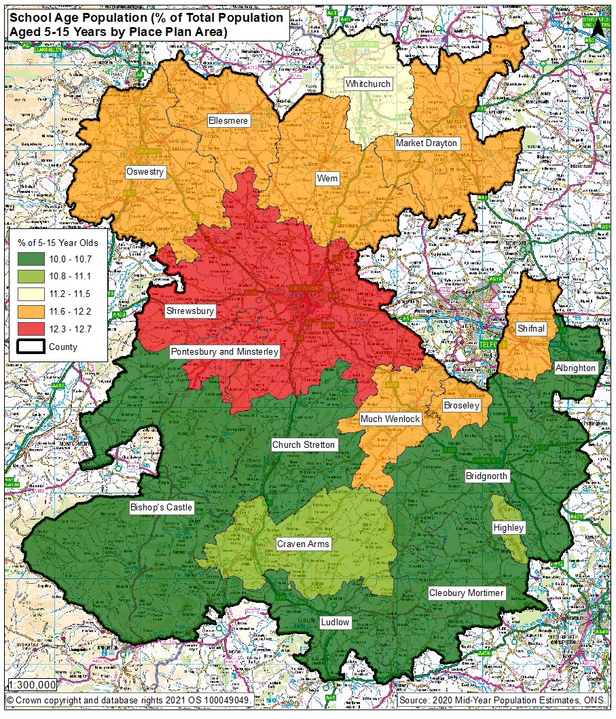
Early Years and School Age Population

Slide 27
Community Engagement Survey Results
850 surveys completed during the consultation period which ran between August and October
Again, the data in the survey is completely unrelated to the data metrics that were shown before

Slide 28
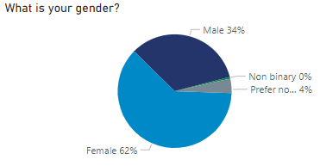
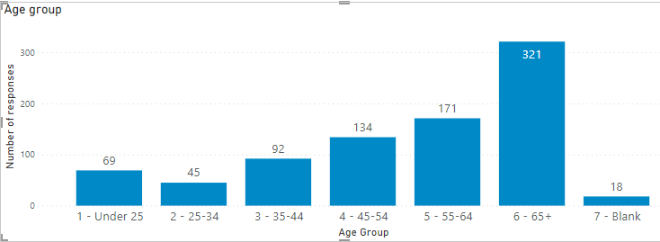
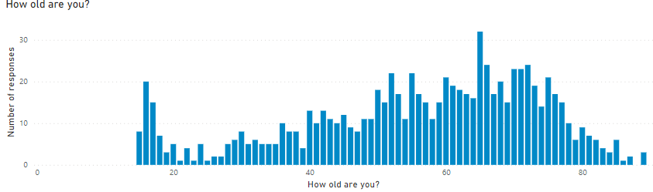
Survey Respondents: Demographics
Average Age = 55.8

Slide 29
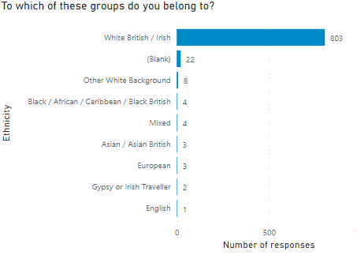
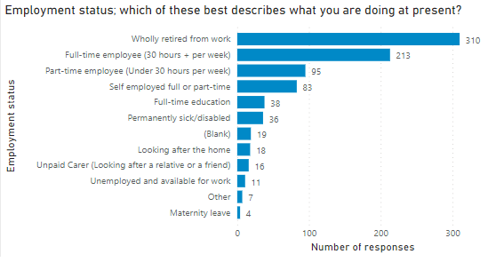
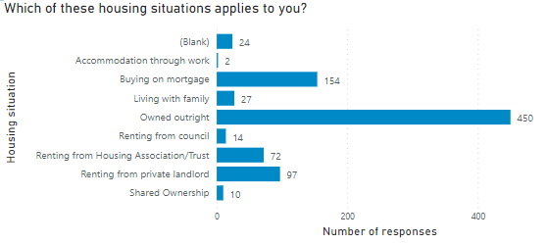
Survey Respondents: Demographics

Slide 30
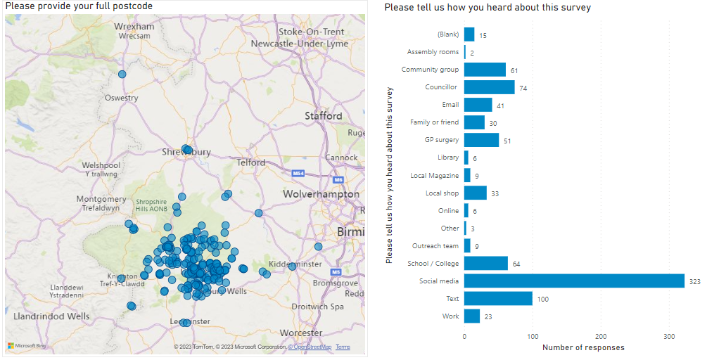
Where responses came from

Slide 31
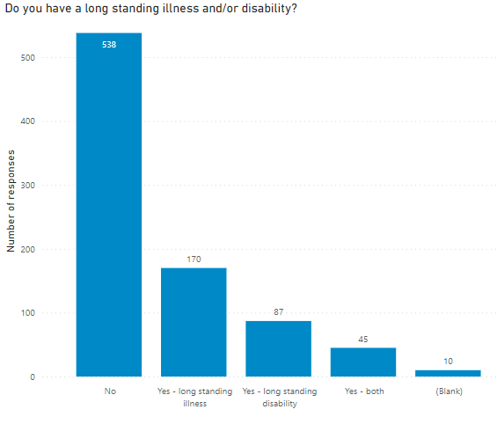
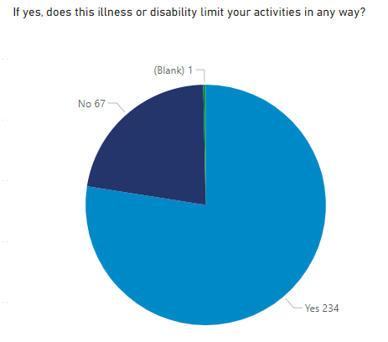

Slide 32
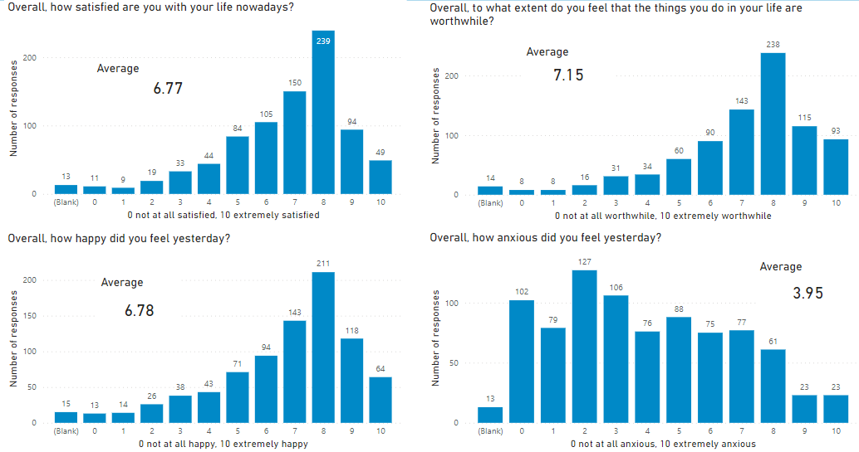
ONS Personal Wellbeing Questions

Slide 33
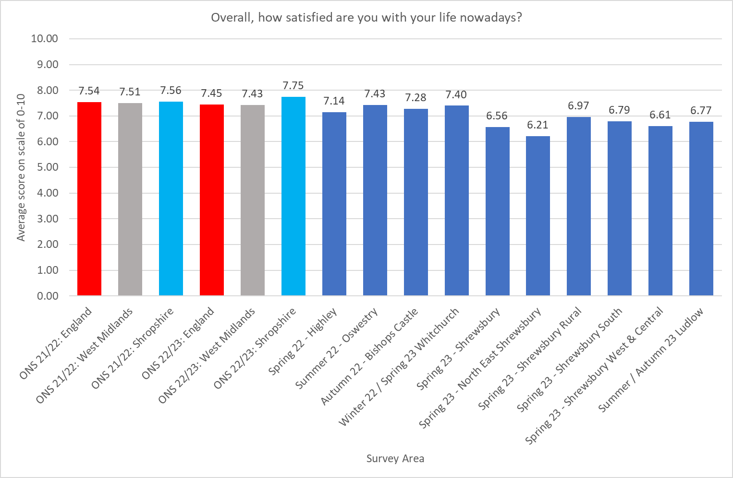
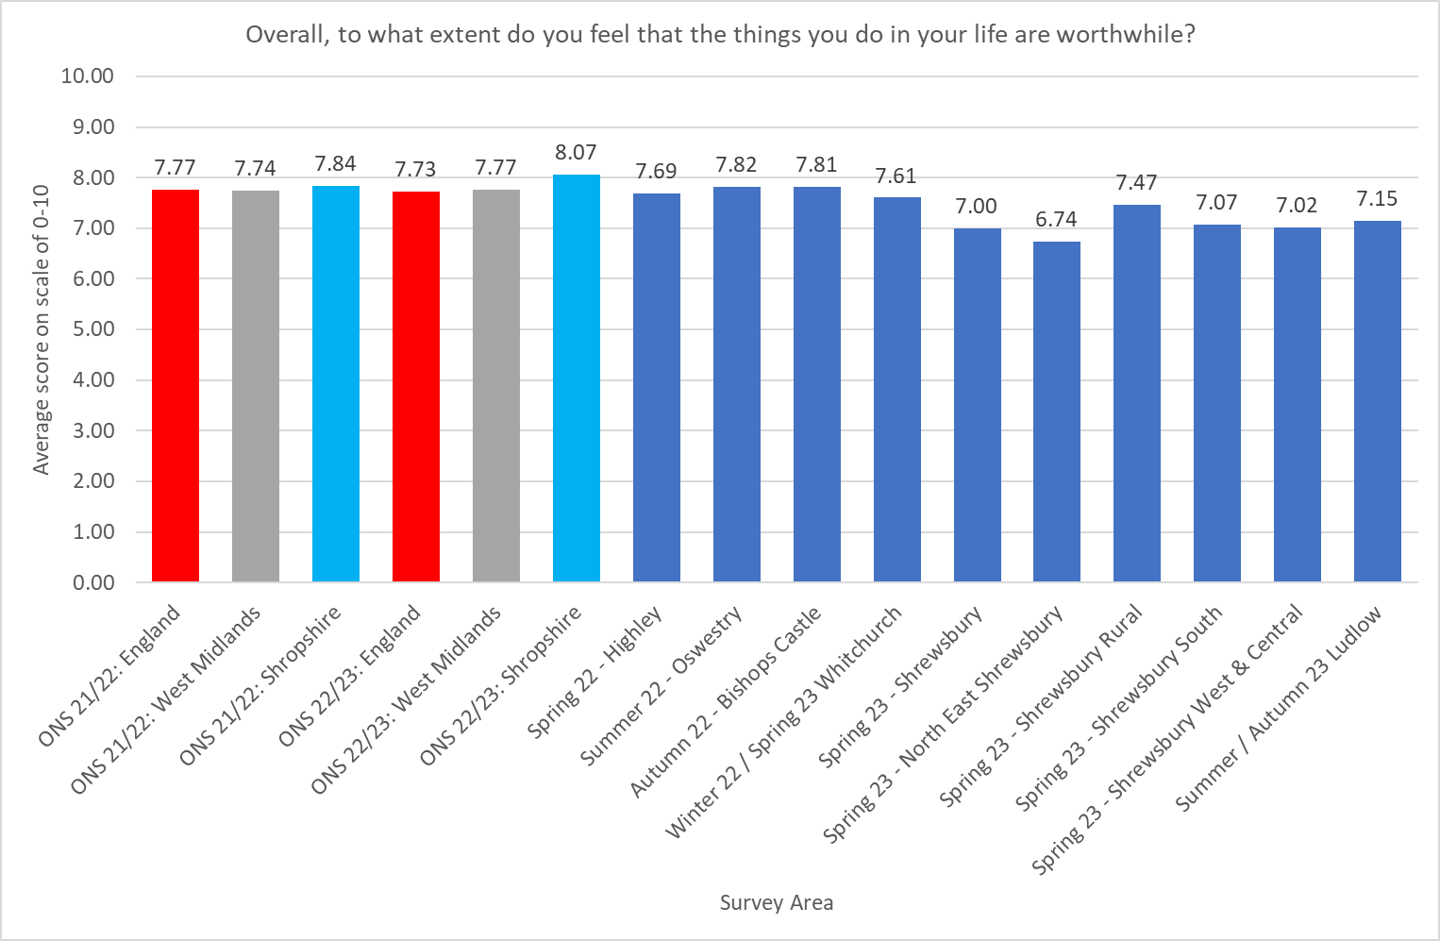
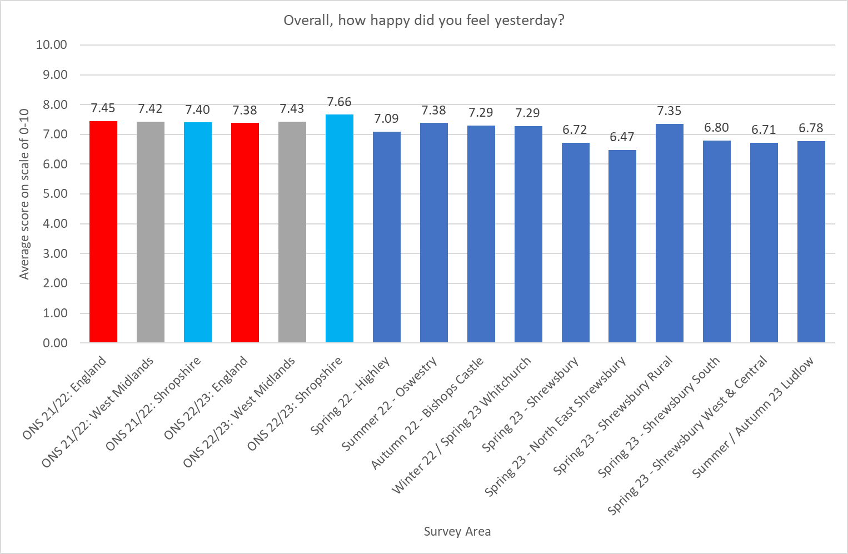
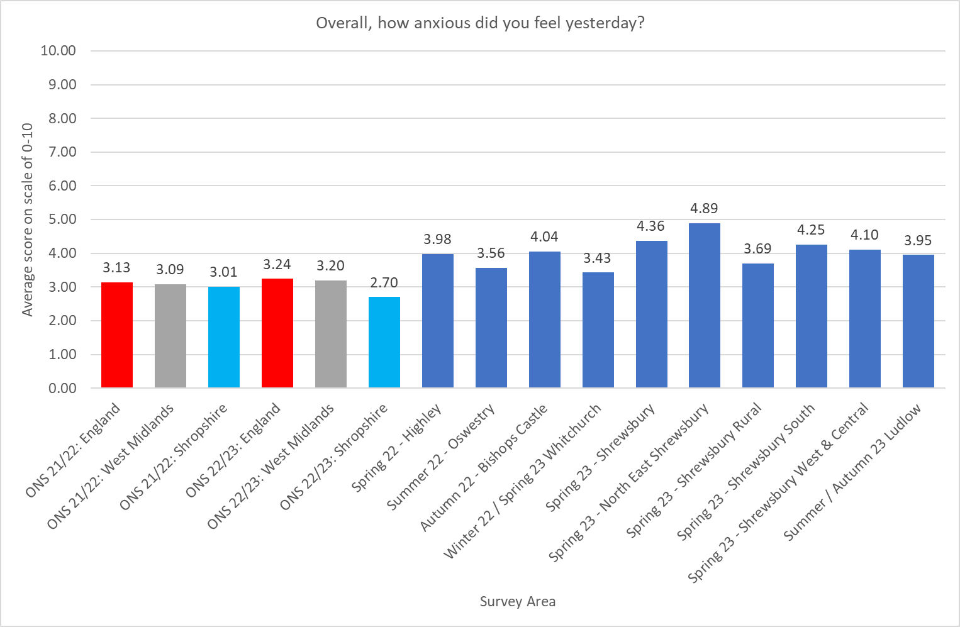
Comparison of Survey Scores to other areas

Slide 34
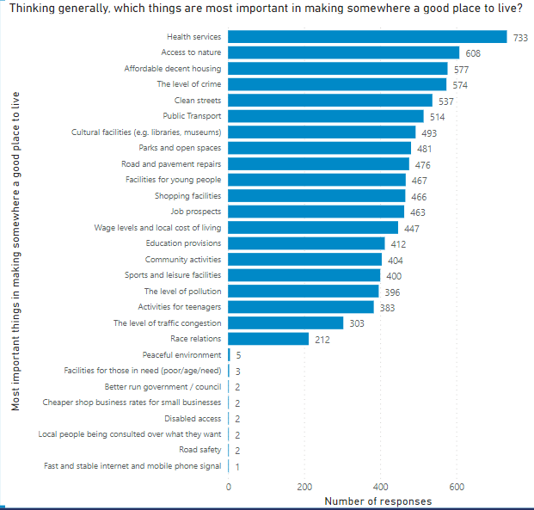
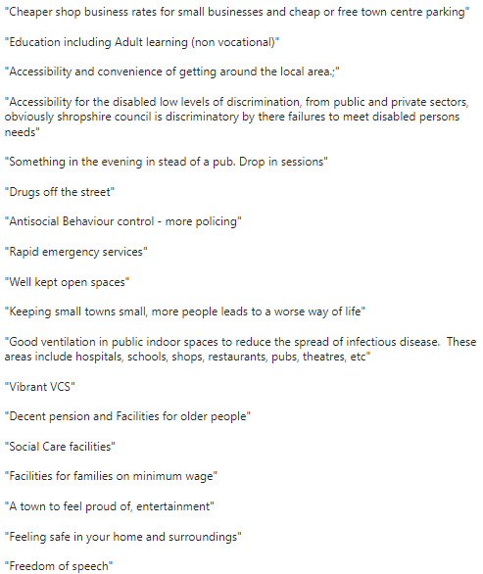
Thinking generally, which of the things below would you say are the most important in making somewhere a good place to live?

Slide 35
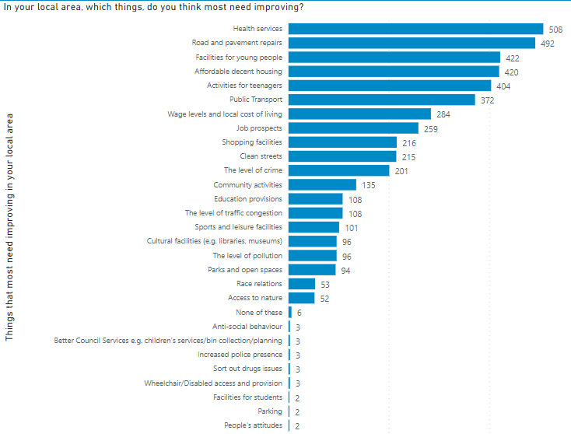
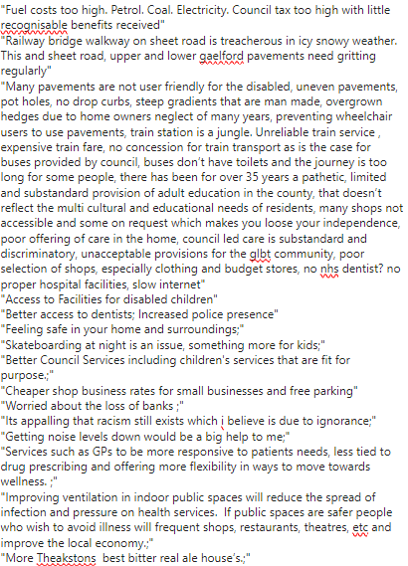
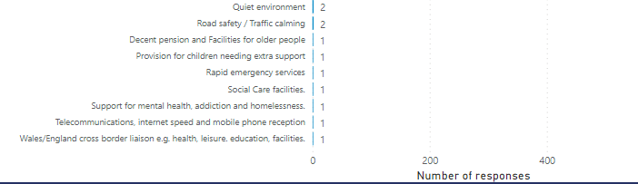
Thinking about this local area, which things do you think most need improving?

Slide 36
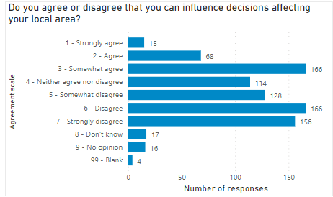
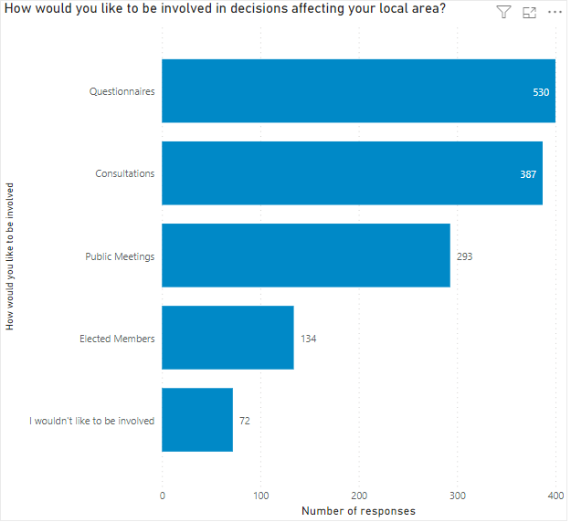

Slide 37
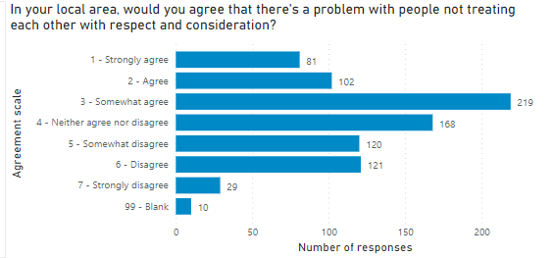
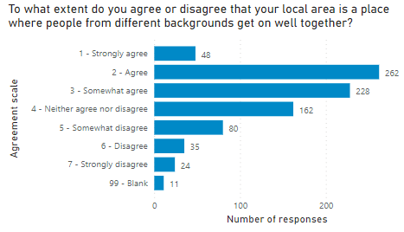

Slide 38
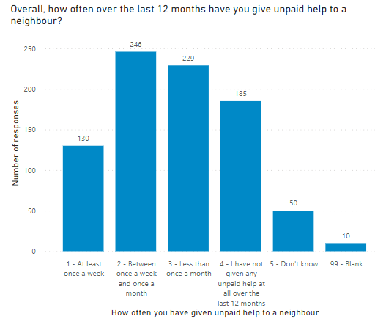
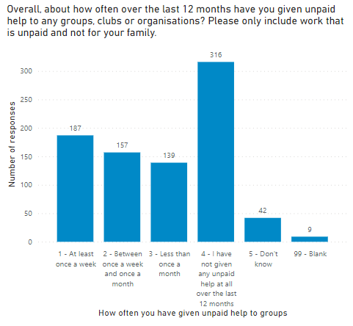

Slide 39
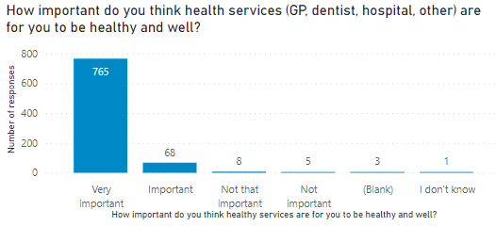

Slide 40
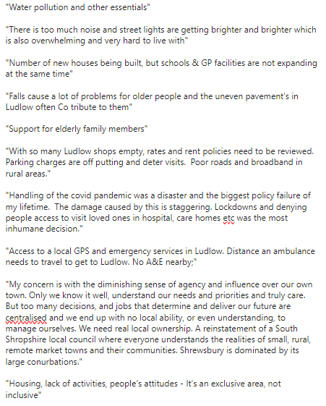
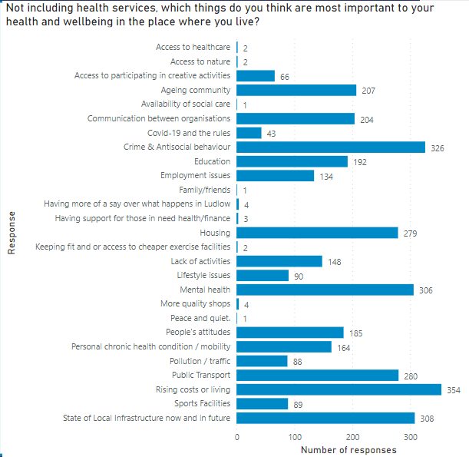

Slide 41
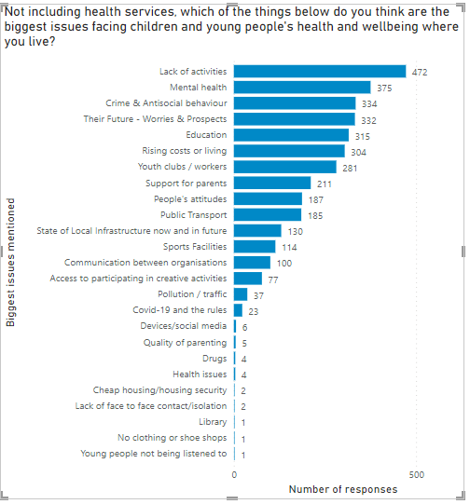
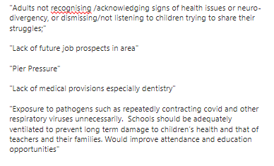

Slide 42
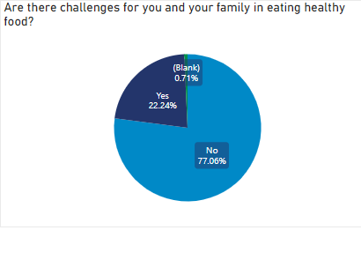



Slide 43




Slide 44
Sarah's story: Her story of living in her community in Ludlow
Sarah said that when she has applied for work you tell the potential employer you are from Sandpits, they just won’t interview you, you are not given an opportunity, the minute they hear the name Sandpits forget it.
Sarah said nothing has improved in her lifetime in Sandpits if anything things are worse.
Her Personal experience with her own family disabilities where she has had to fight for everything, has led her to help others who live in her community, she has become their voice they don’t have anyone speaking up for them. The struggle to provide evidence such as bank statements, identification, legal documents, everything has become paperless or online, don’t have access, services have closed, can’t walk into a bank anymore and ask to print off a bank statements because they don’t exist. Everything has become less accessible.
She has experienced random people who have entered her home trying to take things, she can’t leave her door unlocked at all, she has had to install security cameras into her home, to keep herself and family safe.
She and her family have been victimised after speaking out about an incident, consequently she has taken the decision to stay at home after dark. To this day she and her family are bullied and are subject to abusive and threatening language.
When shopping for her family, there is no suitable clothes shops that are affordable, it's all for the rich people, nothing for teenagers, youngsters even retired people. She and her family must travel to Leominster by train to buy school uniforms public transport is very poor.
She has openly told me that they live daily amongst the drug runners, it’s a normality for them and has openly said until county lines are dealt with the drug runners will always exist.
My daily life in Sandpits consists of dealing with humiliation, constant denial of accusations, burglaries, house theft (house got broken into last night at 4am from across the road), abuse, drug raids, drug runners and eventually once I have dealt with all that I can provide for my family.

Slide 45
Group Discussion
1. What are the key themes for the Ludlow Plan Areas?
2. What is already happening around the key themes?
3. What actions do we need to take to improve the key themes?

